Slide 1
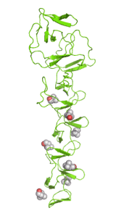
Research Methodology
Ajesh K Zachariah
Department of Chemistry
Mar Thoma College, Tiruvalla

Slide 2
Outline
Introduction
Methods of research
Types of research
Journal and journal articles
Art of scientific writing

Slide 3
Approach
The Problem
Results
Conclusion
Publications

Slide 4
Bulb in Room
Measures adopted?
Solution?

Slide 5
What is Research ?
Art of scientific investigation
Redman and Mory define research as a “systematized effort to gain new knowledge.”

Slide 6
Why Research ?
The purpose of research is to discover answers to questions through the application of scientific procedures
Exploratory/formulative research- (to get familiarity with phenomena or to achieve new insights into it) (E.g:- RED RAIN )
Descriptive research- ( to portray the characteristics of individual, situation or a group) ) (E.g:- Suicide in Kerala)
Diagnostic research- (to determine the frequency with which something occurs or with which something associated with it) ) (E.g:- Halley’s Comet)
Hypothesis testing research- (to test a theory) ) (E.g:- The theory)

Slide 7
Characteristics of Research
Empirical
Research is based on direct experience or observation by the researcher
Logical
Research is based on valid procedures and principles
Cyclical
Research is a cyclical process because it starts with a problem and ends with a problem

Slide 8
Analytical
Research utilizes proven analytical procedures in gathering the data, whether historical, descriptive, experimental and case study.
Critical
Research exhibits careful and precise judgment
Methodical
Research is conducted in a methodical manner without bias using systematic method and procedures
Replicability
The research design and procedures are replicated or repeated to enable the researcher to arrive at valid and conclusive results.

Slide 9
Scientific Methods
Scientific method considers logic to a formulation/theory
Before proposing a scientific problem, a scientist/researcher is clear about all kind of alternatives about the proposal.
All this is done through experimentation and survey investigations

Slide 10
Basic postulates of scientific method
It relies on empirical evidence
It utilizes relevant concepts
It is committed to only objective considerations
It presupposes ethical neutrality,
i.e., it aims at nothing but making only adequate and correct statements
It results into probabilistic predictions
Its methodology is made known to all concerned for critical scrutiny are for use in testing the conclusions through replication
It aims at formulating most general axioms or what can be termed as scientific theories

Slide 11
How can Operate Research ?
Role of Theory
A theory is an attempt to develop a general explanation to some phenomenon
More precisely, theory is concerned with explanation and therefore focuses on determining cause-effect relationships
Scientific Hypothesis
Null Hypothesis

Slide 12
Types of Research
Fundamental/ basic research
Applied Research
Historical Research
Experimental Research

Slide 13
Fundamental/ Basic Research
Mainly concerned with generalizations and with the formulation of a theory.
“ Gathering knowledge for knowledge’s sake is termed ‘pure’ or ‘basic’ research.” (According to Pauline V. Young in Scientific Social Surveys and Research)
Examples
(1) Research concerning some natural phenomenon or relating to pure mathematics are examples of fundamental research.
(2) Research studies, concerning human behavior carried on with a view to make generalizations about human behavior.

Slide 14
Applied/Action Research
Aims at finding a solution for an immediate problem facing a society or an industrial/business organization
Examples
1.Research to identify social, economic or political trends that may affect a particular institution
2. The copy research (research to find out whether certain communications will be read and understood)
3. The marketing research or evaluation research

Slide 15
Historical Research
History is the past and try to understand the present in light of past events and developments
This is a qualitative and quantitative kind of research
This research utilizes historical sources like documents, remains, etc. to study events or ideas of the past, including the philosophy of persons and groups at any remote point of time.

Slide 16
Experimental Research
This provides systematic and logical method of observation - the manipulation of conditions or behavior of substance
These manipulations are deliberate and systematic.
They must be aware of the factors that influence the outcome and remove or control them so that they can establish a logical association between manipulated factors and observed factors.
Here first proposes a hypothesis and some tentative answers
The acceptance/rejection of the hypothesis is done in terms of probability
Mostly these can be done in laboratory

Slide 17
Literature Sources
Primary Source
Secondary Source
Tertiary Source

Slide 18
Tertiary Source
General explanations condensed from 'common knowledge' on the topic intended for a broad public audience.
These sources are usually not credited to a particular author.
These are intended only to provide a superficial overview of what the topic includes, its basic terminology, and often references for further reading
Generally, tertiary sources are not considered to be acceptable material on which to base academic research

Slide 19
Examples
Wikipedia, Encyclopedia Britannica, Reader's Digest, Abstracts, Bibliographies, Chronologies, Classifications, Dictionaries, Directories, Guidebooks and manuals, Population registers, Statistics etc.

Slide 20
Secondary Source
These sources are works written on the topic in question by other researchers
Secondary sources are based on primary sources — they are usually studies which analyze, evaluate, interpret, or criticize primary sources.
To determine what others have already reported about a particular research topic
Secondary sources are "second-hand information," analogous to human conversation.
Secondary sources can be articles in newspapers or popular magazines, book or movie reviews, or articles found in scholarly journals that address someone else's original research.

Slide 21
Examples
Biographies
Prior books & papers on a topic
Literary criticism & interpretation
History & historical criticism
Political analyses
Reviews of law and legislation
Essays on morals and ethics
Analyses of social policy
Study and teaching material

Slide 22
Primary Source
For your own "new" view of the topic, guided by your review of what existing secondary sources
Academic research is based primarily on the analysis of primary sources, guided by perspectives on the topic which already exist via secondary sources

Slide 23
Examples
Personal papers
Letters (both personal and business)
Diaries and journals (both personal and business)
Photographs & paintings, sketches, original maps, etc.
Advertisements, posters, and banners
Memoirs
Genealogy records, both personal/family and from public records
News footage (newsreels, videotapes or audiotapes, etc.)
Newspaper articles written at time of the event
Speeches which are contemporaneous with the event

Slide 24
Examples
Oral histories
Minutes of meetings related to the event
Vital records (birth and death records, census records, court records, tax records, property records, church registers, or other public and private records).
Material artifacts (physical objects or evidence related to the event, including articles of clothing, furnishings, coins, stamps, buildings, tools, weapons,etc.)
Creative works, such as novels, essays, poetry, music, art, and audio or video recordings
More recently, computer software, e-mail archives, web documents, etc.
. . . and many additional types of similar materials.

Slide 25
Important Scientific and Chemistry Journals publishing Groups
American Chemical Society
AAS
Royal Society of Chemistry
Wiley
Elsevier
Springer
Hindawi
Indian Academy of Sciences
and many more……

Slide 26
Important Scientific and Chemistry Journals
Nature
Science
Langmuir
Angewandte Chemie
Chemical Communications
Progress in Polymer Science
Journal of Physical Chemistry
RSC Advances
Applied Materials and Interfaces
Advanced Materials
Advanced Functional Materials
Nature Materials
Macromolecules
Environmental Science and Technology

Slide 27
Literature Databases

Slide 28
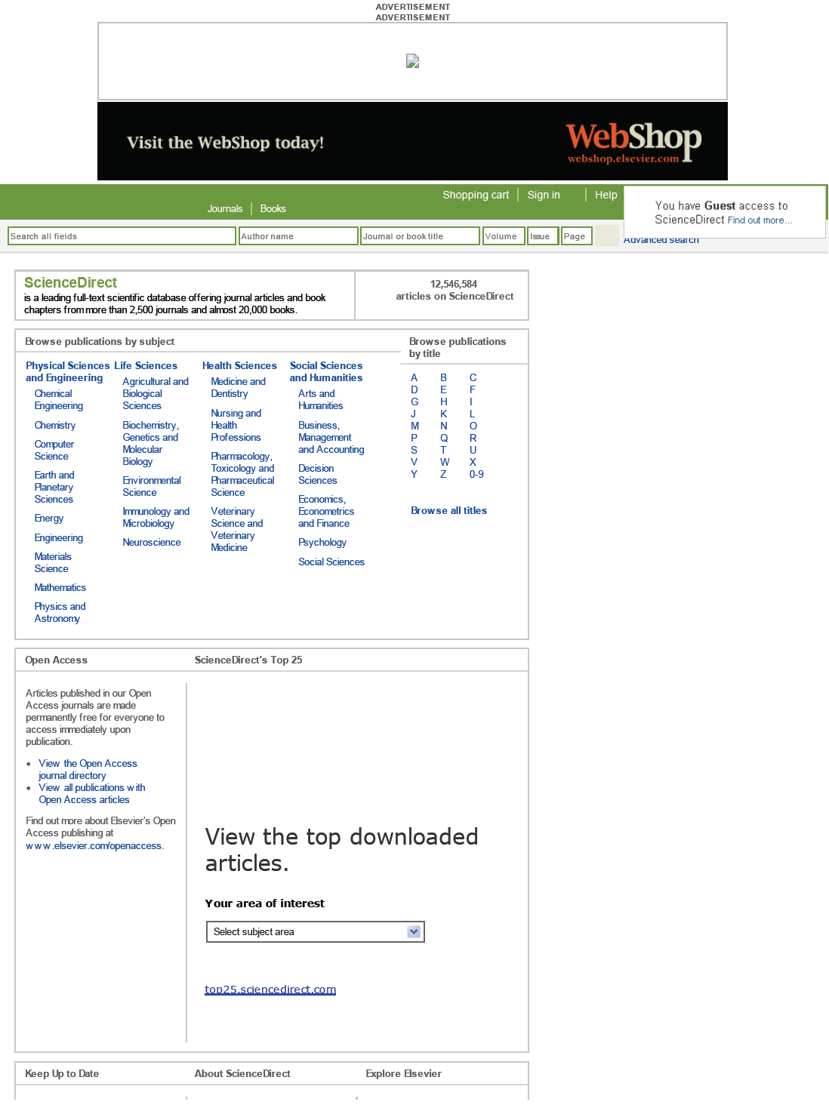
Science Direct

Slide 29
SciFinder

Slide 30
Chemical Abstract
A free web based tool to gather chemical information
Its an American Chemical Society service
CAS is the only organization in the world whose objective is to find, collect and organize all publicly disclosed substance information.
CAS delivers the most current, complete, secure and interlinked digital information environment for scientific discovery.
CAS Registry Numbers (often referred to as CAS RNs or CAS Numbers) are universally used to provide a unique, unmistakable identifier for chemical substances.
A CAS Registry Number itself has no inherent chemical significance but provides an unambiguous way to identify a chemical substance or molecular structure when there are many possible systematic, generic, proprietary or trivial names.

Slide 31
Google Scholar was developed by Google Inc., but it is freely accessible and aims to summarize all electronic references on a subject.
There is no journal frame/list available for Google scholar, because it presumably lists all publications that have emerged from the electronic search.
It allows a quick search and an advanced search. In the advanced search the results can be limited by title words, authors, source, date of publication, and subject areas.
Each retrieved article is represented by title, authors, and source, but the abstract and information on free full text availability are not provided by Google Scholar.
In addition, Google Scholar provides links to relevant articles and allows for a general Google Web search, using self selected keywords from the article and the author name.

Slide 32
PubMed was developed by the NLM, a division of the National Institutes of Health, and rapidly became synonymous with medical literature research worldwide.
It offers a quick free search with numerous keywords as well as limited searching with various criteria [i.e., search by authors, journal, date of publication, date of addition to PubMed, or type of article].
The results of a search can be displayed in a listing including from 5–500 items per page or as a summary [in which the full title, the names of the authors, the source and PubMed identification (PMID) of each article are presented], and the list can also be presented with abstracts, if available.

Slide 33
Information on whether an abstract is available and free text access is comprehensively represented by a displayed icon.
A search can easily be sent to text, a file, the clipboard, e-mail, an RSS feed, and an order. PubMed also allows for direct use of other search.
PubMed now offers 1 million freely available articles of which a significant number come from digitized back issues.

Slide 34
The Scopus database was developed by Elsevier, combining the characteristics of both PubMed and Web of Science.
These combined characteristics allow for enhanced utility, both for medical literature research and academic needs (citation analysis), yet access to the database is not free.
It offers a quick search, a basic search, an author search, an advanced search and a source search.

Slide 35
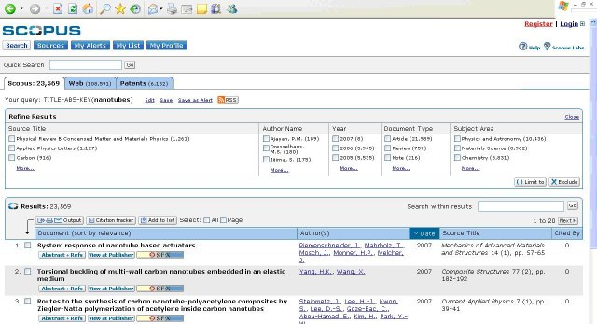

Slide 36
Impact Factor
Impact Factor is a measure of the frequency with which the "average article" in a journal has been cited in a given period of time. The impact factor is used as standard dimension and the relative importance of a scientific journal within its field. The Impact Factor is calculated by several scientific methods including citation analysis
Quality of Publication
Manuscript Quality
Presentational Quality
Editorial Quality

Slide 37
Thomson Reuters impact factor method is widely accepted
The impact factor of a journal is calculated by dividing the number of current year citations to the source items published in that journal during the previous two years
Eg:-
Calculation for journal impact factor.
A= total cites in 1992
B= 1992 cites to articles published in 1990-91 (this is a subset of A)
C= number of articles published in 1990-91
D= B/C = 1992 impact factor

Slide 38
Calculation for five-year impact factor: One year of citations to five years of articles
A= citations in 1992 to articles published in 1987-91
B= articles published in 1987-91
C= A/B = five-year impact factor

Slide 39
JCR (with Impact factor)
Eigenfactor
Other JCR values
SCImago Journal & Country Rank
Google Scholar Metrics
Essential Science Indicators (ESI)

Slide 40
The Art of Scientific Writing
Research Reports
Thesis
Journal Articles
Books

Slide 41
Research reporting is an oral/written presentation of important and useful aspects of the research work done.
Intended to a specific research investigation
It is the last but a major part of the research study
Without a report, a research study is incomplete and of no use
Research Reports: The final report about the research carried out
Thesis: The final report of the research work such as M.Sc, M.Phil or PhD works
Journal Articles: Communicating important results to magazines or journals
Books: Preparation of write ups about a particular subject

Slide 42
The usual steps involved in writing report are:
logical analysis of the subject-matter
(b) preparation of the final outline
(c) preparation of the rough draft
(d) rewriting and polishing
(e) preparation of the final
(f) writing the final draft
(g) bibliography

Slide 43
A comprehensive layout of the research report should comprise
(A) preliminary pages; (B) the main text; and (C) the end matter
preliminary pages
A title and date,
Acknowledgements
‘Preface’ or ‘Foreword’
Table of contents
List of tables and illustrations
(B) Main Text
Introduction
Statement of findings and recommendations
The results
The implications drawn from the results
The summary.

Slide 44
Introduction-
Clear statement of objectives of the study
Background of the study
Hypothesis
Details about experiments/questionnaire
Statement of findings and recommendations-
Statement of findings and recommendations in non-technical language
In a concise form
The results-
The implications drawn from the results-
The summary-

Slide 45
(C) The end matter
Mathematical derivations
Bibliography
Crystallographic data
Index (In case of books)
Bibliography/References
For books and pamphlets the order may be as under:
1. Name of author, last name first.
2. Title, underlined to indicate italics.
3. Place, publisher, and date of publication.
4. Number of volumes.

Slide 46
For magazines, newspapers and journals the order may be as under:
1. Name of the author, last name first.
2. Title of article, in quotation marks.
3. Name of periodical, underlined to indicate italics.
4. The volume or volume number.
5. The date of the issue.
6. The pagination.
Types of References Styles
APA style
ACS style
RSC style etc.
Different Programs are Available

Slide 47
Types of Journal Articles
Articles- A detailed report about the research work done
Communications- A short report about the interesting results
Reviews- A collective analysis of the research works done in a particular field
Construction of Journal Articles
Title of the article
Authors and affiliations
Abstract
Key words
Introduction
Experimental
Materials used
Method of preparation
Characterization
Results and Discussion
Conclusion
References
Article

Slide 48
Software for Graphs and other plots
Microsoft excel/spreadsheet
Microcal origin 6.0/8.0
Mathlab
R- Statistical analysis

