Slide 1
Extra Cellular Matrix
Anoop Philip Varghese
Assistant Professor
Department of Zoology
Mar Thoma College, Tiruvalla

Slide 2
Extra cellular matrix
Region outside the plasmamembrane.
Many materials organised into a network.
Gel like polysaccharide ground substance.
Collagen
Proteoglycan
Fibronectin
Laminin
Extends beyond glycocalyx
Notes:
Glycocalyx / Cell coat is formed of carbohydrates extending from the plasmamembrane.
The ground substance of ECM is actually the GAGs (Glycosaminoglycans) linked to proteins to form proteoglycans. Due to their large negative charged regions they can hold water molecules.

Slide 3
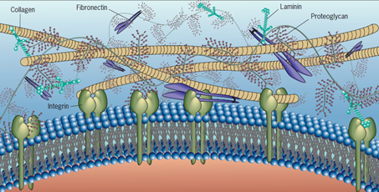

Slide 4
Extra cellular matrix
ECM is secreted by the cell itself.
It is characteristic to each type of cell.
For ex. Thickness of ECM depends on the cell type.
It holds together the cells in a tissue.
Provides support.
Synthetic and secretory activities are thought to be having some relationship with ECM.
Notes:
Cells are actually bathing in ECM.

Slide 5
Collagen
Most abundant protein (more than25% )
Fibrous protein with three helical polypeptide chains wound around each other.
It provide tensile strength to the tissue.
Notes:
It is different from the normal α-helix, which involves only one polypeptide. Also there is no intra chain H-bonds. Instead interchain H-bonds are there.

Slide 6
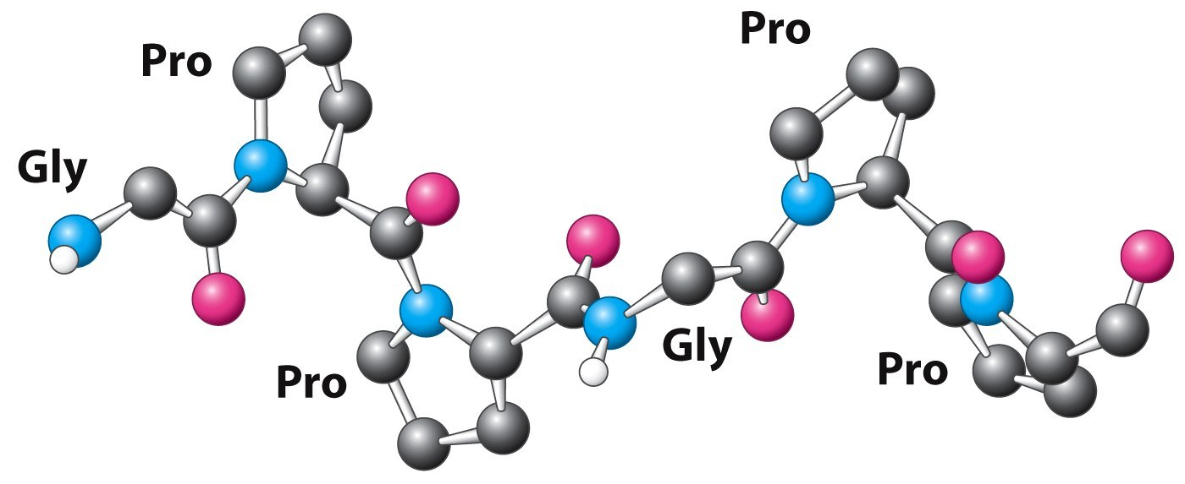
Collagen
There is a frequent recurring of Gly-Pro-HydroxyPro
Every third amino-acid is a Gly
Notes:
The structure is stabilised by sterric repulsion of the large cyclic structure of proline.

Slide 7
Collagen
The structure is stabilised by sterric repulsion

Slide 8
Formation of Hydroxy proline
Notes:
Prolyl hydroxylase is a dioxygenase, which oxygenases two molecules at the same time. Here O from O2 is transferred to proline and α-keto glutarate. This is a coupled reaction. But in an uncoupled reaction, the O is taken up by the enzyme itself (i.e. the enzyme is oxidised). It is then recycled by Ascorbic acid.

Slide 9
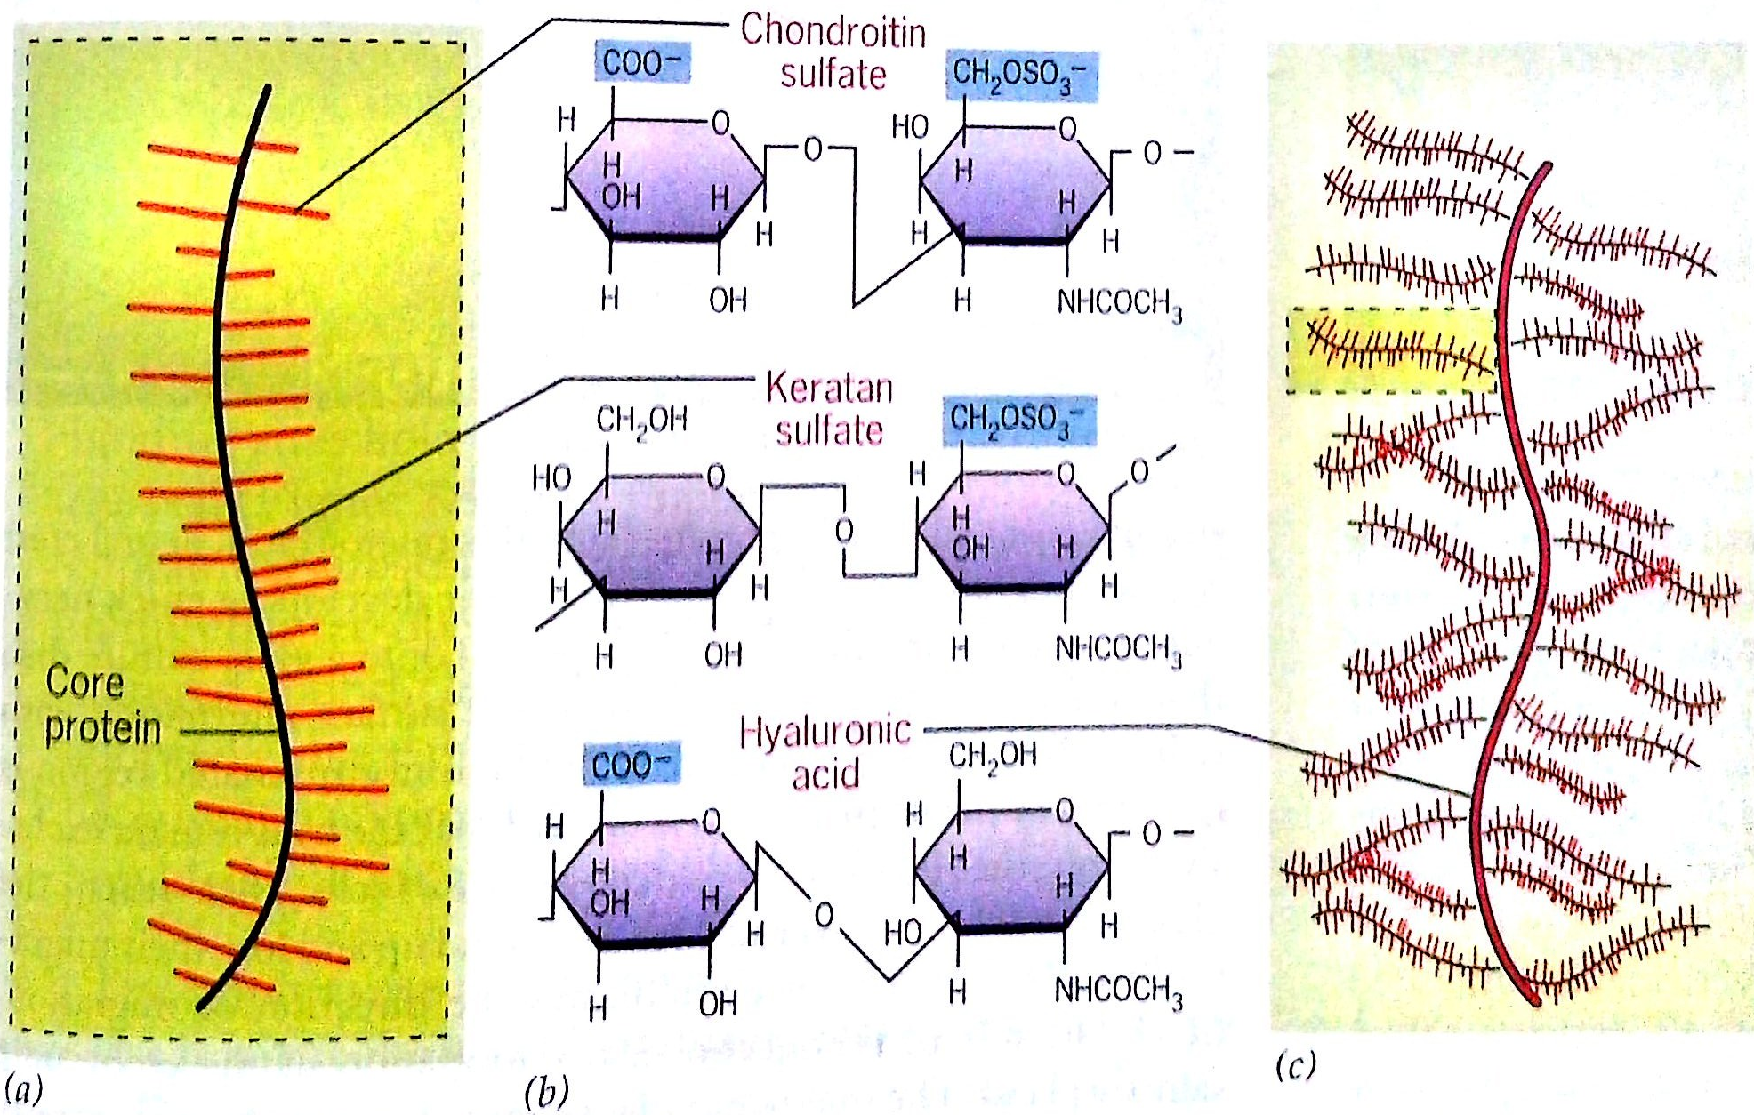
Proteoglycan

Slide 10
Proteoglycan
Are protein-carbohydrate complexes.
A protein backbone is attached with GAGs.
Such a complex is then attached to a long polymer of another GAG.
Due to –ve charge on GAGs they can absorb water molecules on them.

Slide 11
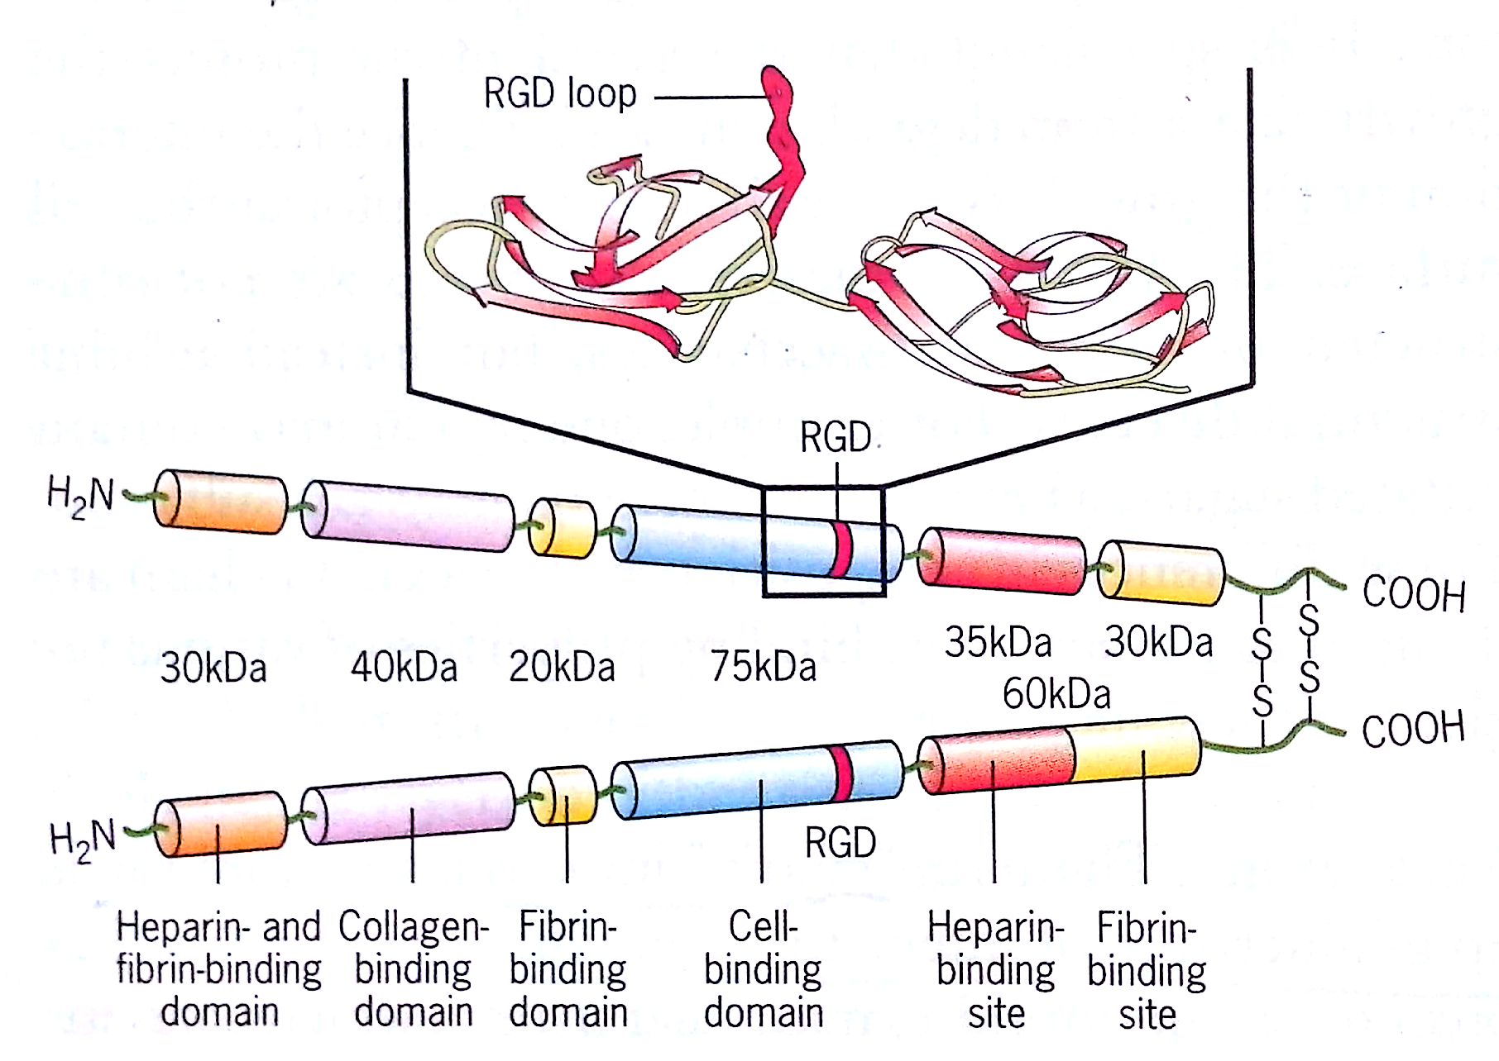
Fibronectin
Consist of two polypeptide chains connected at one end by a pair of disulphide bonds.

Slide 12
Fibronectin
It posses several protein binding domains
So it can bind to several proteins.

Slide 13
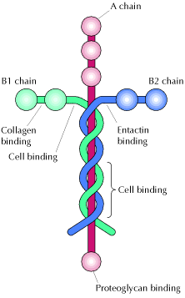
Laminin
Three polypeptide chains
Similar to Fibronectin
Several protein binding domains.

