Slide 1
Introduction to information technology
Module I
2nd DC, B.Com Model II
Lecture taken by,
Prof. Antu Annam Thomas
Dept. of Computer Applications
Mar Thoma College, Thiruvalla

Slide 2
Significance of IT
Integral part of Mordern Business
Major role in personal life

Slide 3
Features of IT
Cheap
Globalization
Job Opportunity
Data Storage
No time barrier

Slide 4
Information and Communication Technology
Umbrella term that includes Communication devices and their services and applications
Extended synonym for Information Technology
Definition : That which store retrieve manipulate transmit or receive information electronically in a digital form

Slide 5
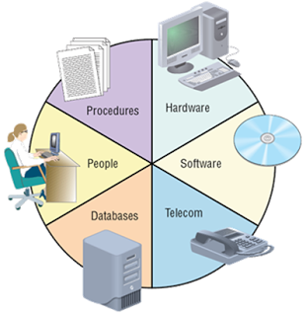
Information system
Collect store and process data into information
Components
Hardware
Software
People
Procedures

Slide 6
Information Technology Act
Provides legal recognition to e-commerce and e-transactions
Provides legal recognition to e-records and digital signatures

Slide 7
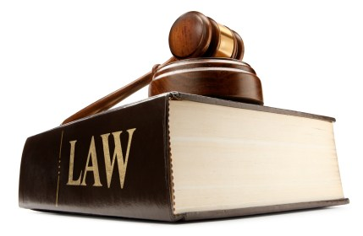
Essence of Act
Legal recognition of electronic documents
Legal recognition of digital signatures
Offences and contraventions
Justice dispensation systems for cyber crimes
Consist of 94 sections segregated in to 13 chapters
Paper laws for Paperless environment

Slide 8
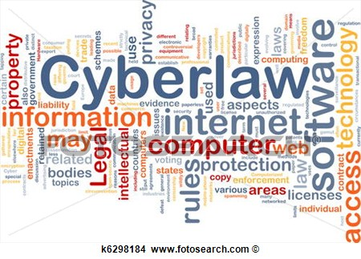
Information Technology (Amendment) act 2008
Brought various sweeping changes in 2000 cyber law
14 chapters and 128 sections
Deals with Cyber Law

Slide 9
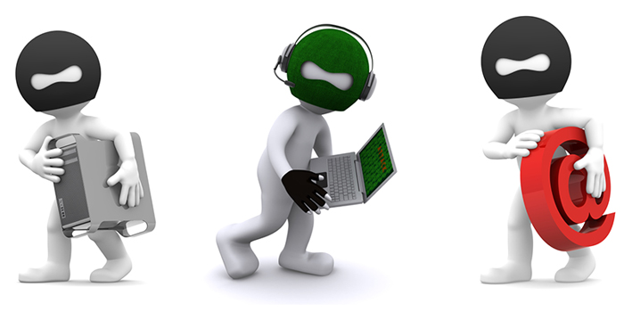
Cyber Crime
Unlawful acts wherein the computer is either a tool or a target
Crimes
Computer as a target
Hacking, Virus/Worms...
Computer as a weapon
Credit card frauds....

Slide 10
Virus and worms

Slide 25
Logic bombs

Slide 26
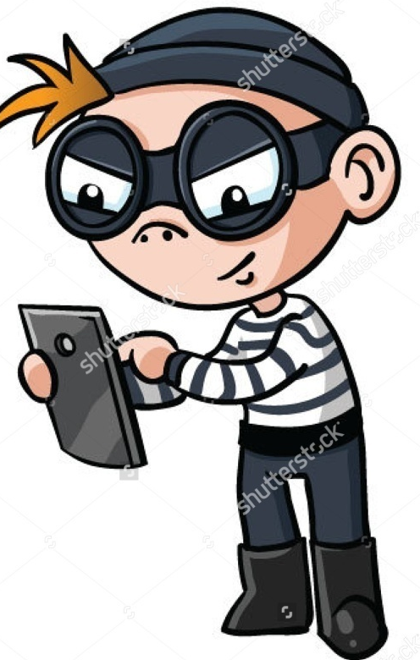
Email related frauds
Email spoofing
Email spamming
Sending malicious code

Slide 28
pronography
forgery
Cyber terrorism

