Slide 1
Research Methodology
Dr. Jacob Thomas
Asst. Professor
PG & Research Department of Botany
Mar Thoma College, Tiruvalla

Slide 2
MODULE 1 SCIENCE & SCIENTIFIC METHODS

Slide 3
Module 1: Introduction to science and the methodology of science (4 hrs)
Scientific method: steps involved - observation and thoughts, formulation of hypothesis; inductive reasoning - testing of hypothesis; deductive reasoning - experimentation - formulation of theories and laws.
Module 2: Experimentation in science (4 hrs)
Selection of a problem - searching the literature – designing of experiments - selection of variables, study area, and a suitable design. Need of control, treatments and replication. Mendel‟s experiments as an example of moving from observations to questions, then to hypothesis and finally to experimentation. Ethics in science.

Slide 4
Practical
1. Design an experiment to verify a given hypothesis.
2. Conduct a survey-based inquiry on a given topic (To test the validity of a given hypothesis. E.g., all angiosperm parasites are Dicot plants).
3. Select an important classical experiment and find out the different elements of the methodology of science (e.g., Robert Koch experiment)

Slide 5
INTRODUCTION
The word science is derived from the Latin word "scientia? meaning knowledge.
Science is a systematic enterprise that builds and organizes knowledge in the form of testable explanations and predictions about the universe.
In other words, "science" refers to a body of reliable knowledge itself, of die type that can be logically and rationally explained.
The purpose of science is to produce useful models of reality.

Slide 6
Systematic process of seeking or producing knowledge
observation and problem definitions & development of hypothesis,
continuous testing and extensive peer review
development of theories, laws or principles

Slide 7
Main features of science
Scientific outcomes are universal:
Science, assumes that the universe is a vast single system in which the basic rules are the same everywhere
Knowledge gained from studying one part of the universe is applicable to other parts.

Slide 8
Main features of science
Scientific ideas are changing:
Science welcomes revision of its outcomes (laws, theories, principles, standards etc.) by continuous testing and evaluation, peer review or replication.
In principle, any theory can change after disproof attempts and new theories may replace the older ones.
Plasticity of thought is the essence of scientific process.
In this sense, science rejects dogmatism.
Scientific dogmatism is the assertion of an idea about a scientific topic without proof and without permitting scientists to explore or express alternative ideas.

Slide 9
Main features of science
Science demands solid evidences;
Science relies on verifiable, measurable, valid evidences and accurate data, at each stage of a scientific process which are gathered by measurements by and only by our senses, or the extensions of our senses (instruments).

Slide 10
Main features of science
Scientific decisions or evaluations are not affected by human feelings, past experience or beliefs:
Development of science and scientific knowledge are not affected by human factors, like prejudices, biases, hopeful or wishful thinking, personal beliefs or priorities or preferences, nationality, sex, ethnic origin, age, political convictions, moral and aesthetic judgments and choices or religion.

Slide 11
Main features of science
Science is shaped by logic and imagination (creativity);
Presence of accurate data is not enough for the advance of science.
Scientific concepts do not emerge automatically from data or from any amount of analysis alone.
Logic (knowledge) and creativity are needed to shape them into scientific outcomes.
All scientific inquiries must conform to the principles of logical reasoning i.e., to testing the validity of arguments by applying certain criteria of inference, demonstration and common sense.

Slide 12
Main features of science
Science as a process:
Science is a process which encompasses many methods in order to reach a final conclusion.
An inference is defined as the reasoning involved in drawing a conclusion or making a logical judgment on the basis or circumstantial evidence and prior conclusions.
Inference is a key part of the process of science.
Much of the science we know is based on inference instead of actual observation.
Collection of data, analysis, synthesis, evaluation and application are crucial parts of science.

Slide 13
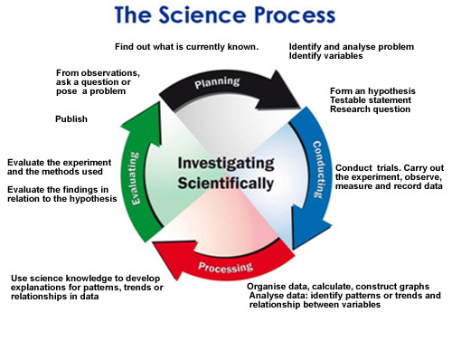

Slide 14
Fundamental characteristics of scientists
Scientists are conducting science as a complex social activity
responsible, honorable and trust worthy individuals; they conduct science through ethical principles
not only serve science, but they are also involved in public affairs as experts or knowledgeable citizens
think critically (scientifically)
eager to learn and teach
learn from each other
work systematically
seek originality
Curiosity and a positive attitude is the fuel of scientists
Creative thinking is a powerful tool for scientists
Scientists nave refined aesthetic notion

Slide 15
The Scientific Method
‘the scientific method is a process for experimentation that is used to answer questions and explore observations.
Scientists use the scientific method to search for cause and effect relationships in nature.
In other words, they design an experiment so that changes to one item cause something else to vary in a predictable way-
The scientific method will help to focus the question, construct a hypothesis, design, execute and evaluate the experiment.
In scientific method, the researcher makes some observations and based on these he poses questions (hypothesis), designs experiments (testing hypothesis) document results and develop explanations.
The scientific method helps to organize thoughts and procedures so that scientists can be confident in the answers they find.

Slide 16
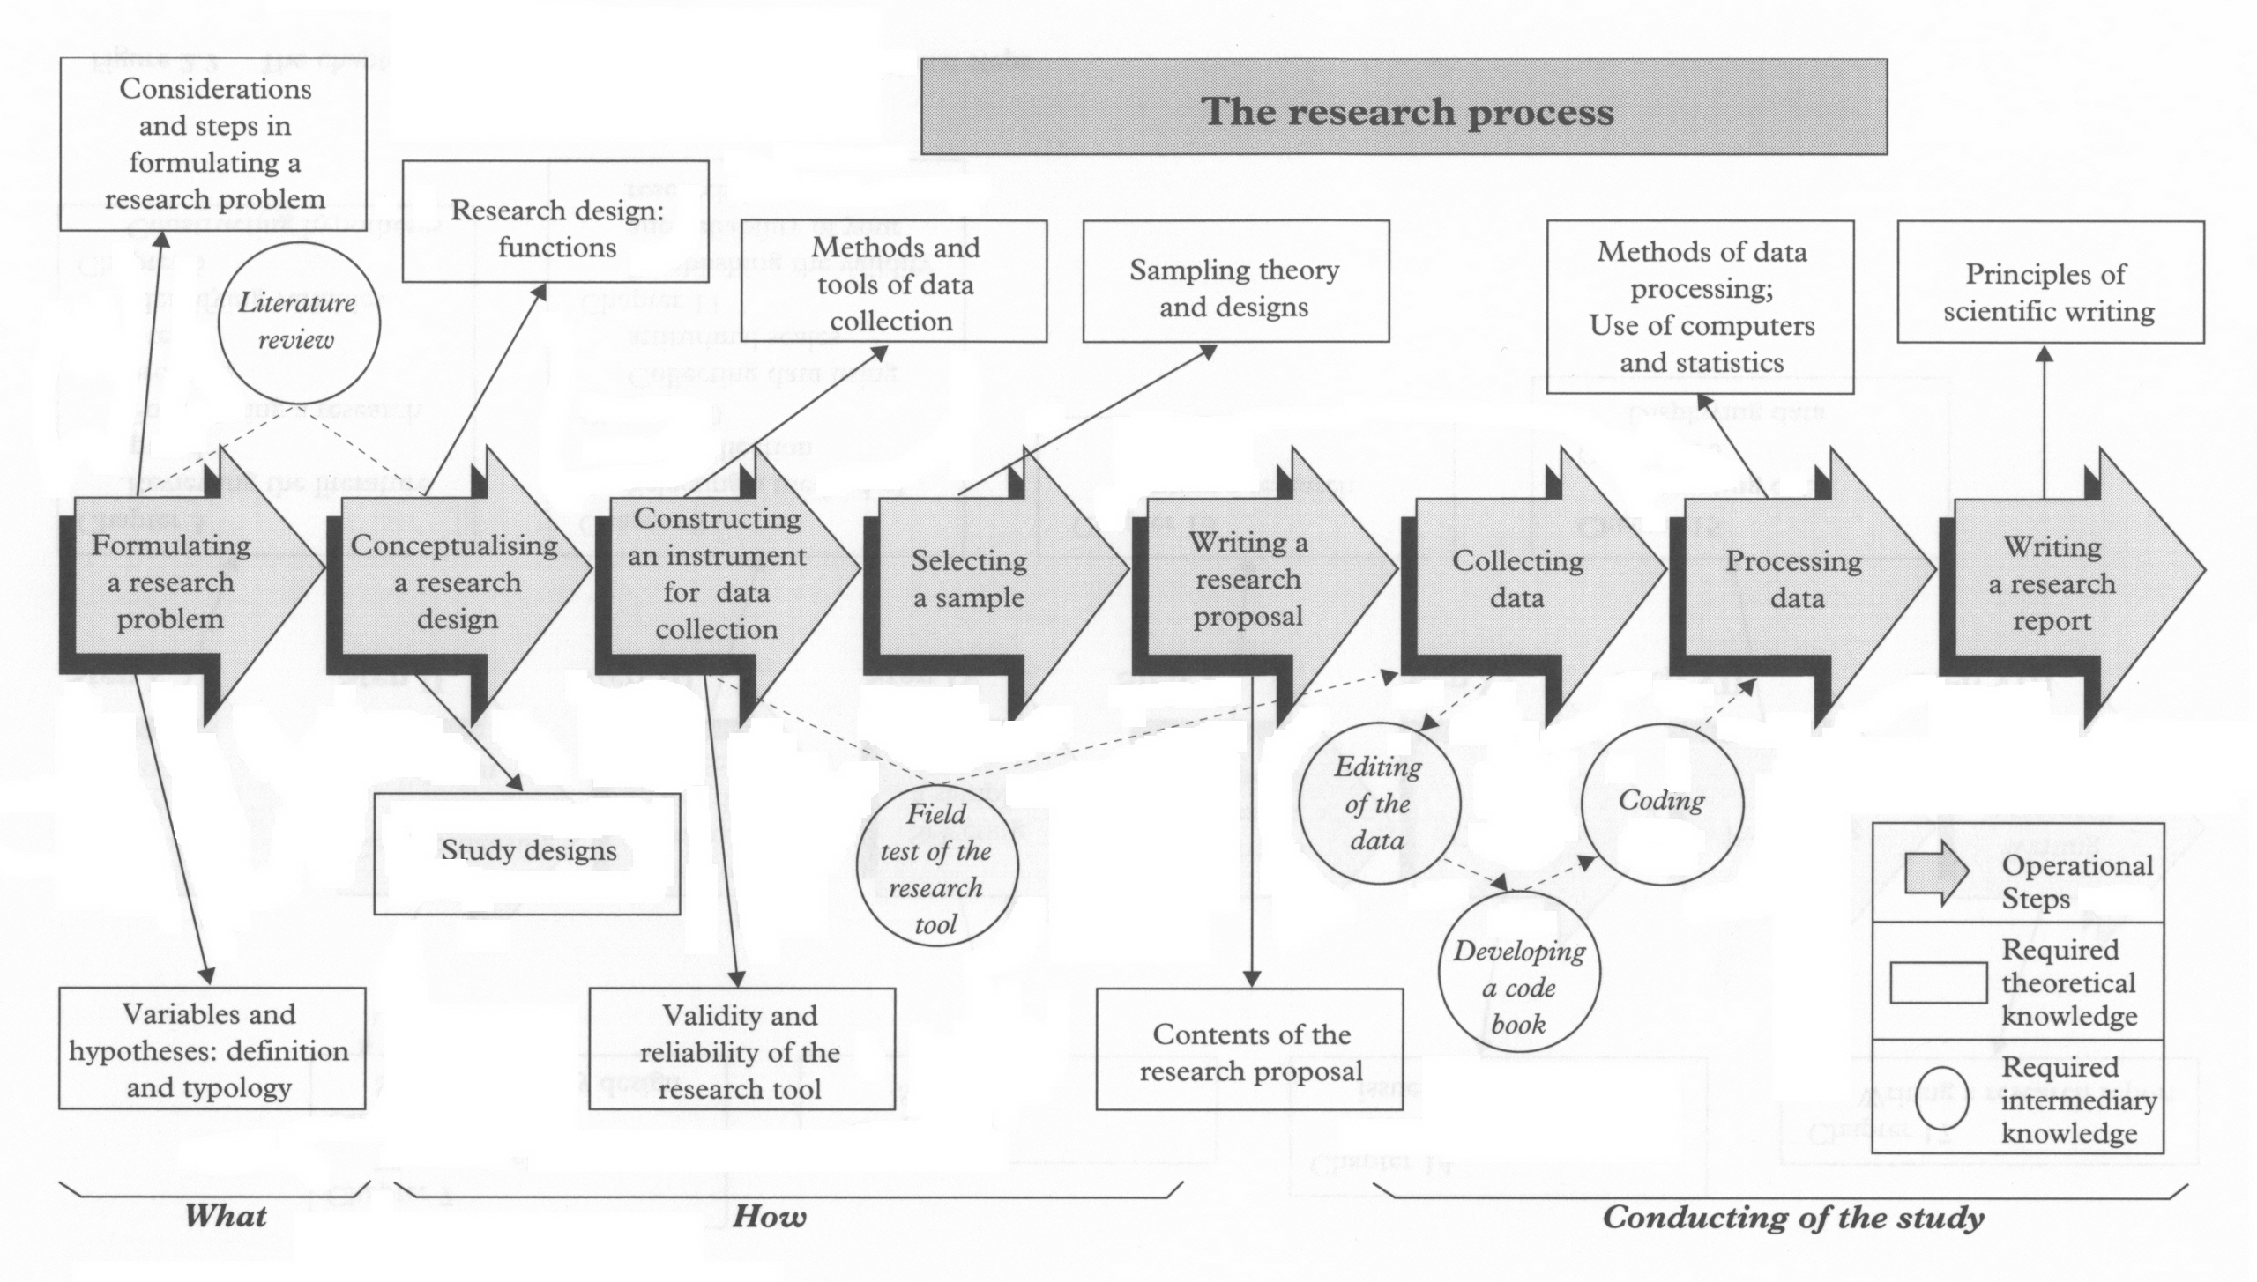
The tasks identified in arrows are the operational steps you need to follow in order to conduct a study.
Topics identified in rectangles are the required theoretical knowledge needed to carry out these steps.
The tasks identified in circles are the intermediary steps that you need to complete to go from one step to another.
It is important for a beginner to work through these steps in the proposed sequence, though with experience you
can change it.

Slide 17
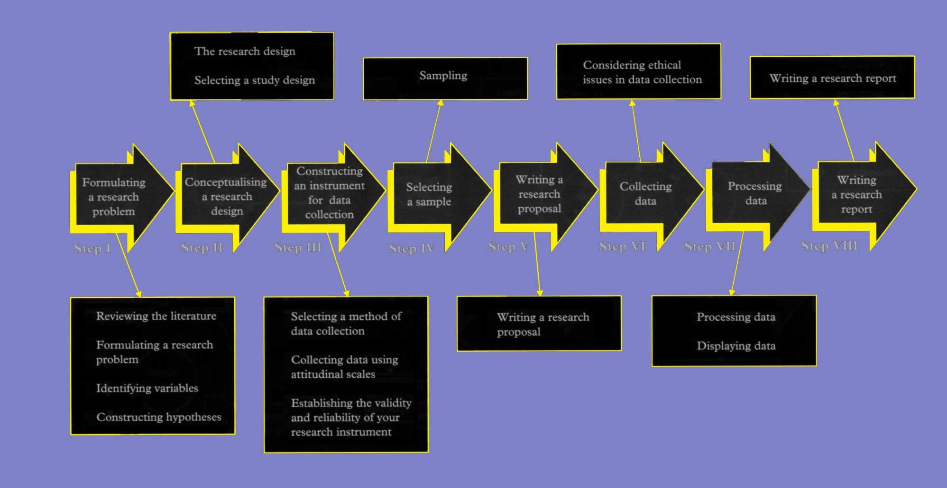
This course is more or less designed around the theoretical knowledge required to undertake each operational step and follows the same sequential progression as is needed to undertake a research investigation.
For each operational step, the required theoretical knowledge is further organized around the operational step to which it is most logically related .
Again, for a beginner, it is important to study this diagram to relate the theoretical knowledge to the operational steps.

Slide 18
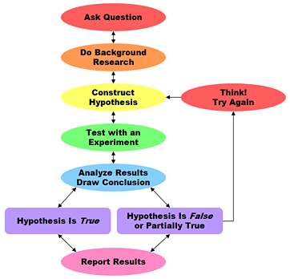
Steps in Scientific Method

Slide 19
Stages in Scientific Method
I. Observation:
It is the first stage in understanding the problem chosen.
After the decision of the area of science and the specific question they want to ask, they collect information as much as they can.
It is from own experiences, books, the internet, discussion with teachers and experts or even smaller "unofficial" experiments.
This initial work is considered as the cornerstone of the selected idea.
Scientific evidence is considered empirical when it can be observed by many people and all will agree as to what they observed.
An example would be reading a thermometer. No matter who observes the thermometer, it still displays the same temperature.

Slide 20
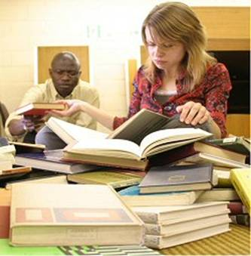
Stages in Scientific Method
II Review of Literature (Exploration and Enquiry)
Investigate what others have already learned about the problem or question.
Gather maximum information that will help to perform the experiment, which usually involves searching scientific publications and books, contacting experts in the field or searching Internet.

Slide 21
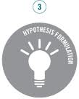
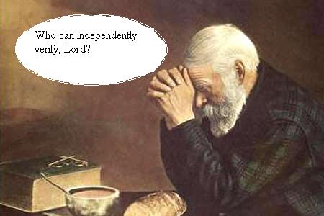
Stages in Scientific Method
III Hypothesis formation-.
A hypothesis is an educated guess about how things work.
You must state your hypothesis in a way that you can readily measure.
The word hypothesis basically means "a possible solution to a problem, based on knowledge and research."

Slide 22
Hypotheses
OK, now that we know how to set up a research project by posing research questions and labeling variables, it is time to move on to a more formal way of structuring and interpreting research.

Slide 23
Hypotheses Definitions
Hypotheses are predictions about the relationship among two or more variables or groups based on a theory or previous research (Pittenger, 2003)
Hypotheses are assumptions or theories that a researcher makes and tests.
Why are hypotheses important?

Slide 24
Importance of Hypotheses
Hypotheses:
Direct our observations
Identifies the variables examined and data to be collected
Describe a relationship among variables
Can state that as one variable increases, the other will decrease; as one variables increases, the other will increase, and so on.
Refer to populations
Hypotheses help researchers infer that results of a sample will translate to a population

Slide 25
4 Functions of Hypotheses
Hypotheses can:
Estimate Population Characteristics
Correlate Variables
Display Differences among Two or more populations
Show possible Cause and Effect

Slide 26
Symbols used in Hypotheses
M= mean
µ (mu: mew)= population mean
Roman Letters (e.g., A, B, C, D) are used to represent statistics
Greek Letters (e.g., α, β) are used to represent parameters
α= significance level; probability of committing a Type I Error (α= .05)
p= probability value (p= .05)
Null Hypothesis= (H₀: µ₁ - µ₂ = 0 or H₀: µ₁ = µ₂)
Alternative Hypothesis= (H₁: µ₁-µ₂ ≠ 0 or H₁: µ₁ ≠ µ₂ )
Sometimes you may see it noted as H_{A}

Slide 27
Stages in Scientific Method
IV Testing hypothesis:
After construction a hypothesis, you need to develop a procedure for testing whether it is true or false which involves changing one variable and measuring the impact of this change on other variables.
When you are conducting the experiment, you need to make sure that you are only measuring the impact of a single change.
Scientists run experiments more than once to verify that results are consistent.
Each time that you perform your experiment it is called a run or a trial.
Several trials are needed to make sure that the results are not affected by unanticipated factors.
The outcomes of an experiment confirm or disprove a hypothesis.

Slide 28
Stages in Scientific Method
V. Analysing the results.
Here we are organizing and analyzing the data collected during the course of an experiment in order to summerise what the experiment indicates which involves determining what the results of the experiment show and deciding on the next actions to be taken.

Slide 29
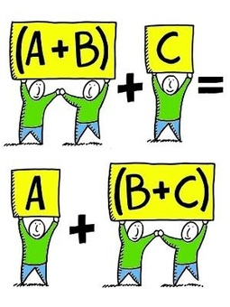
Stages in Scientific Method
V. Drawing conclusion
The final step in thy scientific method is the conclusion.
This is the summary of the experiment's result, and how those results match up to the hypothesis.
The researcher has two options for making conclusions: based on the results, either
(1) you can reject the hypothesis, or
(2) you cannot reject the hypothesis.
A scientific experiment isn't a failure if it proves your hypothesis wrong or it your prediction isn't accurate.
A science fair experiment is only a failure if its design is flawed.
A flawed experiment is one that
(1) doesn‘t keep its variables under control, and
(2) doesn't sufficiently answer the question that you asked of it.

Slide 30
Stages in Scientific Method
VI. Communicating the results.
To complete the scientific project, communication of results to others in a final report or via scientific publications (magazines, journals etc. is needed.
Professional scientists do almost publish their final report or conclusions in a scientific journal or by presenting their results on a poster at a scientific meeting.

Slide 31
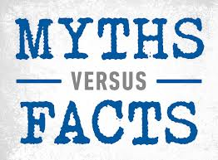
Myth of a scientific method
Our brief examination of the history of science suggests that trial and error have refined the following elements of modern, successful scientific method:
Facts are collected by carefully controlled experiments.
Based on these facts, verifiable hypotheses are proposed, objectively tested by further experiments, and thereby proven or discarded.
Explanatory concepts can be given different labels, depending on our confidence in their reliability.

Slide 32
Myth of a scientific method
A law is an explanation in which we have the greatest confidence, based on a long track record of confirmations.
A theory, on the other hand, denotes an explanation that has been confirmed sufficiently to be generally accepted, but which is less firmly established than a law.
An axiom is a concept that is accepted without proof, perhaps because it is obvious or universally accepted (e.g., time, causality) or perhaps to investigate its implications.
A hypothesis is an idea that is still in the process of active testing; it may or may not be correct.
Models are mathematical or conceptual hypotheses that provide useful perspectives in spite of recognized oversimplification.

Slide 33
Myth of a scientific method
Whereas laws and theories are relatively static, hypothesis formation, testing, and evaluation are the dynamic life of science.
Laws, theories, and hypotheses also differ in generality and scope.
Theories tend to be broadest in scope (e.g., the theories of relativity and of natural selection); most provide a unified perspective or logical framework for a variety of more specific and more limited laws and hypotheses.
All three are generalizations; rarely do they claim to predict the behavior of every particular case, because they cannot encompass all variables that could be relevant.
Most laws are expected to be universal in their applicability to a specified subset of variables, but some are permitted exceptions.

Slide 34
Scientific dogmatism
Scientific dogmatism is the assertion of an idea about a scientific topic without proof and without permitting scientists to explore or express alternative ideas.
Cardinal components of scientific thinking
The scientific method is practiced within a context of scientific thinking
scientific thinking is based on three things:
using empirical evidence (empiricism),
practicing logical reasoning (rationalism) and
possessing a skeptical attitude (skepticism) about presumed knowledge that leads to self-questioning, holding tentative conclusions and being undogmatic (willingness to change one's beliefs).
These three ideas are universal throughout science; without them, there would be no scientific or critical thinking.

Slide 35
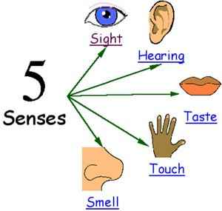
Empiricism: The use of empirical evidence
Empirical evidence is the evidence that is susceptible to one's senses (hear, touch, taste, or smell).
Empirical evidence is important as it is repeatable.
Empirical evidence is the only type of evidence used by scientists and critical thinkers to make vital decisions and reach sound conclusions.
Science has unquestionably been the most successful human endeavor in the history of civilization, because it is the only method that successfully discovers and formulates reliable knowledge.

Slide 36
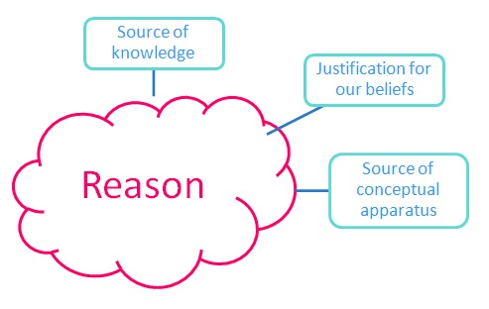
Rationalism: The practice of logical reasoning
Logic allows us to reason correctly, but it is a complex topic and not easily learned;
many books are devoted to explaining how to reason correctly.
Logic is a skill or discipline that must be learned within a formal educational environment
Emotional thinking, hopeful thinking and wishful thinking are much more common than logical thinking, because they are far easier and more congenial to human nature.
Most individuals would rather believe something is true because they feel it is true, hope it is true, or wish it were true, rather than deny their emotions and accept that their beliefs are false.

Slide 37
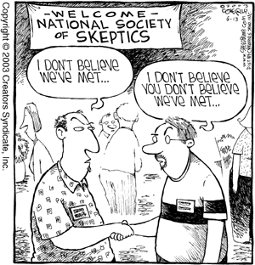
Skepticism: Possessing a skeptical attitude
The final key idea in science and critical thinking is skepticism, the constant questioning of your beliefs and conclusions.
Good scientists and critical thinkers constantly examine the evidence, arguments and reasons for their beliefs.
Self-deception and deception of yourself by others are two of the most common human failings.
Self-deception often goes unrecognized because most people' deceive themselves.

Slide 38
The scientific method is based on certain basic postulates:
It relics on empirical evidence
It utilizes relevant concepts
It is committed to only objective considerations
It aims at nothing but making only adequate and correct statements about population objects
It results into probabilistic predictions
Its methodology is made known to all concerned for critical scrutinies are for use in testing the conclusions through replication
It aims at formulating most general axioms or what can be termed as scientific theories

