Slide 1
Linguistics Basic concepts
Dr.G.Koshy
Associate Professor
Department of English
Mar Thoma College, Tiruvalla

Slide 2
LINGUISTICS
the scientific study of language and its structure, including the study of grammar, syntax, and phonetics.
Specific branches of linguistics include:
sociolinguistics, dialectology, psycholinguistics, computational linguistics, comparative linguistics, and structural linguistics.

Slide 3
Main branches of Linguistics
Historical linguistics.
Geographical linguistics.
Descriptive linguistics.
Comparative and contrastive linguistics.
Psycholinguistics.
Sociolinguistics.
Ethnolinguistics.
Syntactics/Grammar.

Slide 4
BASIC CONCEPTS
Morphology
morpheme, inflection, paradigm, declension, derivation, compound
Phonology
phoneme, allophone, segment, mora, syllable, foot, stress, tone
Grammar
tense, aspect, mood and modality, grammatical number, grammatical gender, case
Syntax
phrase, clause, grammatical function, grammatical voice
Lexicology
word, lexeme, lemma, lexicon, vocabulary, terminology
Semantics
meaning, sense, entailment, truth condition, compositionality
Pragmatics
presupposition, implicature, deixis

Slide 5
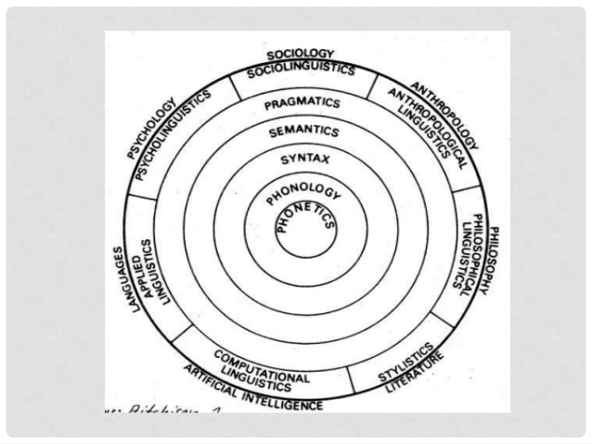

Slide 6
The Branches of linguistics
1. GENERAL LINGUISTICS
General linguistics generally describes the concepts and categories of a particular language or among all languages. It also provides an analyzed theory of the language.
Descriptive linguistics describes or gives the data to confirm or refute the theory of a particular language explained generally.

Slide 7
2. MICROLINGUISTICS
It is concerned with the internal view of language itself (structure of language systems) and how to apply it in daily life. Some fields of micro linguistics:
a. Phonetics, the study of the physical properties of sounds of human language
b. Phonology, the study of sounds as discrete, abstract elements in the speaker's mind that distinguish meaning
c. Morphology, the study of internal structures of words and how they can be modified
d. Syntax, the study of how words combine to form grammatical sentences

Slide 8
e. Semantics, the study of the meaning of words (lexical semantics) and fixed word combinations (phraseology), and how these combine to form the meanings of sentences
f. Pragmatics, the study of how utterances are used (literally, figuratively, or otherwise) in communicative acts
g. Discourse analysis, the analysis of language use in texts (spoken, written, or signed)
h. Applied linguistics is the branch of linguistics that is most concerned with application of the concepts in everyday life, including language-teaching.

Slide 9
3. MACROLINGUISTICS
It is the broadest view of language. It is concerned with the external view of language itself with relation to other sciences and how to apply it in daily life. Some fields of micro linguistics:
a. Stylistics, the study of linguistic factors that place a discourse in context.
b. Developmental linguistics, the study of the development of linguistic ability in an individual, particularly the acquisition of language in childhood.
c. Historical linguistics or Diachronic linguistics, the study of language change.
d. Language geography, the study of the spatial patterns of languages.
e. Evolutionary linguistics, the study of the origin and subsequent development of language.

Slide 10
f. Psycholinguistics, the study of the cognitive processes and representations underlying language use.
g. Sociolinguistics, the study of social patterns and norms of linguistic variability.
h. Clinical linguistics, the application of linguistic theory to the area of Speech-Language Pathology.
i. Neurolinguistics, the study of the brain networks that underlie grammar and communication.
j. Biolinguistics, the study of natural as well as human-taught communication systems in animals compared to human language.

