Slide 1
SYMMETRY AND GROUP THEORY
Dr.Koshy John
Department of chemistry

Slide 2
Symmetry Elements
The elements used to ascertain the symmetry of a molecule quantitatively is called Symmetry elements.
A symmetry element is a geometrical entity such as a line about which a rotation is carried out, a point about which an inversion is carried out or a plane about which a reflection is carried out to generate an equivalent orientation or indistinguishable orientation.
Elements of symmetry are;
1. Identity(E)
2. Proper axis of symmetry(C_{n})
3. Centre of symmetry(i)
4. Plane of symmetry
5. Improper axis of symmetry

Slide 3
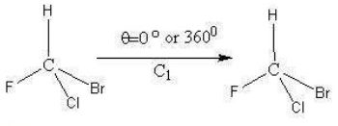
1.Identity
Every object possess an identity element
It’s a doing nothing operation

Slide 4
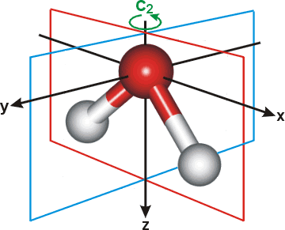
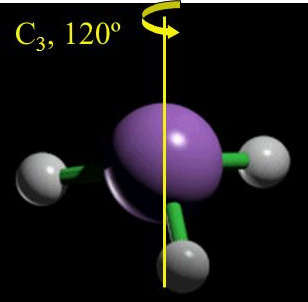
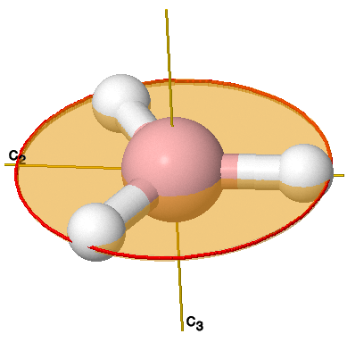
2.Proper axis of symmetry
An imaginary axis about which the molecule is rotated through an angle 360º/n to generate an equivalent orientation.
It is an axis of n fold symmetry or an axis of order n.
The highest order axis passing through maximum number of atoms is the principal axis.
Water molecule has a 2-fold axis, Ammonia has a 3-fold axis and Boron trifluoride has a 3-fold and three 2-fold axes.
H₂O
NH₃
BF₃

Slide 5
Molecule | Principal axis | Subsidiary axes
Water | C₂ | Nil
Ammonia | C₃ | Nil
BF₃ | C₃ | 3C₂
XeF₄ | C₄ | 4C₂
Cyclopentadienyl anion | C₅ | 5C₂
Benzene | C₆ | 6C₂
H₂O₂ | C₂ | Nil
XeOF₄ | C₄ | Nil

Slide 6
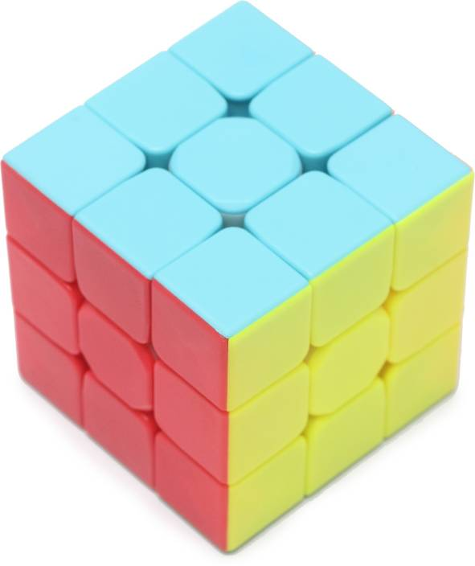
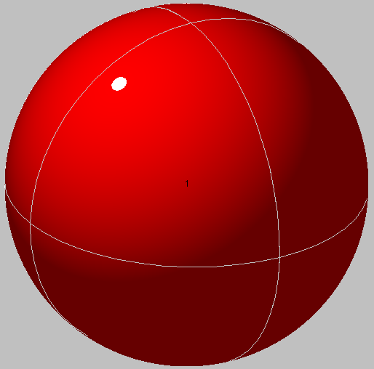
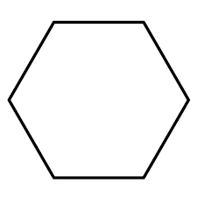
3.Centre of symmetry(i)
It is a point at the centre of the molecule from which lines are drawn in opposite directions will meet exactly similar points at exactly same distance.
Molecules such as N₂F₂,C₂H_{4,}PtCl₄,C₆H₆ etc contain ‘i’
Objects possessing ‘i’ are Sphere, Cube, Hexagon etc.

Slide 7
4.Plane of symmetry(σ)
A plane of symmetry is a plane which divides the molecule into two equal halves such that one half is the exact mirror image of the other half.
Plane of symmetry can take up different orientations with respect to the principal axis.
A plane which is perpendicular to he principal axis is denoted as σ_{v} plane.
Plane parallel to principal axis is σ_{h} plane.
A vertical plane which divides the the angle between two C axes is denoted as σ_{d} plane.
Number of planes of symmetry of a molecule can vary from one to infinity.
Linear molecules have infinite number of planes.

Slide 8
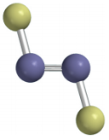
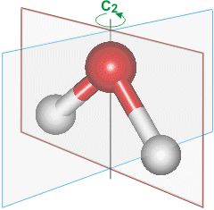
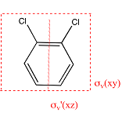
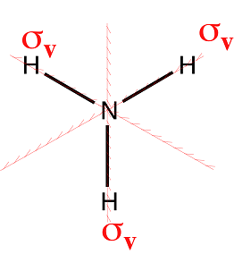
Examples,
N₂F₂
H₂O
C₂H₄
NH₃
Dichlorobenzene

Slide 9
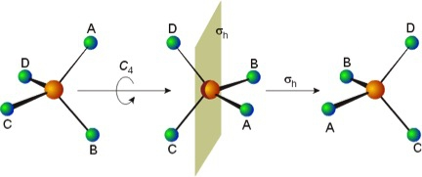
5.Improper axis of symmetry(S_{n})
It is an axis about which the molecule is rotated through 360/n followed by a reflection in a plane perpendicular to the axis produces an equivalent orientation
Example N₂F₂

Slide 10
The various symmetry elements and operations are given below
Symmetry elements | Symmetry operation | Schoenflies symbol
Axis of symmetry | Rotation through an angle | C_{n}
Plane of symmetry | Reflection | σ
Centre of symmetry | Inversion | i
Improper axis of symmetry | Rotation followed by reflection | S_{n}

Slide 11
Let us try to assign the point groups of some molecules now.
Molecule | Symmetry elements | Point group
BF₃ | C₃+3C₂+σ_{h} | D_{3h}
PF₅ | C₃+3C₂+σ_{h} | D_{3h}
Ethylene | C₂+2C₂+σ_{h} | D_{2h}
Ethane(Eclipsed) | C₃+3C₂+σ_{h} | D_{3h}
Ethane(staggered) | C₃+3C₂+3σ_{d} | D_{3d}
Allene | C₂+2C₂+2σ_{d} | D_{2d}
Benzene | C₆+6C₂+σ_{h} | D_{6h}
XeF₄ | C₄+4C₂+σ_{h} | D_{4h}
HCl | C_{α}+ασ_{v} | C_{αv}
H-H | C_{α}+αC₂+σ_{h} | D_{αh}
CH₂Cl₂ | C₂+2σ_{v} | C_{2v}
CH₃Cl | C₃+3σ_{v} | C_{3v}
CH₄ | 4C₃+3C₂+6σ_{d} | T_{d}
SF₆ | 4C₃+6C₂+3C₄+3σ_{h} | O_{h}

Slide 12
Thank you

