Slide 1
HAEMOGLOBIN STRUCTURE
Ms. Letha P Cherian
Assistant Professor
Department of Zoology
Mar Thoma College Thiruvalla

Slide 2
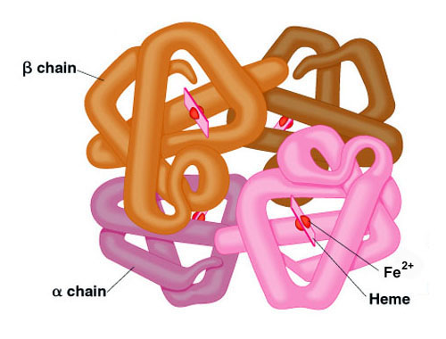

Slide 3
Adult hemoglobin is a [α(2):β(2)] tetrameric hemeprotein found in erythrocytes where it is responsible for binding oxygen in the lung and transporting the bound oxygen throughout the body where it is used in aerobic metabolic pathways.
Each subunit of a hemoglobin tetramer has a heme prosthetic group identical to that described for myoglobin. The common peptide subunits are designated α, β, γ and δ which are arranged into the most commonly occurring functional hemoglobins.

Slide 4
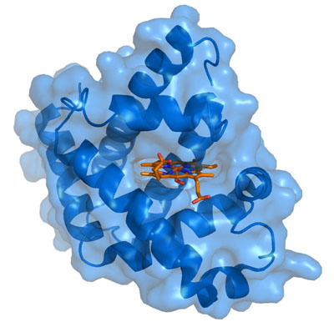

Slide 5
Myoglobin is a monomeric heme protein found mainly in muscle tissue where it serves as an intracellular storage site for oxygen.
During periods of oxygen deprivation oxymyoglobin releases its bound oxygen which is then used for metabolic purposes.
The tertiary structure of myoglobin is that of a typical water soluble globular protein. Its secondary structure is unusual in that it contains a very high proportion (75%) of α-helical secondary structure.
A myoglobin polypeptide is comprised of 8 separate right handed α-helices, designated A through H, that are connected by short non helical regions.
Amino acid R-groups packed into the interior of the molecule are predominantly hydrophobic in character while those exposed on the surface of the molecule are generally hydrophilic, thus making the molecule relatively water soluble.

Slide 6
ORIGIN 1 gacgccatgg tcgaggactg accgctcgct cacagctacg acacagactt gcccggcgcg
61 tgcaccggta gtttgaacca aacgcacaat cgacgggcaa acgaacggaa gaacacaacc
121 atgaagatgg tgaaatcgat cgccgcaggt ctgaccgccg cggctgcaat cggcgccgct
181 gcggccggtg tgacttcgat catggctggc ggcccggtcg tataccagat gcagccggtc
241 gtcttcggcg cgccactgcc gttggacccg gcatccgccc ctgacgtccc gaccgccgcc
301 cagttgacca gcctgctcaa cagcctcgcc gatcccaacg tgtcgtttgc gaacaagggc
361 agtctggtcg agggcggcat cgggggcacc gaggcgcgca tcgccgacca caagctgaag
421 aaggccgccg agcacgggga tctgccgctg tcgttcagcg tgacgaacat ccagccggcg
481 gccgccggtt cggccaccgc cgacgtttcc gtctcgggtc cgaagctctc gtcgccggtc
541 acgcagaacg tcacgttcgt gaatcaaggc ggctggatgc tgtcacgcgc atcggcgatg
601 gagttgctgc aggccgcagg gaactgattg gcgggccggc ttcagcccgc tgttcagcta
661 cgccgcccgc ctggtgacgc gtccatgtcg aacactcgcg cgtgtagcac ggtgcggttg
721 cgcagggcc //
Mycobacterium tuberculosis low-molecular-weight secreted antigen precursor (mtb12) gene, complete cds

Slide 7
THANK YOU

