Slide 1
GEOMETRICAL ISOMERISM IN OCTAHEDRAL COMPLEXES
Mary Sarah Cherian
Associate Professor
Department of Chemistry
Mar Thoma College Tiruvalla

Slide 2
GEOMETRICAL ISOMERISM
Geometrical isomerism is a type of isomerism arises in heteroleptic complexes due to different possible geometric arrangements of the ligands.
Important examples of this behavior are found with co-ordination numbers 4 and 6.
There are two simples types of geometric isomerism possible for octahedral complexes.

Slide 3
The first type of geometrical isomerism exists for complexes of the type MA2B4.
Two geometrical isomers are also possible for complexes of the type MA2B4.

Slide 4
GEOMETRICAL ISOMERS OF MA2B4 TYPE
The ‘A’ ligands in MA2B4 may be either next to each other called cis isomer.
The ‘A’ ligands in MA2B4 are on opposite apexes of the octahedron called trans isomer.
Complexes of this type were studied by Werner,who showed that the praseo and violeo complexes of tetraaminedichlorocobalt(III) were of this type .

Slide 5
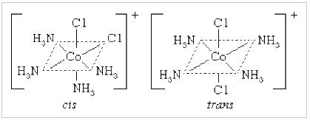
Examples of cis and trans octahedral isomers of tetraaminedichloro cobalt(III)

Slide 6
The second type of geometrical isomerism exists for the complexes of the type MA3B3.
Two geometric isomers are also possible for MA3B3 type.

Slide 7
GEOMETRICAL ISOMERS OF MA3B3 TYPE
The ligands of one type may form an equilateral triangle on one of the faces called facial isomer or fac isomer.
The ligands may span three positions such that two are opposite to each other called meridional isomer or mer isomer.

Slide 8
Mer-fac isomers are easier to notice than cis-trans isomers in the sense that they only exist in octahedral geometry.
Just like cis-trans isomers,mer-fac isomers are determined based on whether or not the ligands exist on the other side.

Slide 9
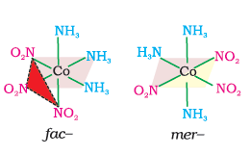
Examples of facial and meridional octahedral isomers of triaminetrinitro cobalt(III).

Slide 10
THANK YOU…….

