Slide 1
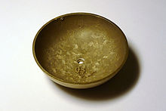
BRONZE AGE CIVILISATIONS
Tutor : Prof. Mathew Sam
Assistant Professor
Department of History
Mar Thoma College, Tiruvalla
Topic : Bronze Age Civilisations

Slide 2
What is Bronze ?
Alloy of Copper and Tin
Why Bronze age?
Why was Bronze preferred over Copper?

Slide 3
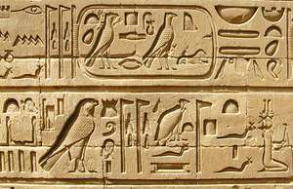
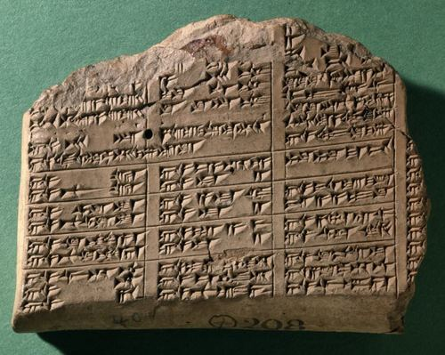
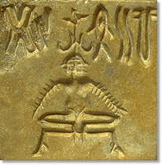
The Bronze Age marked the first time humans started to work with metal.
Ancient Sumerians in the Middle East may have been the first people to enter the Bronze Age
Humans made many technological advances during the Bronze Age, including the first writing systems and the invention of the wheel
In the Middle East and parts of Asia, the era lasted from roughly 3300 to 1200 B.C.,

Slide 4
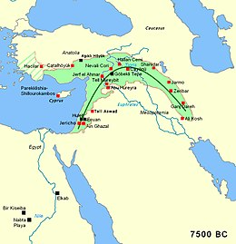
Humans may have started smelting copper as early as 6,000 B.C in the Fertile Crescent, a region often called “the cradle of civilization”
Present day Egypt, Jordan, Lebanon, Palestine, Israel, Syria, Turkey, Iran, Iraq and Cyprus.

Slide 5
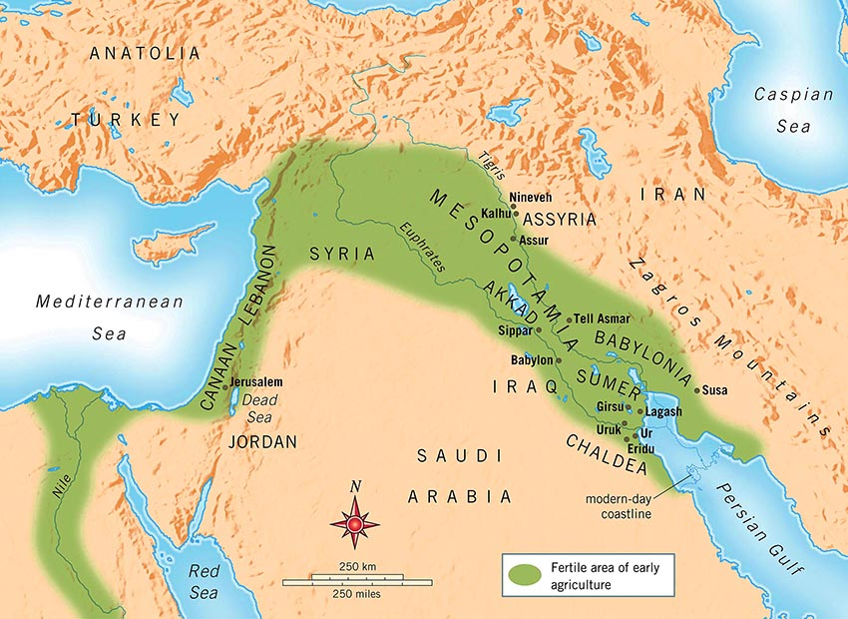
Ancient Sumer may have been the first civilization to start adding tin to copper to make bronze. Bronze was harder and more durable than copper, which made bronze a better metal for tools and weapons.

Slide 6
Archaeological evidence suggests the transition from copper to bronze took place around 3300 B.C. The invention of bronze brought an end to the Stone Age—the prehistoric period dominated by the use of stone tools and weaponry.
Different human societies entered the Bronze age at different times. Civilizations in Greece began working with bronze before 3000 B.C., while the British Isles and China entered the Bronze Age much later—around 1900 B.C. and 1700 B.C., respectively.

Slide 7
The Bronze Age was marked by the rise of states or kingdoms—large-scale societies joined under a central government by a powerful ruler
Bronze Age states interacted with each other through trade, warfare, migration and the spread of ideas
The Bronze Age ended around 1200 B.C. when humans began to forge an even stronger metal: iron.

Slide 8
BRONZE AGE-
MESOPOTAMIA

Slide 9
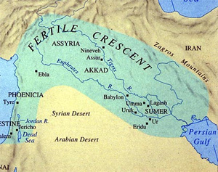
Corresponds to present day Iran
Mesopotamia produced the earliest known bronze age civilisations- Sumerian Civilisation
Euphrates and Tigris or Purattu and Idiqlat

Slide 10
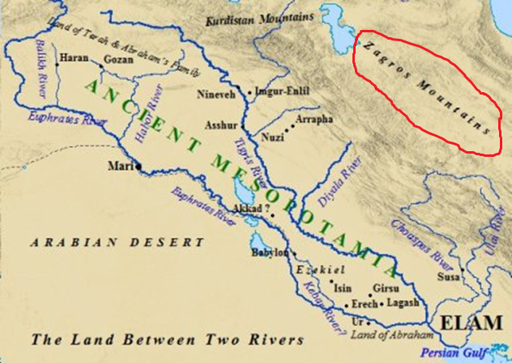
Mesopotamia can be divided into two distinct regions- North and South
Northern part extends from Zagros Mountain to middle Tigris
In the west this region is bound by the Syrian Desert
Northern Mesopotamia was called Assyria

Slide 11
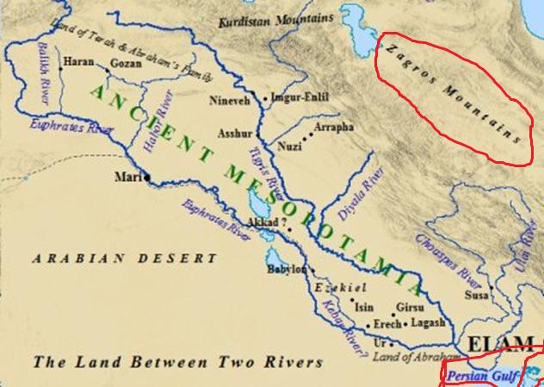
Southern Mesopotamia- between Middle Tigris and Persian Gulf
DESERT
IRAN

Slide 12
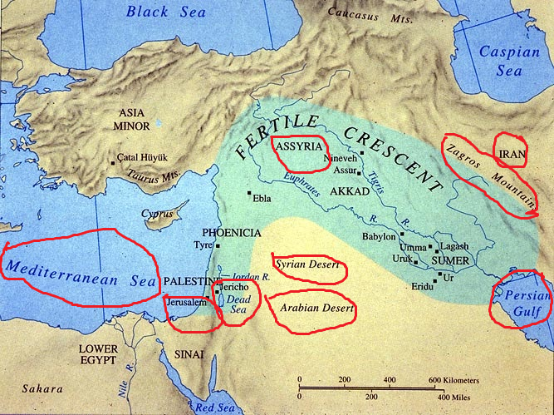

Slide 13
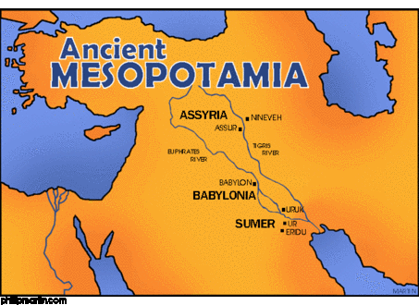
Southern Mesopotamia was an arid zone surrounded by deserts. But the rivers provided the water needed for cultivation
Southern part was known as Sumeria. It also included Akkad.
From 2000 BC Sumeria and Akkad were known as Babylonia .
Babylonia or Babylon was the political centre of a major empire in Southern Mesopotamia.

Slide 14
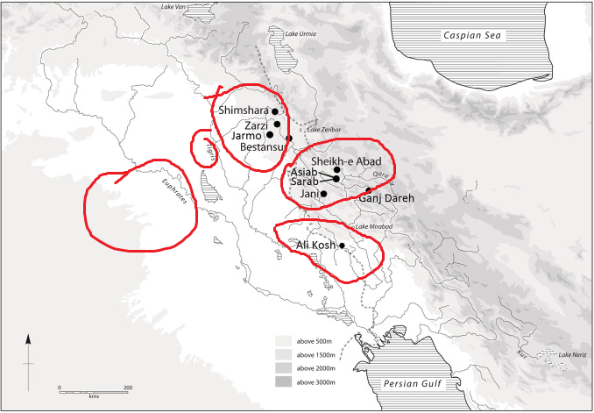
Foothill of Zagros Mountain or Northern Mesopotamia has seen the beginning of food production during Neolithic

Slide 15
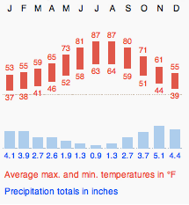
Northern Mesopotamia was blessed with rainfall – no need of irrigation
Wheat and Barley- winter rainfall
Mediterranean climate- Dry summer and Cool Winter

Slide 16
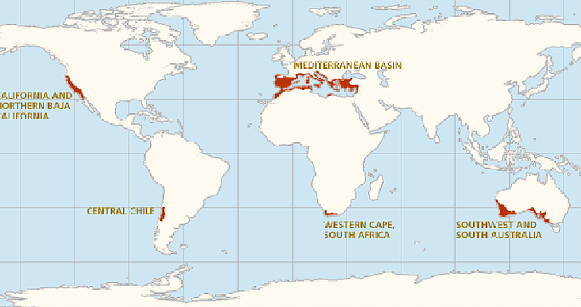

Slide 17
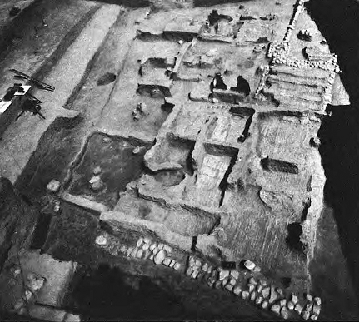
B/w 8000 and 6000 BC- Neolithic Villages came up in Northern Mesopotamia
Eg:-Jarmo
Multiroomed houses
Mud walls
Oven
Storage basin
Sickle
Food production
Wheat and barley

Slide 18
By 6000B.C food production became widespread in Northern Mesopotamia.
Cultivation was based on winter rainfall
Hassuna Culture (6000-5500 BC)
From Tell Hassuna (Iraq)
House with several rooms
Storage Pits
Stone Sickles
Heavy Javelins
Painted Pottery decorated with geometric designs

Slide 19
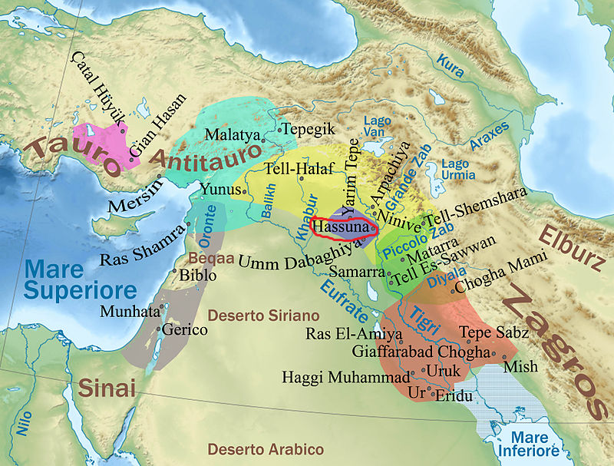

Slide 20
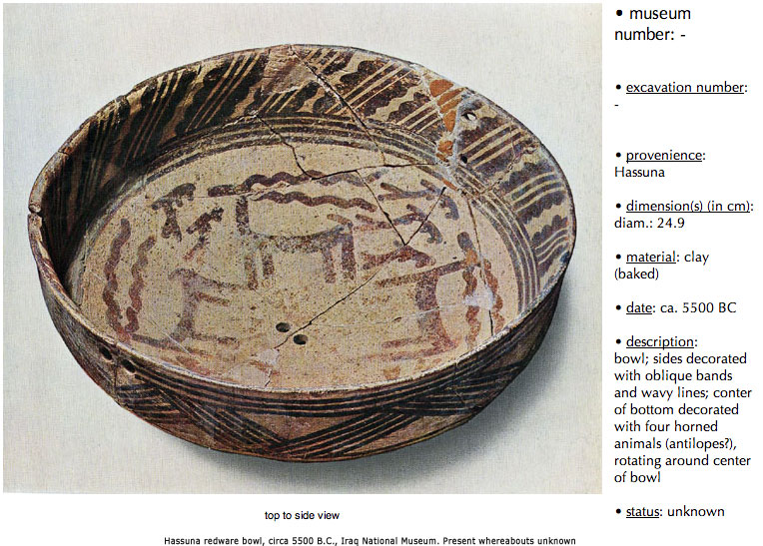

Slide 21
Samarra Culture (5500-5000 BC) followed Hassuna
By this time people began to settle in the margins of southern Mesopotamia or along the middle Tigris.
Winter rainfall- scarce
Artificial irrigation
Canals were built to carry water
Village was protected by a ditch
Wheat and Barley
Linseed

Slide 22
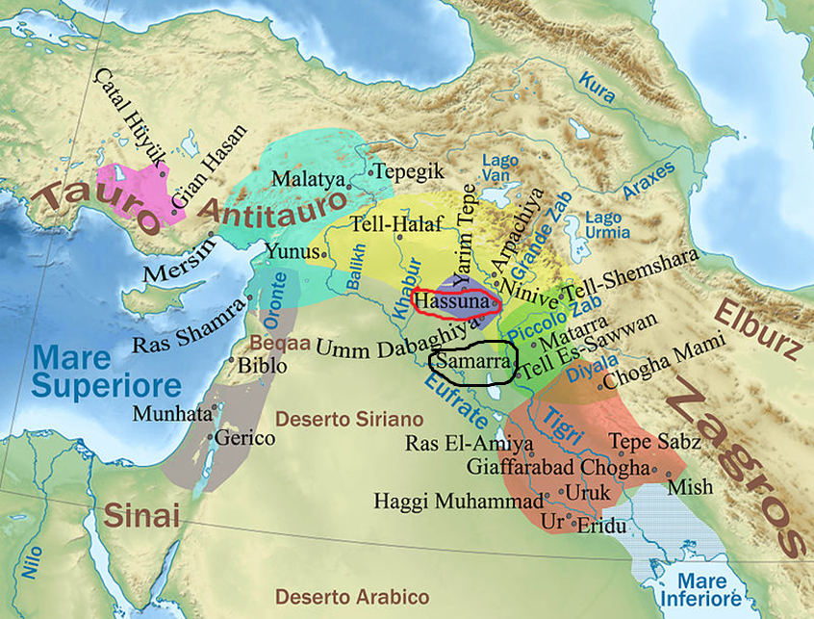

Slide 23
Halafian Culture was the most advanced Neolithic Culture in Northern Mesopotamia
5500-4500 BC
Beads of Metallic Copper found
Mining??
Painted and Glazed Pottery
Fired at high temperature-glaze
Pottery found from Zagros in the East to Syria in the West
Trade??

Slide 24
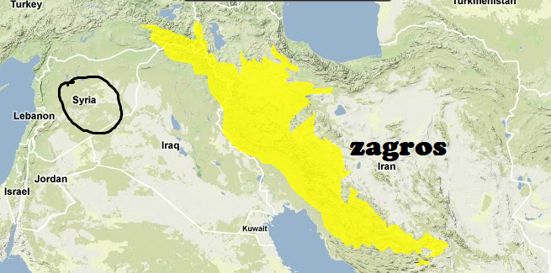

Slide 25
Soil of Southern Mesopotamia was fertile provided it was irrigated
Digging canals to take the water to the field
The bed of Euphrates was higher than Tigris- SLOPE
Naturals channels- diverted

Slide 26
Neolithic Cultures in Southern Mesopotamia began to appear with the beginning of irrigation
Al-Ubaid Culture (5000-4000 BC)
Uruk Culture (4000-3200 BC)
Jamdat Nasr (3200-3000 BC)

Slide 27
