Slide 1
Controlling
Nijin K Mathew
Asst.Professor,Dept of Commerce,
MarThoma College, Tiruvalla

Slide 2
Looking back……
planning
Directing
Staffing
Organising

Slide 3
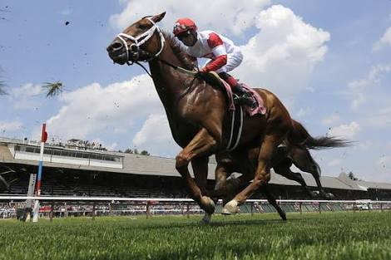
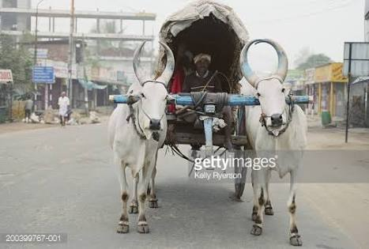
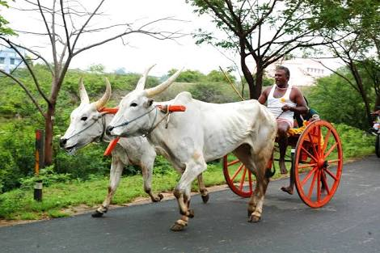

Slide 4
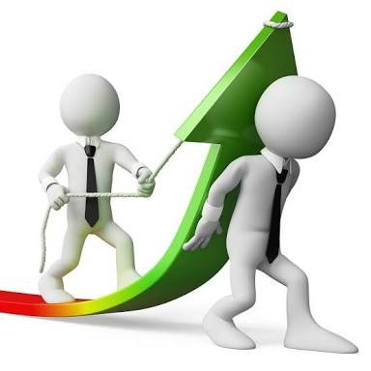
Controlling in Management
Controlling is the process of ensuring that actual activities confront to planned activities

Slide 5
Features of controlling
Goal oriented process
Pervasive function
Forward as well as backward looking
continuous process
Delegation of authority

Slide 6
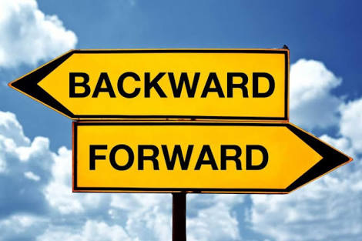
planning
controlling
Planning and controlling are interdependent and inseparable function of management.
Planning and control are forward looking

Slide 7
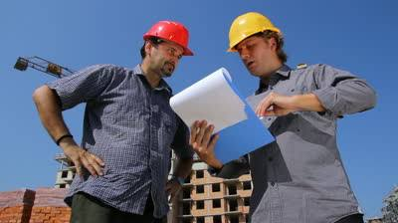
controlling process
Establishment of standard
Standard : criteria against which actual performance would be measured.
Eg: cost to be incurred, revenue to be earned, number of units to be produced , time to be spent in performing a task
Standards should be precise quantitative terms
Notes:
Time taken by customer to wait for the table, time taken to place the order, time taken to collect the order

Slide 8
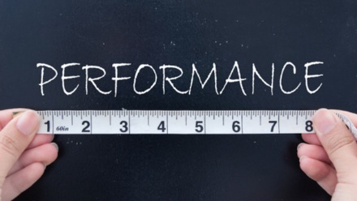
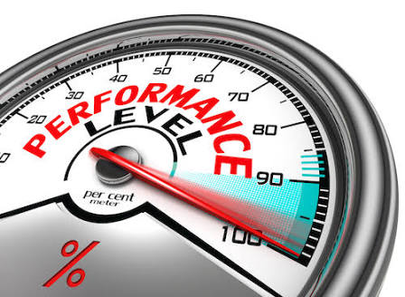
Measurement of performance
Management should not merely guess the performance but measure in real manner.
Personal observation, Performance reports, Sample checking etc

Slide 9
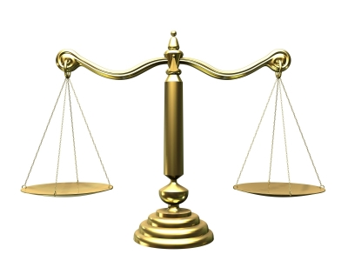
Comparing actual performance with standards

Slide 10
Analysing deviations
Deviations means gap between actual performance and standards.
Deviations may be + or –
Critical point control & Management by exception
Notes:
+ actual > standard
- Actual <standard

Slide 11
Management by exception
Major deviation which go beyond the permissible limit should be report to the management and take actions

Slide 12
Taking Corrective Actions
Notes:
Revision,change in task,training,

Slide 13
ACTIONS | standard | Actual | Deviation | Corrective actions
Time taken to wait for the table | 01 minute | 30 seconds | + | Nothing
Time taken to wait for the order | 01 minute | 3 minutes | - | Recruit more employees.
Time taken to serve | 05 minute | 08 minutes | - | Fast delivery
Time taken to give bill | 02 minutes | 1 minute | + | No actions
Time taken to give balance | 01 minute | 30 seconds | + | No actions

Slide 14
Establishing Standards
Measurement of performance
Does performance match with the standard
NO
TAKE CORRECTIVE ACTION
YES
DO NOTHING

Slide 15
Methods and Techniques
Traditional Methods
Modern Methods

Slide 16
Traditional Methods
Observation
Statistical Data and Charts
Break Even Analysis
Analysis of Cost behaviour in relation to changing volumes of sales and its impact on profit
Cost – sales- profit
Sales =total cost
Probable profit and losses inin different levels of activity.
Budgetary Control
External Audit
Internal audit
Notes:
Tables,charts, graphs – ratios, Averages, SD,Co efficient of correlation, Regression etc

Slide 17
Modern Methods
Return on Investment
Net Income / Total Investment *100
Capital invested in the business has been effectively used or not
Responsibility Accounting
Org is divided into departments called responsibility centres
Each responsibility centre is headed by a manager.
He is responsible for the achievement of target
Management Audit
Systematic examination , Analysis, appraisal and Evaluation of functioning, performance and effectiveness of various management process and functions
Analysis of the decisions made by the managers
Programme Evaluation and Review Technique (PERT)
Aid in planning, Scheduling and Controlling
Compute total time to complete a project and identify bottleneck activities

Slide 18
Critical Path Method (CPM)
Scheduling the work with the help of scheduling
Helps to identify the critical activities in an organisation.
Project is analysed into different operations or activities
Relationship of different activities and shown on the network diagram.
CPM marks the critical activities in a project and concentrates on them.

