Slide 1
Department of Malayalam Marthoma College, Tiruvalla
BA/B.SC (MODEL-1)
COMMON COURSE MALAYALAM
SEMESTER - 1 presented by
Kesia Mary Philip
Dept. of Malayalam

Slide 2
“Enmakaje” & “Valiya chirakulla pakshikal:” Reality and representation

Slide 3
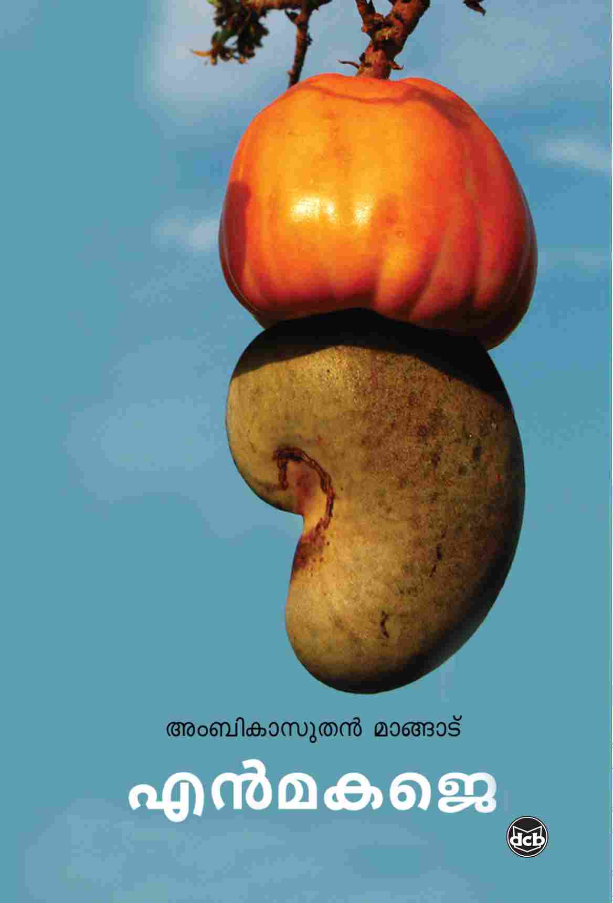
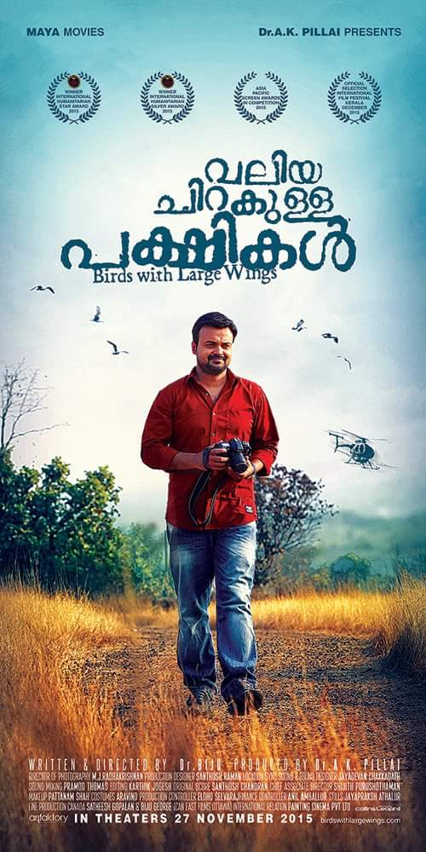

Slide 4
Enmakaje is a Malayalam novel writtern by Ambikasuthan Mangad.
Enmakaje portrays the life of victims in the villege Enmakaje of Kasaragod. The book has played a major role in banning the pesticide.
Valiya Chirakula Pakshikal is a 2015 Malayalam drama filim writtern and directed by Dr.Biju.
The main Character is based Madhuraj a Mathrubhumi press photojournalist whose 2001 expose shed light on the environmental damage that resulted from the use of endosulfan tragedy.
Dr.Biju's Valiya Chirakula Pakshikal is about the harmful effects caused by the unethical use of the pesticide Endosulfan in the plantations of Kasaragod district of Kerala.

Slide 5
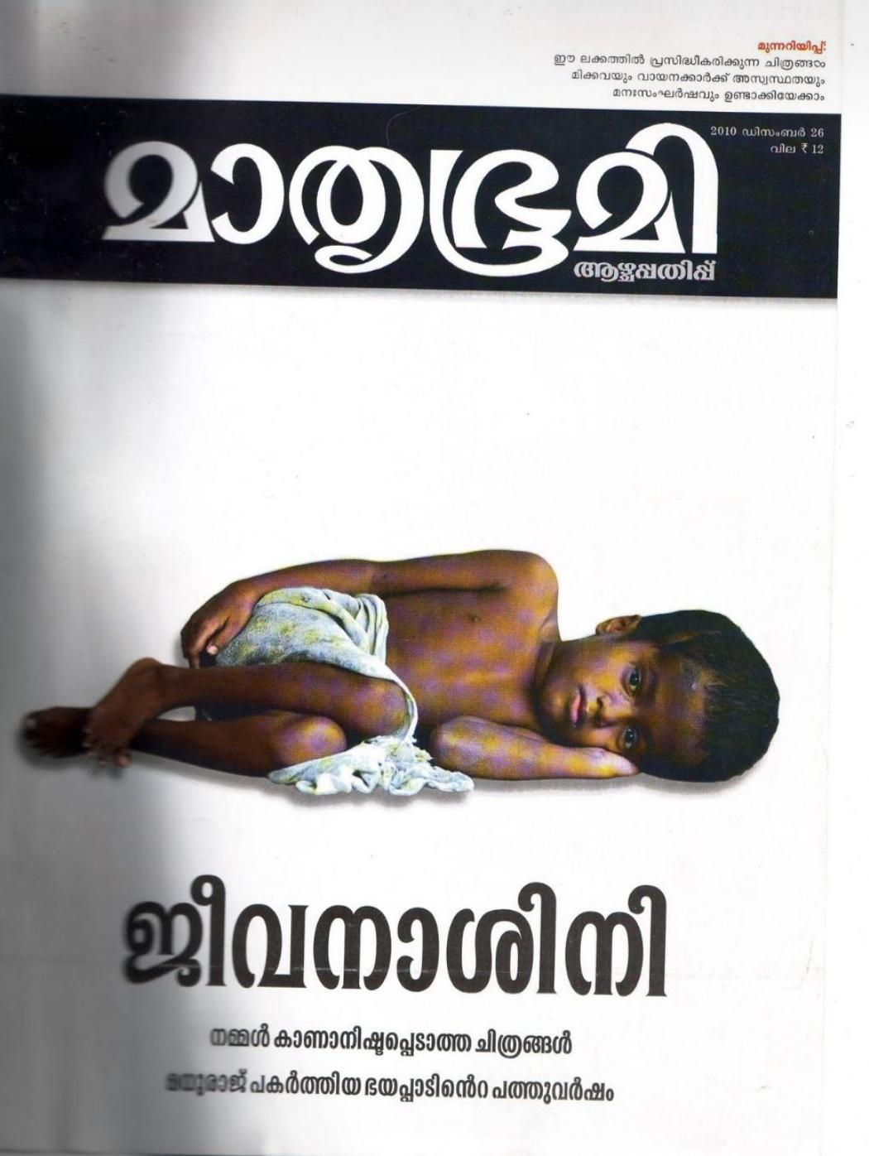
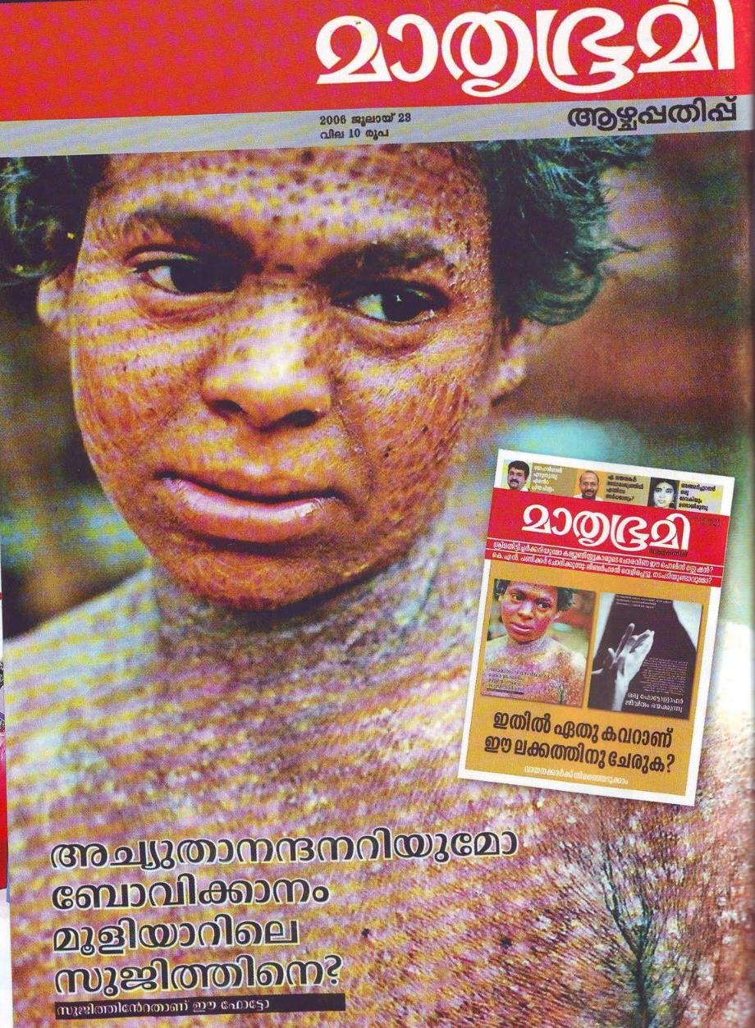

Slide 6
