Slide 1
Elements of Film
Rahul N
Assistant Professor
Department of English
Mar Thoma College, Tiruvalla

Slide 2
Introduction
Film, a recent phenomenon, borrowed a lot from other forms
Criteria and terminology of painting/drama often applied to films
Film combines in complex ways, those characteristics other forms exhibit in particular ways only – painting: images, novels: words – film combines images and words.
Films and fiction – narrative; Films and poetry – metaphors; Films and drama – presentation of action. Films also convey information as argument, like essay.

Slide 3
Kuleshov Effect
Eisenstein’s Montage
Mise en scene

Slide 4
Specific Mechanisms: Shot
Shot/Word: important to distinguish between a word and another similar in sound while reading// to understand a shot and discriminate one shot and another.
Word/Shot analogy breaks down – finite no. of words in a language vs. infinite no. of possible shots.

Slide 5
Specific Mechanisms: Images
Record faithfully – a legacy of the camera and the technology that goes into the ‘finished product’.
Traffic moving in the streets/ “traffic moving in the streets”
Everything that we see in films has gone through an extremely complicated process intended at reproducing the objects and the people so that all intervening fictional processes are invisible.

Slide 6
Specific Mechanisms: Machinery
Camera, film, editing equipment, laboratories, projector, screen, plus ‘something’ to be photographed.
None of these is visible to the spectator, except the screen.
The screen is to be made invisible, by the images projected.

Slide 7
Words/Images
Difficult to acknowledge: “read” movie images just like one “reads” images in poetry or fiction.
eg. DH Lawrence’s rocking horse refers to a children’s toy and to some abstraction – easy to forget the horse is literal, and see the same as a free floating metaphor – necessary to remind oneself of the literal level of fiction.
In a filmed version – necessary to be reminded constantly, the photographed object as extraordinary and visionary vehicle, the “rocking horse” – due to the physical immediacy of the horse in the film – only be evoked on a printed page.
Words refer, images reproduce.
There are images in films that do not purport to reproduce: For eg, King Kong, the ape / the shark in Jaws. Though very much ape-like or shark-like, we know these have been elaborately constructed.

Slide 8
Verisimilitude in Films
Films rely on ability to convince us that they simulate the real world.
For eg. the Washington Post city room scenes in All the President’s Men – exact replicas, authentic locations & special lenses to give the reportorial ‘feel’. Placing two well known actors as reporters elicit sympathy and identification from the viewers, forcing them to admit that some sort of a reconstruction of a real event is taking place before them.
The gangster films of 1930s and film noirs of the 1940s, extraordinary and effective lighting was used – heighten psychological states / make interesting formal patterns in the demarcation of space.
Directors – Josef von Sternberg, Fritz Lang & Billy Wilder used cigarette smoke and bold shadows to enhance cafes, city streets and automobile interiors.

Slide 9
Verisimilitude in Films
But never was the shadow of a microphone or a camera permitted to be seen.
‘Continuity’ and great care in recording voice to keep absolute fidelity to the story. [But accuracy was compromised during amorous scenes drowned in background music.]
The narrative film - always bent the rule a little: photographic verisimilitude occurs within a highly prescribed series of conventions.
The problems of representation are related to the manufacture of the image and its reproduction, construction of the film as a product, concerns growing out of the task of storytelling, and problems of action and movement.
- dealt with under: Camera and Image, Editing and Narrative.

Slide 10
Camera and Image
The Non-Presence of the Camera
The Shape of the Image
The Image and its Physical Representation
The Distance Between Camera and Object
The Movement of the Camera

Slide 11
The Non-Presence of the Camera
Camera – line of division between the photographed and the perceiving (spectator/character/implied observer).
Things in front are shown, and when the camera moves to face the area behind, we do not see the director or others – free from all traces of production.
180° rule – camera is limited to take in from one edge of a hypothetical semi circle.
Directors have used a single shot that rotates the camera in a complete circle, showing ‘everything’. Yet nothing is ‘revealed’ here.
The mystery of the camera and its invisible place is preserved.

Slide 12
The Shape of the Image
Images must be centralized – spectators get disconcerted if image spills over the screen.
The frame enables to put the image in a central position.
The shape of the images/‘aspect ratio’ has changed from 1.33:1 in 1950s to a ‘standard’ of 1.85:1, and even 2.55:1.
Still, the tendency of the spectator is to look toward the centre of the image. This is a tradition of perspective originating in paintings of 15th century, congruent with the converging focal planes of the eye. (Paintings by Jackson Pollock /Andy Warhol try to combat this gravitational pull)
The culturally inherited perspective laws make us infer planar depth. Perspective painting.

Slide 13
The Shape of the Image Contd.
Films that utilize perspective are doubly centred. Images place the most significant action in the centre of the frame, and the sightlines in the composition move to a limitless horizon at the rear centre of the image.
Composition – evokes the distribution of parts within the frame.
An image can be made to seem rigid – marching troops (Leni Reinfenstahl’s Triumph of the Will)/dancing chorus line in a musical lend fixity.
Sculptural immobility lent by solemn architecture (German Expressionists) and massive structures (Orson Welles).
Fluidity by making people and objects to be in motion through the frame (Howard Hawks).
Frame is also used as an insufficient container as by Jean Renoir.

Slide 14
The Shape of the Image Contd.
These directors see the frame as it were an opening unto the scene of action, events move past the camera, creating an ‘event’ through movement.
John Ford in his movies utilizes open spaces and places people to provide a kind of posed, epic portraiture.

Slide 15
The Image and its Physical Representation
The conventional image is focused with sharp outlines.
Unless loss of focus is part of the aesthetic design (blurring when hero is knocked out/ fog)
Focus won’t be lost on centre/on leading actors
‘Deep focus’ maintains sharp focus on objects whether they’re in the foreground or background of the frame. (Citizen Kane)

Slide 16
The Image and its Physical Representation
This use of special lenses pushes focus to an extreme, artificially stylized degree.
Light coming through the aperture – greater the light, darker the negative, and the print is reversed to look as it appears to the eye.
But, the photochemical process can be made to differ subtly, and tones and values can be controlled and drastically changed.
Many cameramen operated with freedom and guarded their secrets as to how they attained certain effects.
But, 1920s film industry – effort to standardize – screen was set at standard ratio, projectors regulated at a constant speed of 24fps, focus and exposure of the stock was regulated.
Large studios and massive production schedules – required regularized product and uniform results, and so, variations had to be achieved under more controlled conditions.

Slide 17
The Image and its Physical Representation
The early films of the comedians (‘Golden Age of Comedy’ - Chaplin, Keaton, Lloyd, Sennett) were shot with available light to get the special look – the film business was moved to California due to its clear, smogless uniformity of the sun.
As film making moved into the constructed environments of studios, the range of effects got narrowed.
Film became a more controlled product and more sophisticated – a practiced eye needed to spot variations in lighting, camera movement, subtle editing and other devices.
Studios tried to duplicate the even lighting of California sun or to mold lighting – play of light source and shadows – so as to yield visual meaning.

Slide 18
The Image and its Physical Representation
Greta Garbo worked for MGM which aimed at production of images with a consistently high-gloss, with even light, except for moments of particular dramatic atmosphere.
Dietrich’s work at Paramount under Josef von Sternberg, featured extremely complex and varied light. Sternberg constructed Dietrich’s face through lighting, with series of spotlights. He used her face as the whitest element of the image, so she was called on less to act than to emanate, and had fewer emotions than Garbo and elicited emotions from others.
In both cases, lighting was used as a means of shaping the image in artificial ways. The image itself, through framing and composition, tends to the artificial.

Slide 19
The Distance Between Camera and Object
Variation of distance between camera and the photographed lends visual meaning.
Early films (Lumiere/Porter) it was usually 10-15 feet.
Moviegoers had not assimilated facial close-ups (by DW Griffith) into cinematic grammar.
35 years later, startling extreme close-ups were used by Orson Welles and Gregg Tolland
No dividing line between a close shot and a medium shot.

Slide 20
The Distance Between Camera and Object
The position of camera shapes our attitude to the events and the shape of the events also.
A murder/robbery scene – a distant camera makes one go in for a closer look. A close shot makes you want to step back to put things in perspective.
A mixture of focal lengths provides a blending of perspectives that satisfies viewer’s needs to identify and participate, and to detach himself from a situation that might jeopardize him.
Based on this theory, classical film construction varies distance with care.
Viewers learn to ‘read’ this movement, even anticipating when we see the murderer’s face.

Slide 21
The Distance Between Camera and Object
Variations of these movements produce startling effects.
An establishing shot – for e.g. for a murder scene, a shot including much of the potential field, with a separate shot of the advancing murderer.
If in place of the establishing shot, a close-up shot of the murder weapon – a bread knife – the attention captured by it plays in our minds throughout the scene.
Incremental repetition causes the murder to seem to confirm the suspicion, though explicit shock is lost.
The choice of camera’s location – an element of the shot – defines the action and presents us with the field of vision.

Slide 22
The Movement of the Camera
‘Moving pictures’
Double movement – of camera and of object photographed – accounts for film’s complexity
Camera movement on a base – a series of gestures made along a fixed axis of rotation. They often appear as movement, and the shape of the images change.

Slide 23
The Movement of the Camera
The camera can tilt vertically on its base
Image from varying angles – directly overhead, high angled, eye level to low angled shots.
Camera style – traditional criterion for interpretation.
Low angles – dominate the audience (exceptions as Hitler in Triumph of the Will)
Conventional narratives avoid extremes, employing eye level shots or slight deflections.
Tilt shot

Slide 24
The Movement of the Camera
The Camera can, fixed on its base, swivel from side to side, horizontally.
Often undetectable, in a close up shot of a face, a slight lateral movement traces a glance.
Delineation of physical space and the revelation of an object’s presence – camera looks down at a stagecoach and ‘pans’ to reveal a band of hostile Indians.
Pan shot

Slide 25
The Movement of the Camera
Movement involving actual transportation of the camera.
A Crane shot places the camera and its operator in a flexible bucket that arcs out over the area - Fluid movement away from or toward an object, varying the angle.
A tracking shot – camera placed on a flat bed dolly and tracks similar to railroads are laid down – follow the movement of actors.
These shots can be very complex, registering the point of view of a character and intensify that identification. (Ophuls’s Letter from the Unknown)

Slide 26
The Movement of the Camera
Tracking shots that combine movement of the vertical axis require complicated cinematic arrangements – films using lateral movement of the camera avoid tracks and dolly, and films a chase through the window of a car or from the back of a pickup truck. The tires are under-inflated to absorb excess vibration. (Francois Truffat’s 400 Blows)
Tracking shots are being used rarely of late –
Development of Lighter equipment – camera held by the operator.
Demise of the studios with vast sound stages and technicians
Directors want films to be more immediate and shot in less elaborate ways.
Advent of special wide-angle and telephoto lenses substitute the movement of the apparatus.

Slide 27
Editing and Narrative
Audience remember moments from films as ‘shot’
Shot vs. Footage – footage ~ all events recorded when camera is running – from different angles, in movement or in stasis, with different lenses and differing lighting. Footage to be sifted and arranged during editing.
Few scripts contain directions about placement of camera or actors, and if found, are mostly disregarded by directors.
Mechanisms of cinema have operated all along on ‘Apelles principle’, to synchronize the divisions that are mandatory in construction of a film. (Apelles – Gk painter who painted fruits so real that birds pecked at them)

Slide 28
Editing and Narrative: Key Terms
The Take:
The least likely element in the pattern of film continuity to show up in the final version
Each one of the many recordings of the same scene will be called a take.
Film operates on the premise of surplus, from which the ‘real film’ will be ‘cut’.
Some directors use ‘long takes’ – the time taken to unfold them on screen is exactly the time taken to record them. No interruptions to the temporal and spatial unity of the event, as if the film is ‘untouched by human hands’
A Take – points to the harmony and synchronization between the registration of an event by the camera and its reception by the audience.

Slide 29
Editing and Narrative: Key Terms
The Shot:
A shot differs from a take, it designates an edited unit of the finished film. Some takes never become shots, but all shots are takes.
It could be filmed as a single continuous action, as one shot. Or interrupt the same action in between, moving the camera to a different position and start up again. Shooting the event as a single continuous also gives the opportunity of doing other takes, with different camera angles or positions or lighting.
The take which is finally chosen to print in the finished film is designated as a shot.

Slide 30
Editing and Narrative: Key Terms
The Shot:
Shot – sometimes mistaken as connected with shooting. Sometimes, this is true as in the case of the snow sequence in Citizen Kane, taken with the long take.
What is filmed in a single shot could be represented in the text of the film as a series of shots.
Shot – begins and ends with specifically marked cinematic punctuation – a cut, or other optical device. Or, a shot designates a portion of the edited version of a film, and doesn’t refer to the shooting process, but to the process of structuring, or, ‘editing’.
Shots may be brief or lengthy, can include movement, or be still, can be taken any distance from the object.

Slide 31
Editing and Narrative: Key Terms
The Fact of Synchronisation
Image and sound are recorded separately – i.e. by different mechanisms.
Dubbing and re-recording led to diversification of sources on the soundtrack, but with little experimentation.
Few attempts were made at deliberate discontinuity and disharmony between image track and soundtrack. Many viewers fail to distinguish between the two.
Image and sound made to appear to have been harmoniously together from the beginning – accomplished in two stages – filming and printing stages.
Sprocket holes enable the film to be projected ensuring synchronization.
Synchronization – regulation of the cinematic apparatus – things taken apart for editing are put back so as to disguise the fact that they had ever been separated.

Slide 32
Editing and Narrative: Key Terms
The Cut
Most fundamental procedure of editing – the joining of two separate pieces of film to present them as related.
Though literally, means interruption of a shot, the term ‘cutting’ refers to the construction of two or more shots end to end.
Classic narrative cutting – make the breaks in construction of film invisible – the end of one shot and the beginning of the next will match.
If the cut moves the audience great distances in time and space – a break is unavoidable.
A cut that unites two shots of a couple talking – one shot reversing the other – will be registered less as a movement than as a negligible joining of two opposed points of view.
Cuts that do not work to preserve the continuity are called “jump cuts” – vary from small ‘flaws’ in continuity. Modernist directors may take liberties with cuts.

Slide 33
Editing and Narrative: Key Terms
Optical Effects
Other than a cut, pieces of film can be joined by modifying the image.
A dissolve superimposes one image on another. A lap dissolve slows down the transition by making one image fully visible while another is superimposed upon it. An image can fade away so that the frame contains a momentary blankness. A fade in makes an image emerge from this blankness, as opposed to fade out. An image might be retained on screen while focus is made slightly less definite as in a freeze. Iris (in or out) begins/ends the rectangular frame as a point of circular light, and the wipe changes the image by moving a line across the screen.
An optical device moves the film in time or space. A dissolve accompanied by a pictorial emblem – whirling leaves or wind blowing pages of a calendar – to indicate movement into the past or ‘Flashback’.

Slide 34
Editing and Narrative: Key Terms
The Sequence
A film’s patterning effects made available through smaller units called sequences.
A sequence may be a single lengthy shot, but mostly a compilation of several shots. Directors may establish continuity and unity within this limited area, as a whole with organic development. They may also promote discontinuity, subverting cinematic articulation.
Rhythmic parallelism – movement back and forth between parallel activities build the action into a pattern that could be resolved when the two actions came together.
Cross cutting or montage – a series of shots which seem to stand in some significant relation to the resolution of the narrative pattern, a series of shots welded together to form a thematic and formal whole.
Eisenstein placed shots together to make them discontinuous. But others were concerned with establishing unified patterns.

Slide 35
Editing and Narrative: Key Terms
Examples of Cinematic Narration
Cinematic Narration – not only the arrangement of visual events to tell a story, but also the way in which these events are presented to us. Unlike in written fiction, in film, the events are before us – we see and hear them. The film maker’s problem is to give them human significance, without overstating it.
Narration by External Narrator:
Disembodied narrative voice robs the eye of its joys in discovering. An authoritative spokesman would define the problem, establish setting and introduce central characters (‘News on the March’ newsreel in Citizen kane).
Narration by someone totally outside the plot relinquishes omniscience in favour of distance and detachment.

Slide 36
Editing and Narrative: Key Terms
Narration by Internal Narrator:
A more common technique – like novels utilizing first person narration – camera and narration usually work in counterpoint. The camera records, while the voice of a central character interprets and explains.
If the camera were to become a true first person narrator, it would record the world as though the lens were the eyes of the protagonist – a highly stylized and unwieldy method.
Camera as Narrator:
The camera establishes a relation between two formerly discrete areas through movement, or repeats a movement made in another rpart of the film, or pulls back to obscure an act.
Forces the narrator to become conscious of what might have been an invisible and unthought-of mechanism.

Slide 37
Editing and Narrative: Key Terms
Modernist Narrative:
Film narrative has become very problematic recently. The look and shape of movies changed during the 1960s.
Experimentations with new, composite narratives. Jean-Luc Godard played with inherited American generic models – narratives using monologues, straight characterization, action sequences, songs silences – before arriving at a position of distrusting any narrative.
Godard’s Pierrot le Fou utilizes songs sung by Anna Karenina, printed titles, radio announcements, passages read out, stream of consciousness voice over, monologues addressing the audience directly, fairy tales and parables, a printed and narrated diary, poems, a film within the film and anecdotes by characters seen only once.
These narrative postures irritate and confuse the viewers, but promote an extraordinary freedom within the film.

Slide 39
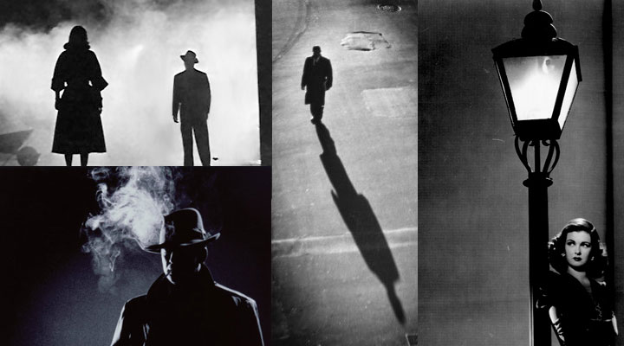
Film Noirs

Slide 40
Perspective Painting

Slide 41
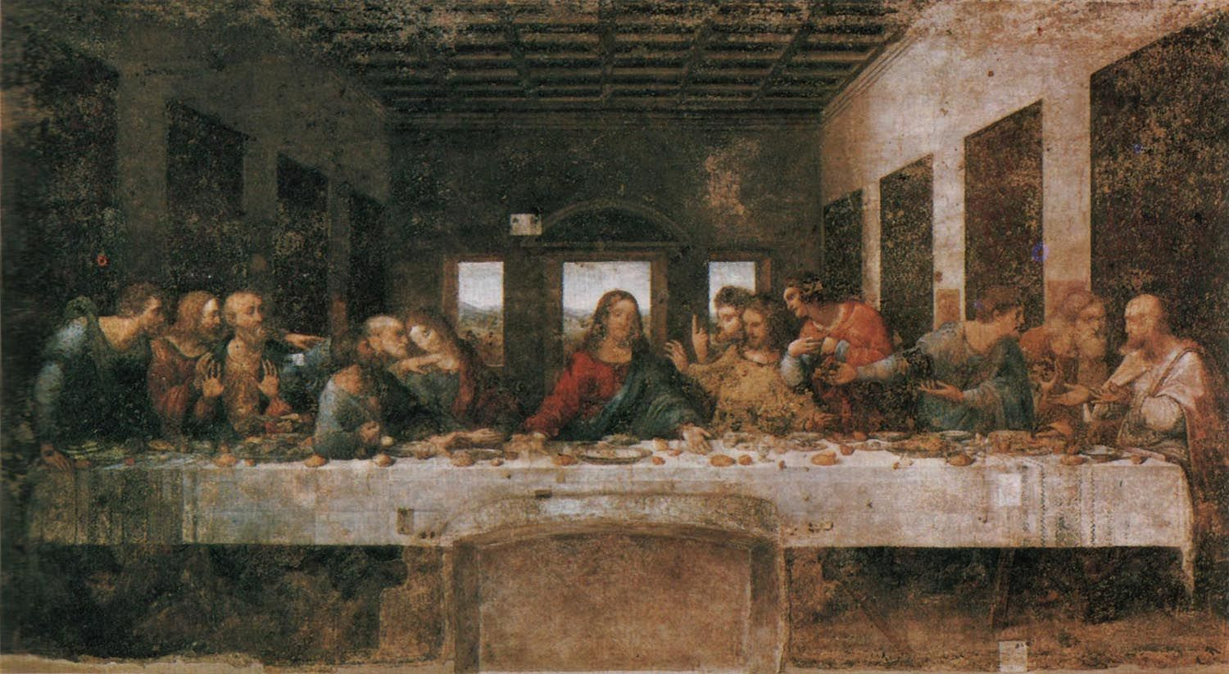
Perspective Painting

Slide 42
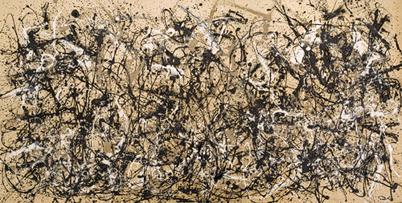
Jason Pollock

Slide 43
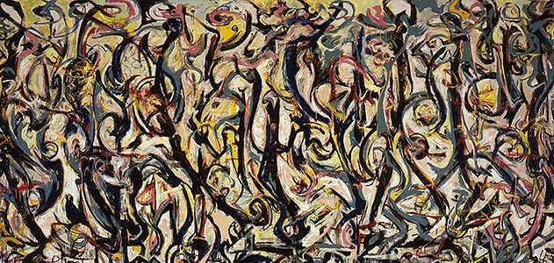
Jason Pollock

Slide 44
German Expressionists/ The Cabinet of Dr. Caligari

Slide 45
John Ford

Slide 46
John Ford

Slide 47
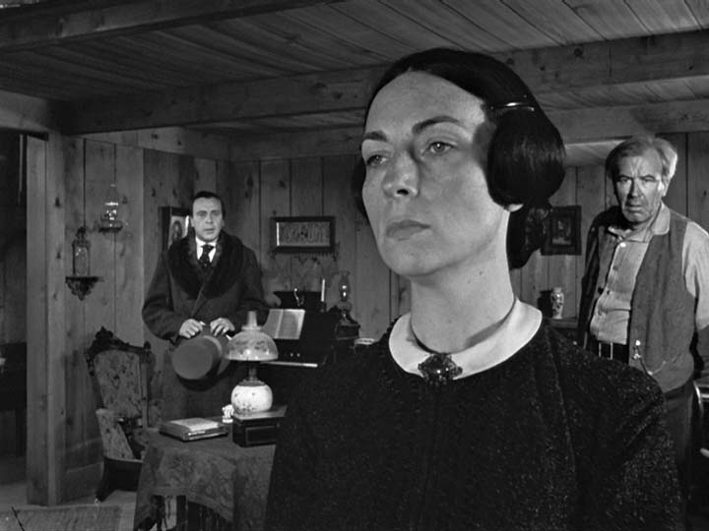
Deep Focus in Citizen Kane

Slide 48
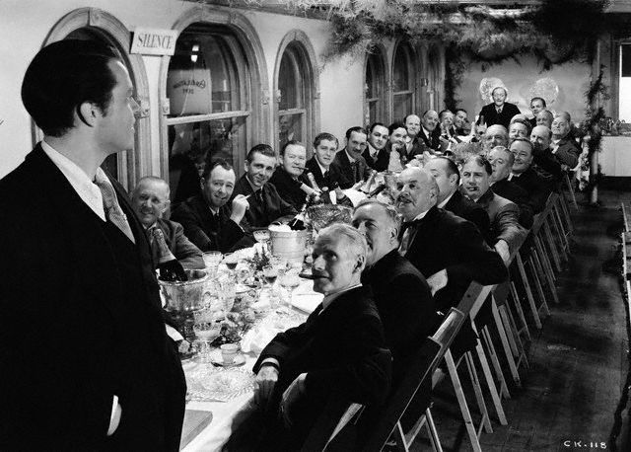
Deep Focus in Citizen Kane

Slide 49
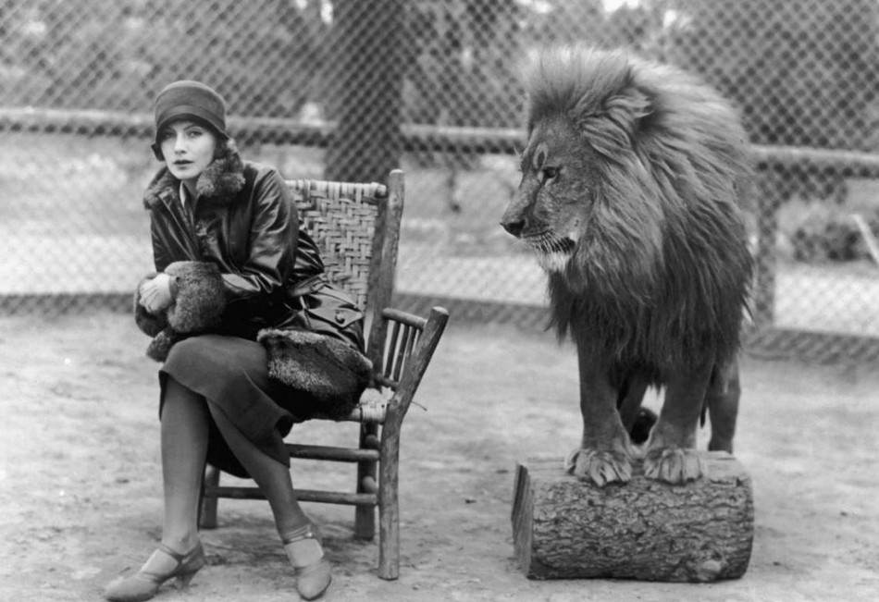
Greta Garbo

Slide 50
Greta Garbo 2

Slide 51
Dietrich

Slide 52
Dietrich 2

Slide 53
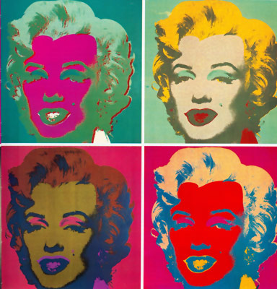
Andy Warhol

Slide 54
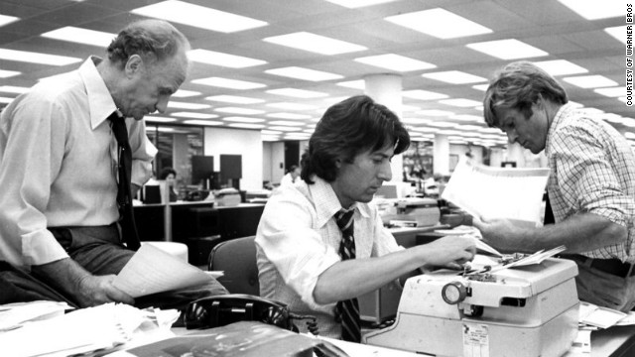
All the President’s Men

Slide 55
Establishing Shot

Slide 56
Overhead Shot

Slide 57
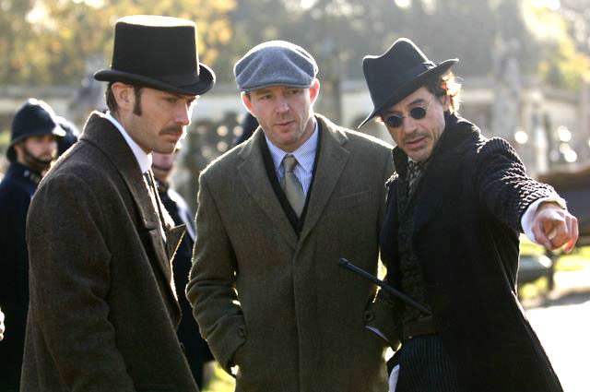
Eye level shot

Slide 58
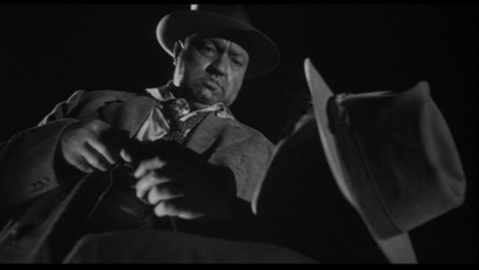
Low angle shot

Slide 59
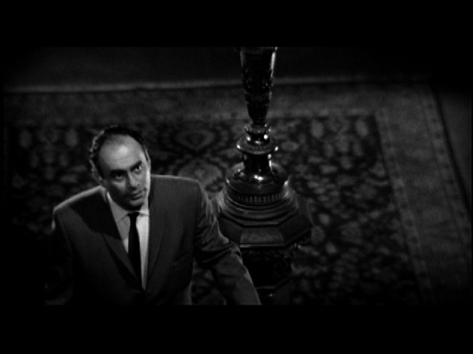
High angle shot

Slide 60
Tilt Shot

Slide 61
Pan Shot

Slide 62
Crane shot

Slide 63
Tracking Shot

Slide 64
The Rocking Horse Winner

Slide 65
Continuity Error

