Slide 1
BLASTULATION AND IT’S TYPES
Dr. Raju Thomas K.
Dept. of Zoology,
Mar Thoma College, Tiruvalla

Slide 2
Blastulation
The blastomeres in the early cleavage stage tend to assume a spherical shape. The whole embryo appear to posses a shape of mulberry. This stage is called Morula.
Further cleavage to morula terminates in Blastula. It can be defined as a hollow sphere of blastomeres, surrounding a cavity, the Blastocoel. The process of formation of blastula is called Blastulation.
The cellular layer surrounding the blastocoel is called Blastoderm.

Slide 3
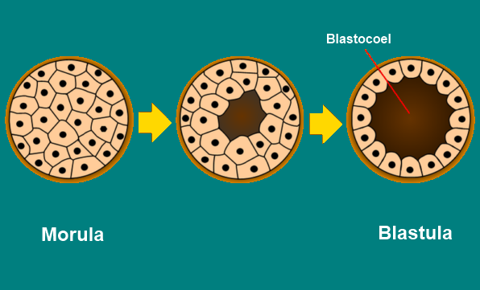

Slide 4
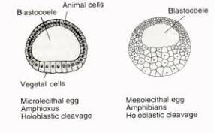
Types of Blastulae
Coeloblastula
Blastula containing large spacious blastocoel.
The blastula from holoblastic equal cleavage is called Equal Coeloblastula(Eg: Echinoderms, Branchiostoma) and that results from Holoblastic unequal cleavage is called Unequal Coeloblastula(Eg:Frog)

Slide 5
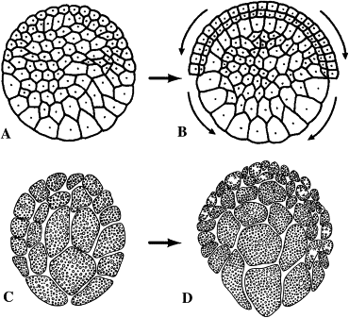
Stomoblastula
A blastula with a mouth like opening is called Stomoblastula.The blastula develops an opening leading to the blastocoel. This opening serves as the mouth through which the maternal tissue is engulfed for nutrition.
Eg: Sycon

Slide 6
Stereoblastula
Composed of an aggregate of larger sized and relatively lesser number of cells without or with extremely small blastocoelic space in the centre.
Eg: Insects, Nereis(Worm), Amphibians

Slide 7
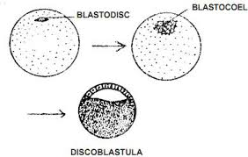
Discoblastula
Consists of a disc shaped mass of blastomers overlying a large yolk mass.
Result of Meroblastic discoidal cleavage.
Eg: Fishes, Reptiles and Birds

Slide 8
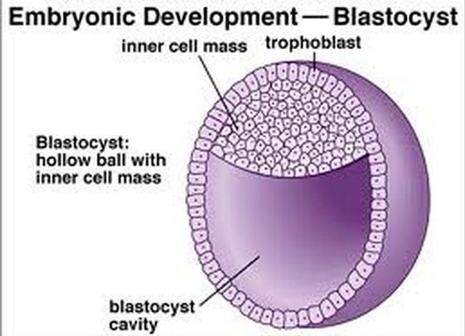
Blastocyst
Blastula Stage of mammals.
Consists of a hollow spherical blastula containing inner cell mass. Outer single layer of cells enclosing the blastocoel is Trophoblast.
Trophoblast helps in nutrition in developing embryo.

Slide 9
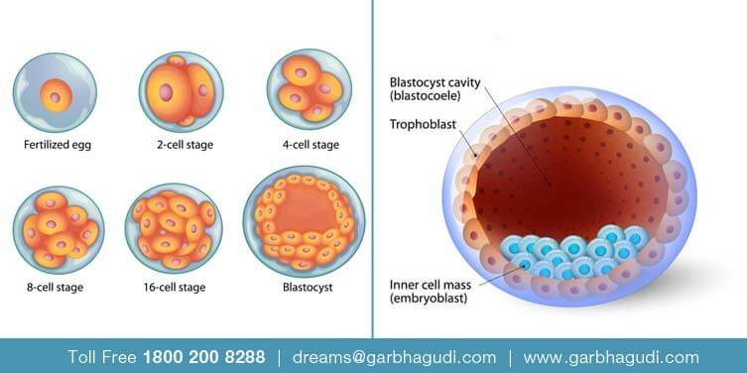

Slide 10
THANK YOU

