Slide 1
Thermometric Titrations
Dr. Reenamol. G
Assistant Professor
Department of Chemistry
Mar Thoma College, Tiruvalla

Slide 2
Thermometric Titrations
An analytical method in which one reactant (the titrant) is added continuously or stepwise to an adiabatic vessel containing another reactant.
Titrant is added at a known constant rate to a titrand until the completion of the reaction is indicated by a change in temperature.
The enthalpy change(s) of the ensuing reaction(s) causes a temperature change which, when plotted versus volume of titrant, may be used to find the titration endpoint(s).

Slide 3
The temp change is due to the heat evolved or absorbed between the analyte and reagent
The enthalpy ΔH = Δ G+ T Δ S
Temperature change during the titration is given by
ΔT= n ΔH/K, where n is the number of moles of reactant and K is the heat capacity of the system.
So, total change in temp is directly proportional to number of moles of the analyte

Slide 8
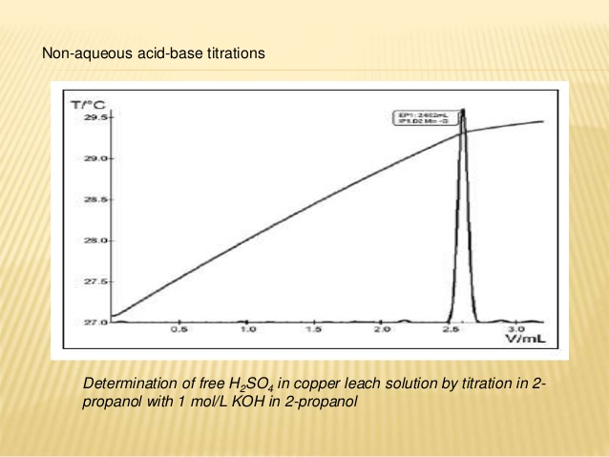

Slide 9
Redox reactions are normally strongly exothermic, and can make excellent candidates for thermometric titrations. In the classical determination of ferrous ion with permanganate, the reaction enthalpy is more than double that of a strong acid/strong base titration

Slide 11
2. The reaction of silver nitrate with chloride is strongly exothermic. For instance, the reaction enthalpy of Ag⁺ with Cl⁻ is a high −61.2 kJ/mol. This permits convenient determination of chloride with commonly available standard 0.1 mol/L AgNO₃.

Slide 12
Radiochemical methods
Activation analysis - Radioactivity is induced by irradiation
Physically introduce in to the sample ( eg, tracers)- A common method is Isotopic dilution method
Measure naturally occurring Radio activity
Radio active decay
Occurs with the emission of electromagnetic radiations
They are four type:
Alpha
Beta
Gamma
X-rays

Slide 13
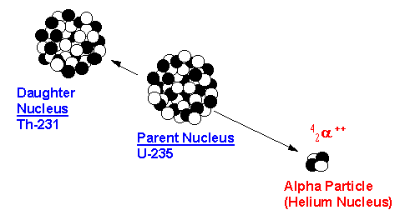
Alpha Radiation
Alpha particles contain two protons and two neutrons ( Helium nucleus)

Slide 14
Alpha Radiation
α has the same constitution as a helium nucleus
Alpha particles may be written as
They have a double positive charge and a mass of 4 u

Slide 15
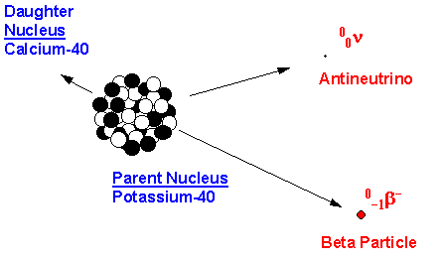
Beta- decay
Encountered with negatron, positron and electron capture
Beta-minus particles are electrons

Slide 16
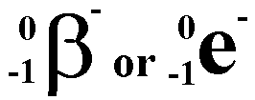
Beta-minus Radiation
β⁻ is produced when a neutron decays
Beta-minus particles may be written as
They have a negative charge and a mass of ¹/₁₈₀₀ u

Slide 17
Beta-minus Radiation
β⁻ is produced when a neutron decays
The surplus mass is released as kinetic energy in the β⁻ and as an antineutrino

Slide 18
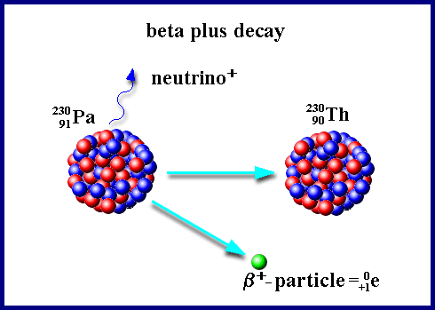
Beta-plus Radiation
β⁺ particles (positron) are positrons

Slide 19
Beta-plus Radiation
β⁺ is produced when a proton decays
The surplus mass is released as kinetic energy in the β⁺ and as a neutrino
Beta particles are not effective as alpha particles in producing ion pairs because of their small mass. Beta emission is characterised by production of particles with continuous spectrum.

Slide 20
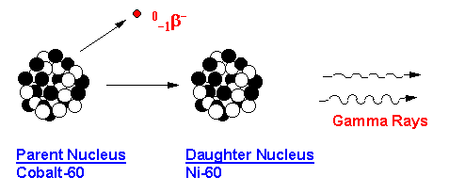
Gamma Radiation
Gamma rays are a form of electro-magnetic radiation

Slide 21
Gamma Radiation
γ release is often associated with α or β decay
Gamma rays remove energy from an unstable nucleus
It is a nuclear relaxation process

Slide 22
X-ray Emission
X rays are formed from
Electronic transitions in which outer electrons fills the vacancies of inner shell electrons
Internal conversion – electromagnetic interaction btwn an excited nucleus and an extra nuclear electron results in the ejection of electron with a KE, which creates a vacancy and this vacancy is filled by X-ray emission
It is an Electronic relaxation process

Slide 23
Penetrating power
α has a high mass
It is stopped by a few centimetres of air
β has a small mass
It is stopped by a few millimetres of aluminium
γ has zero mass
It is stopped by thick lead or concrete

Slide 24
Penetrating power
α has a high charge
It is dangerous if swallowed
β has a small charge
It is dangerous at medium range
γ has high energy
It is dangerous at distance

Slide 25
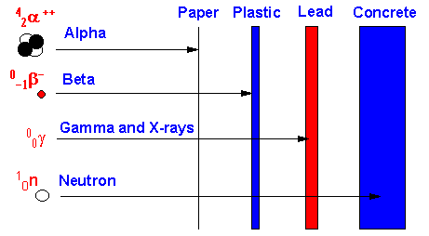
Penetrating power

Slide 26
Decay laws - alpha
When an isotope emits an α particle
Its nucleon number decreases by 4
Its proton number decreases by 2
For example:

Slide 27
Decay laws – beta-minus
When an isotope emits a β⁻ particle
Its nucleon number is unchanged
Its proton number increases by 1
For example:

Slide 28
Decay laws – beta-plus
When an isotope emits a β⁺ particle
Its nucleon number is unchanged
Its proton number decreases by 1
For example:

Slide 29
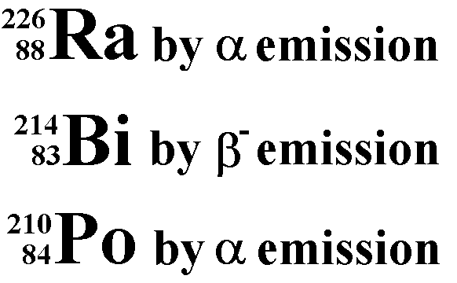
Decay laws
Try writing the nuclear equations for the decay of these isotopes

Slide 30
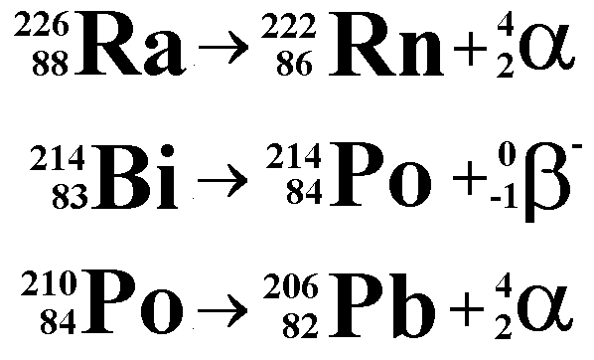
Decay laws
Answers

Slide 31
Radio active decay
-dN/dt= λN, first order rate
N = number of radio active nuclei at time ‘t’
λ = decay constant
On integration with a range of t=0 to t and N=N₀ to N,
lnN/N₀=- λt
N=N_{o}e^{- λt}
Half life :: It is time taken for the radioactive substance to reduce to half its activity. Mathematically it is given by:
t1/2 = ln 2/Decay Constant

Slide 32
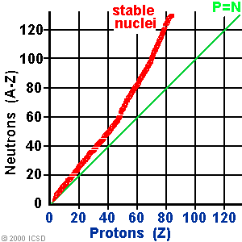
N v Z graphs
A Graph of neutron number (N) against proton number (Z) helps to predict whether an isotope will emit α or β⁻radiation

Slide 33
Measurement of alpha, beta and Gamma radiations
Instrumentation includes
Pulse height analysers record the alpha particle spectra
Gas filled chambers
Scintillation counters,
Semiconductor detector
Pulse height analysers- Consists of one or more pulse height selectors configured to get the spectra
A single channel analyser with a window of voltage 0.1 to 0.5 V
The signal from channel is accumulated in the memory location of analyser permits the recording of spectra
Measurement of Alpha:
Thin film deposits of apha emitting samples were prepared by electrodeposition or vapourisation
These deposits were counted in wondow-less ionization chamber
Immediately placed adjacent to a solid state detector

Slide 34
Measurement of beta particles
For low energy beta emitters like C-14, Sulpher-35, and tritium, liquid scintillation counters are used
Sample is dissolved in to a soln of scintillation compound
Vial containing sample is placed between the photomultiplier
Output from the tube is collected in to the detector which records the counts
Liquid scintillation helps to use this in clinical laboratories

Slide 35
Measurement of Gamma rays
Gamma rays can be detected and measured in essentially the same way as X-radiation.
Gas-filled transducers (Geiger tube)- Radiation enters the inert gas filled chamber and interact with the argon to produce photoelectrons. These PE produce a flood of electrons and cations which results in the current and is easy to measure
Scintillation counters – Consists of transparent crystal of Sodium iodide. As the radiation pass through the crystal, it lost its energy, released as photons of fluorescence. This light is transmitted to the photocathod tube and converted to electrical pulses which can be amplified and counted
Number of photons produced in each flash is equal to the energy of radiation
Semiconductor detectors - consists of Li drifted Si or Ge, fashioned as three layers of P-type --- central intrinsic zone---- n-type layer. When a voltage is applied across the crystal, a current pulse accompanies the absorption of photons and the size of pulse directly proportional to the energy of the photon. The photons pre amplified and detected.

Slide 36
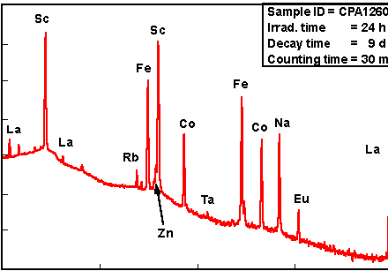
Gamma Ray Spectrometer
Gamma ray
+
Multichannel pulse-
height analyzer
Q
e
e
h
e
h
e
h
Voltage
supply
Germanium crystal
—
counts
display

Slide 37
What is Neutron Activation Analysis (NAA)?
NAA is a method for qualitative and quantitative determination of elements based on the measurement of characteristic radiation from radionuclides formed directly or indirectly by neutron irradiation of the material.
Detect the concentration of elements in a sample

Slide 38
NAA Method
For Example, Irradiate sodium (Na23) sample with neutrons
Neutron captured to give Na₂₄ in excited state
Jumps to lowest state of Na₂₄—> emits gamma-ray(s) (photon)
With 1/2 life 15 hours:
Na24 emits electron to become Mg₂₄ (beta decay)
And another gamma (photon)

Slide 39
NAA Categories
According to type of emitted γ-ray measured
If the Prompt γ-ray is the measured radiation
Prompt γ -ray neutron activation analysis (PGNAA)
The measurements take place during irradiation.
If Delayed γ-ray is the measured radiation.
Delayed γ -ray neutron activation analysis (DGNAA)
The measurements take place after a certain decay period.
(DGNAA) is more common.

Slide 40
I. PGNAA
The PGNAA technique is generally performed by using a beam of neutrons extracted through a reactor beam port.
Detectors are placed very close to the sample compensating for much of the loss in sensitivity due to flux.
The PGNAA technique is most applicable to elements
with extremely high neutron capture cross-sections (B, Cd, Sm, and Gd);
elements which decay too rapidly to be measured by DGNAA;
elements that produce only stable isotopes; or
elements with weak decay gamma-ray intensities.

Slide 41
II. DGNAA
DGNAA (sometimes called conventional NAA) is useful for the vast majority of elements that produce radioactive nuclides.
The technique is flexible with respect to time such that the sensitivity for a long-lived radionuclide that suffers from an interference by a shorter-lived radionuclide can be improved by waiting for the short-lived radionuclide to decay.
This selectivity is a key advantage of DGNAA over other analytical methods.

Slide 42
Instrumental vs. Radiochemical NAA
It is generally possible to simultaneously measure more than thirty elements in most sample types without chemical processing.
The application of purely instrumental procedures is commonly called instrumental neutron activation analysis (INAA) and is one of NAA's most important advantages over other analytical techniques.
If chemical separations are done to samples after irradiation to remove interferences or to concentrate the radioisotope of interest, the technique is called radiochemical neutron activation analysis (RNAA).

Slide 43
NAA procedure
Sampling;
Pre-irradiation sample treatment (such as cleaning, drying or ashing, pre-concentration of elements of interest or elimination of interfering elements, sub-sampling and packing);
Irradiation (and prompt gamma-ray counting in PGNAA);
Radiochemical separation (only in RNAA);
Radioactivity measurement;
Elemental concentration calculation;
Critical evaluation of results and preparation of the NAA report.

Slide 44
Irradiation
There are several types of neutron sources: reactors, accelerators, and radioisotopic neutron emitters.
Nuclear reactors with their high fluxes of neutrons offer the highest available sensitivities for most elements.
Most neutron energy distributions are quite broad and consist of three principal components (thermal, epithermal, and fast).

Slide 45
I. Thermal Flux
The thermal neutron component consists of low-energy neutrons (energies below 0.5 eV) in thermal equilibrium with atoms in the reactor's moderator.
At room temperature, the energy spectrum of thermal neutrons is best described by a Maxwell-Boltzmann distribution with a mean energy of 0.025 eV and a most probable velocity of 2200 m/s.
In most reactor irradiation positions, 90-95% of the neutrons that bombard a sample are thermal neutrons.

Slide 46
II. Epithermal Flux
The epithermal neutron component consists of neutrons (energies from 0.5 eV to about 0.5 MeV)
A cadmium foil 1 mm thick absorbs all thermal neutrons but will allow epithermal and fast neutrons above 0.5 eV
In a typical unshielded reactor irradiation position, the epithermal neutron flux represents about 2% the total neutron flux.
Both thermal and epithermal neutrons induce (n,gamma) reactions on target nuclei.
An NAA technique that employs only epithermal neutrons to induce (n,gamma) reactions by irradiating the samples inside either cadmium or boron shields is called epithermal neutron activation analysis.

Slide 47
III. Fast Flux
The fast neutron component of the neutron spectrum (energies above 0.5 MeV) consists of the primary fission neutrons which still have much of their original energy following fission.
Fast neutrons contribute very little to the (n,gamma) reaction, but instead induce nuclear reactions where the ejection of one or more nuclear particles - (n,p), (n,α), and (n,2n) - are prevalent.
In a typical reactor irradiation position, about 5% of the total flux consists of fast neutrons.
An NAA technique that employs nuclear reactions induced by fast neutrons is called fast neutron activation analysis (FNAA).

Slide 48
Neutron Energy Distribution

Slide 49
Advantages of NAA
Very low detection limits for 30–40 elements,
Simultaneous analysis for many elements
Chemical preparation rarely necessary
Non-destructive testing
Reliable quantitative results
Very high sensitivity (for some elements) In the field of coal, metals, sediments, ores, tissues, bone, synthetic fibers, alloys, bullets, crystals, gems, glass, hair, gunshot residues, moon samples, wheat spores, wood, tree leaves, tree needles, plastic films, rocks, salts, shells, skin, soil, sugar, teeth, minerals, metals.
NAA can be used to determine the presence of a variety of elements in a sample.
Examples include:
Mercury levels in tuna fish
Aluminum levels in finger nails
Gold levels in hair
Zinc levels in soil
Arsenic levels in plants

Slide 50
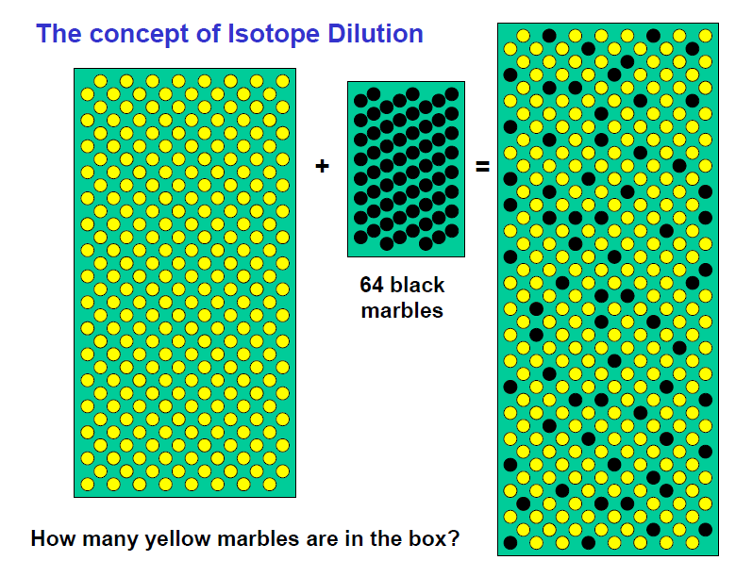
Isotope Dilution Analysis
In this method, a weighed quantity of radioactively tagged analyte having a known activity is added to a measured amount of sample.
The mixture is then mixed to homogeneity and then a fraction of the compound of interest is isolated and purified. The analysis is based upon the activity of the isolated fraction.

Slide 51
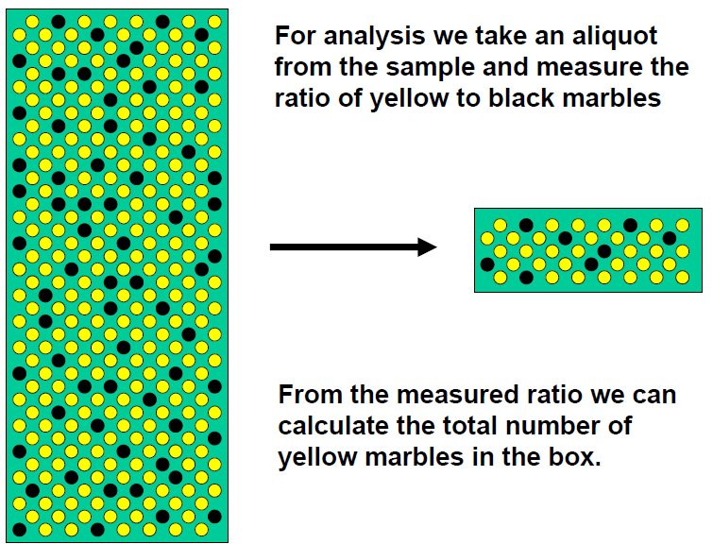

Slide 52
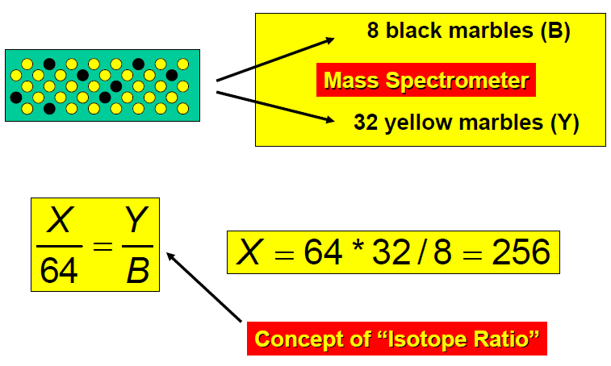
By counting the mass, the extend of dilution of the active material can be calculated

Slide 53
Applications of Isotope Dilution analysis
For the determination of compounds in organic and biochemistry
Eg, Vit B12, Sucrose, insulin, penicillin etc
Antibody- radio active antigen mixing like isotope dilution
For nonradioactive applications such as estimation of size of salmon population in Alaskan coastral stream

Slide 55
