Slide 1
Nature and Woman : A View of Mary Oliver’s Selected Poems through Ecofeministic Lens.
Presented by
Remi Cherian George
Assistant Professor
Department of English
Mar Thoma College, Tiruvalla.

Slide 2
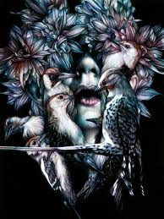
What is Ecofeminism?
Domination of both nature and women by men leads to ecological crisis
Synthesizes feminism and environmentalism
Coined by Françoise d’Eaubonne
Ascribes feminine values to nature
Capitalism and industrialism as products of patriarchy

Slide 3
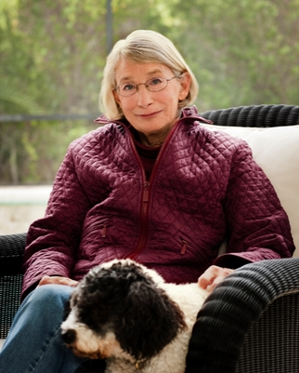
Mary Oliver as a Poet

Slide 4
An American poet born in 1935.
Winner of the prestigious Pulitzer Prize and the National Book Award.
First collection No Voyage and Other Poems was published in 1963.
Clear and poignant observances of natural world.
Poems as antidote to inattention and baroque conventions of everyday life.

Slide 5
Poems to be Analysed Ecofeministically
“Some Questions You Might Ask”
“Sleeping in the Forest”
“Aunt Leaf”
“The Honey Tree”
“The Fish”
“Such Singing in Wild Branches”
“Summer Day”

Slide 6
“Some Questions You Might Ask”
Questions man’s self centredness
Every living being on earth has a soul
Interconnected nature of living beings
Love and concern for creatures
Disseminates nature consciousness

Slide 7
“Sleeping in the Forest”
Comfort in the presence of nature
Reverence for nature
Self dissolving into the larger world
Earth as a nursing and soothing mother
Intense relation between earth and human being

Slide 8
“Aunt Leaf”
Endows the leaf with womanhood
Comradeship with the leaf
Laments at human civilization
Submerge and become a part of nature

Slide 9
“The Honey Tree”
Embodies a bear and displays its emotions
Sustaining and nourishing qualities of nature
Escape from human constraints
Represents freedom, celebration and empowerment

Slide 10
“The Fish”
Becoming one with the fish
Woman and fish as a victim and sacrificial object
Shared pain and sense of finality
Reciprocal relation between woman and nature

Slide 11
“Such Singing in Wild Branches”
Eco consciousness and Eco sensitivity
Attention to the world and life around
Merging of the soul with nature
Mind comforting and soul soothing experience
Reminder to exercise wisdom

Slide 12
“Summer Day”
Natural world of a grasshopper
Questions human conscience
The effectiveness of religion
Seeing nature in oneself as the best prayer to offer
Cooperate, collaborate and cohabit with nature

Slide 13
Conclusion
Female speaker’s engagement with nature
Drive home truths that are ineffable to human sensibilities
Mutual interaction and participation
Communion with nature as soul redemptive and life succouring
Earth as sacred and life as valuable

Slide 14
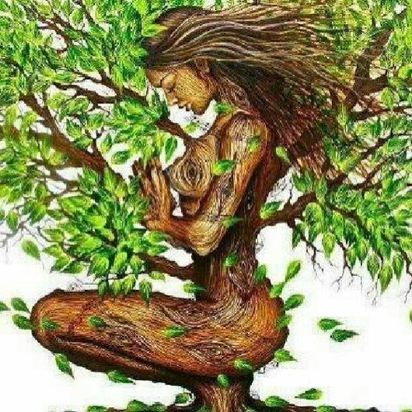
Thank You

