Slide 1
Amino Acids and Proteins
Dr. Reni George
Assistant Professor
Department of Chemistry
Mar Thoma College, Tiruvalla

Slide 2
Amino Acids
Amino acids
Are the building blocks of proteins.
Contain a carboxylic acid group and an amino group on the alpha (α) carbon.
Are ionized in solution.
Each contain a different side group (R).
R R
│ + │
H₂N—C —COOH H₃N—C —COO−
│ │
H H
ionized form

Slide 3
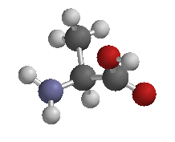
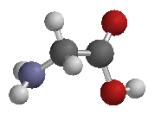
Examples of Amino Acids
H
+ │
H₃N—C—COO−
│
H glycine
CH₃
+ │
H₃N—C—COO−
│
H alanine

Slide 4
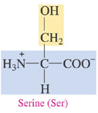
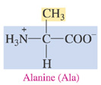
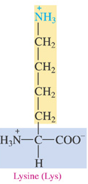
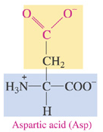
Types of Amino Acids
Amino acids are classified as
Nonpolar (hydrophobic) with hydrocarbon side chains.
Polar (hydrophilic) with polar or ionic side chains.
Acidic (hydrophilic) with acidic side chains.
Basic (hydrophilic) with
–NH₂ side chains.
Nonpolar Polar
Acidic
Basic

Slide 5
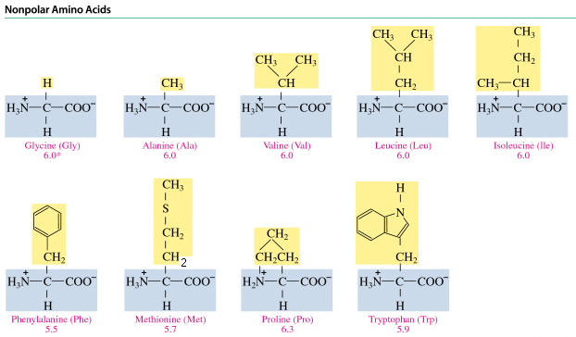
Nonpolar Amino Acids
A nonpolar amino acid has
An R group that is H, an alkyl group, or aromatic.

Slide 6
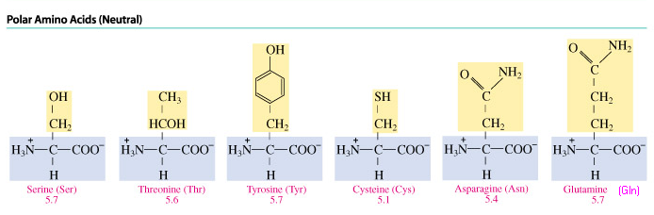
Polar Amino Acids
A polar amino acid has
An R group that is an alcohol, thiol, or amide.

Slide 7
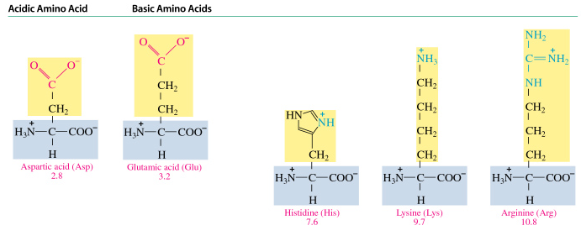
Acidic and Basic Amino Acids
An amino acid is
Acidic with a carboxyl R group (COO⁻).
Basic with an amino R group (NH₃⁺).
Basic Amino Acids

Slide 8
Fischer Projections of Amino Acids
Amino acids
Are chiral except for glycine.
Have Fischer projections that are stereoisomers.
That are L are used in proteins.
L-alanine D-alanine L-cysteine D-cysteine

Slide 9
Zwitterions and Isoelectric Points
A zwitterion
Has charged —NH₃⁺ and COO⁻ groups.
Forms when both the —NH₂ and the —COOH groups in an amino acid ionize in water.
Has equal + and − charges at the isoelectric point (pI).
O O
║ ₊ ║
NH₂—CH₂—C—OH H₃N—CH₂—C—O–
Glycine Zwitterion of glycine

Slide 10
Amino Acids as Acids
In solutions more basic than the pI,
The —NH₃⁺ in the amino acid donates a proton.
₊ OH–
H₃N—CH₂—COO– H₂N—CH₂—COO–
Zwitterion Negative ion
at pI pH > pI
Charge: 0 Charge: 1−

Slide 11
Amino Acids as Bases
In solutions more acidic than the pI,
The COO⁻ in the amino acid accepts a proton.
₊ H⁺ ₊
H₃N—CH₂—COO– H₃N—CH₂—COOH
Zwitterion Positive ion
at pI pH< pI
Charge: 0 Charge: 1+

Slide 12
pH and Ionization
H⁺ OH⁻
+ +
H₃N–CH₂–COOH H₃N–CH₂–COO– H₂N–CH₂–COO–
positive ion zwitterion negative ion
(at low pH) (at pI) (at high pH)

Slide 13
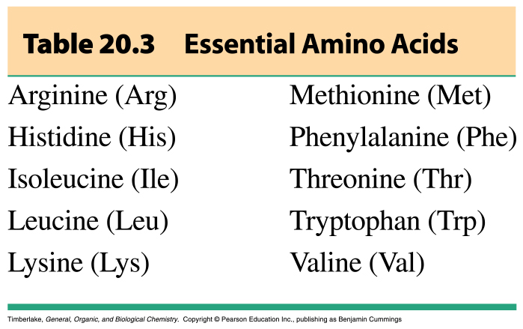
Essential Amino Acids
Essential amino acids
Must be obtained from the diet.
Are the ten amino acids not synthesized by the body.
Are in meat and
diary products.
Are missing (one or more) in grains and vegetables.
TABLE 19.3

Slide 14
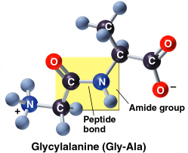
Formation of Peptides

Slide 15
The Peptide Bond
A peptide bond
Is an amide bond.
Forms between the carboxyl group of one amino acid and the amino group of the next amino acid.
O CH₃ O
+ || + | ||
H₃N—CH₂—C—O– + H₃N—CH—C—O–
O H CH₃ O
+ || | | ||
H₃N—CH₂—C—N—CH—C—O– + H₂O
peptide bond

Slide 16
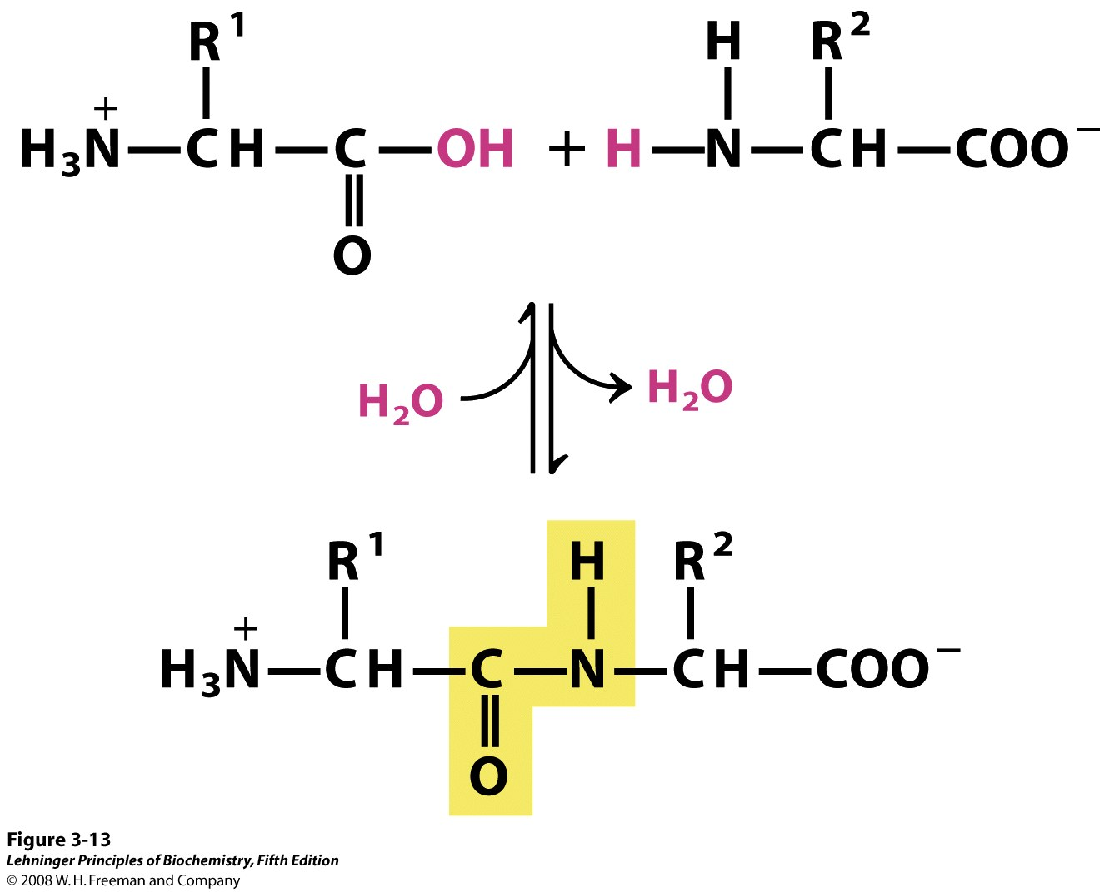
Peptides and Peptide bonds
Peptide bond in a di-peptide
“Peptides” are small condensation products of amino acids
They are “small” compared to proteins (di, tri, tetra… oligo-)

Slide 17
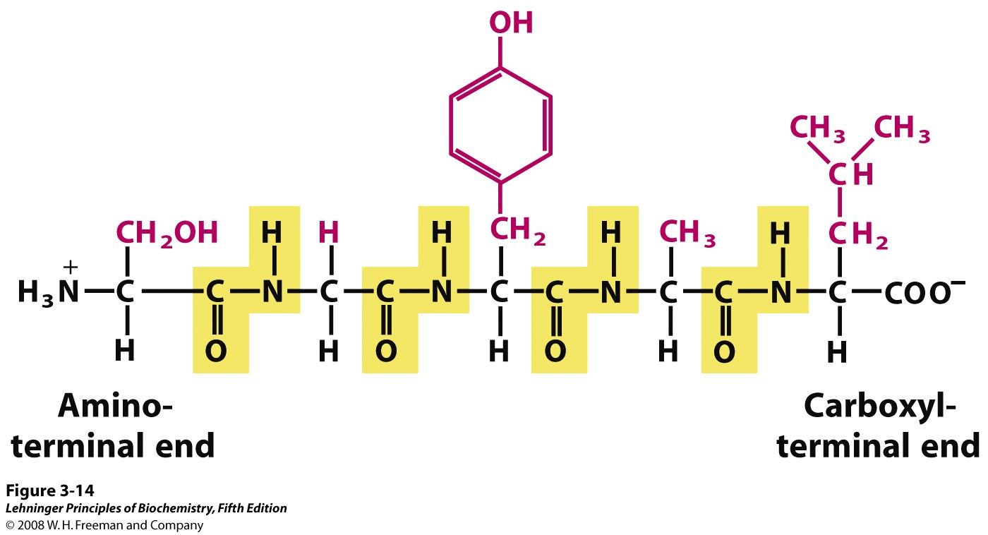
Peptide Ends are Not the Same
Numbering starts from the amino terminus
AA₁ AA₂ AA₃ AA₄ AA₅

Slide 18
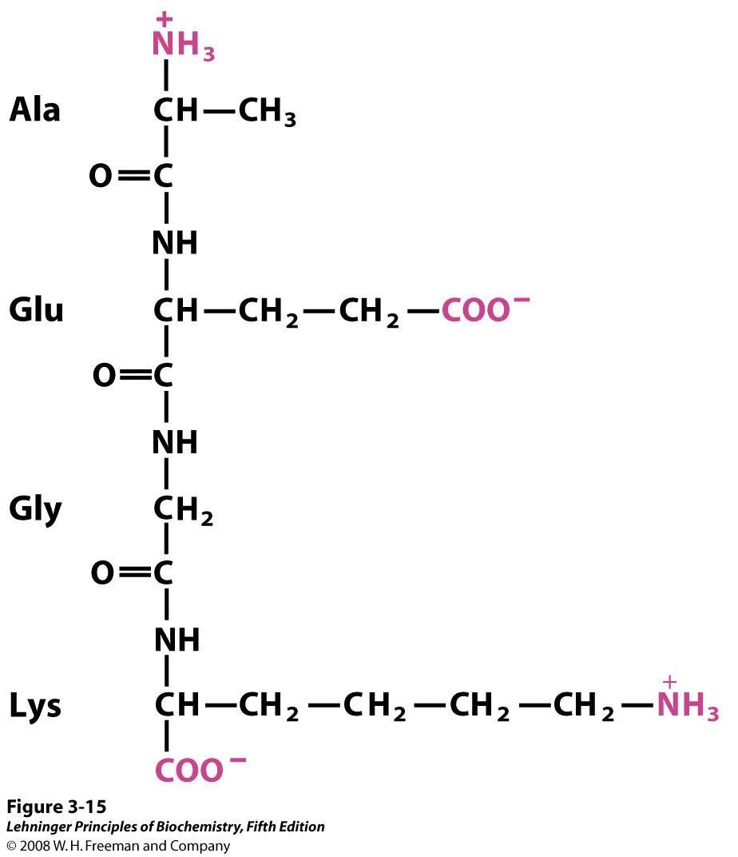
The Three Letter Code
Naming starts from the N-terminus
Sequence is written as:
Ala-Glu-Gly-Lys
Sometimes the one-letter code is used:
AEGK

Slide 19
Proteins are:
Polypeptides (covalently linked α-amino acids) + possibly –
    cofactors,
    coenzymes,
    prosthetic groups,
    other modifications
Cofactor is a general term for functional non-amino acid component
  Metal ions or organic molecules
Coenzyme is used to designate an organic cofactors
  NAD⁺ in lactate dehydrogenase
Prosthetic groups are covalently attached cofactors
  Heme in myoglobin

Slide 20
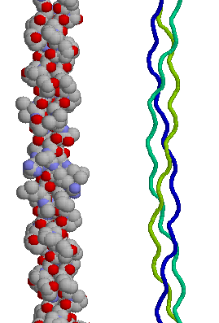
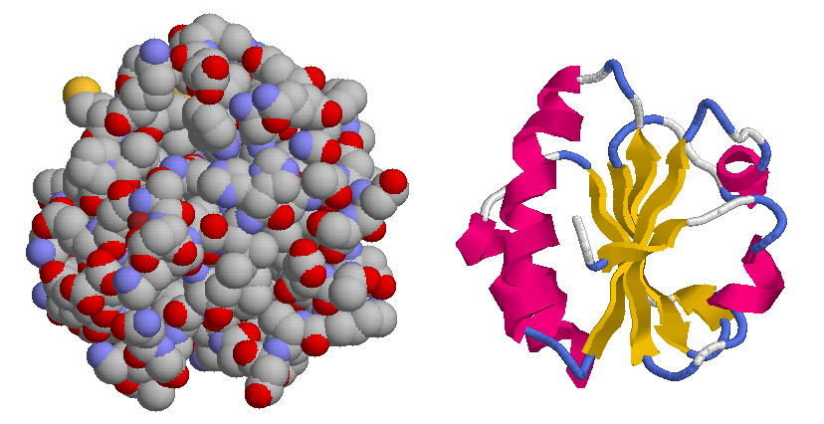
Protein Structure
Fibrous versus globular

Slide 21
Protein Structure
Proteins display up to four levels of structure
  Primary structure
    This is the amino acid sequence, which is unique for each protein
    This defines the covalent structure of a protein
  Secondary structure
    Regular, periodic structures, that involve hydrogen bonding between the backbone amides

Slide 22
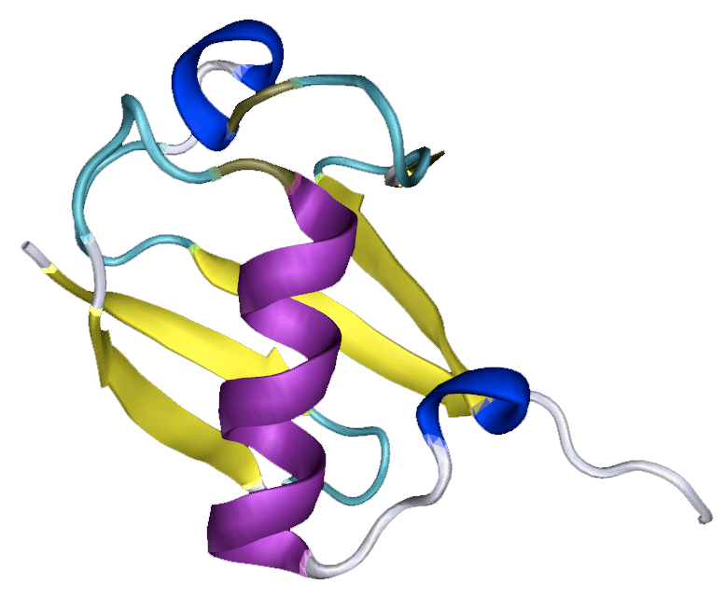
Protein Structure
  Tertiary structure
    The 3-dimensional fold of the polypeptide in which the backbone twists and turns its way through the folded structure of the protein.
    It involves interactions between the side chains of the amino acids and is highly influenced by the amino acid sequence.
The protein ubiquitin

Slide 23
Protein Structure
Primary Structure
  A protein’s amino acid sequence is referred to as its primary structure.
  Every protein has a unique primary structure that is determined by the gene for that protein.
  The primary structure defines the covalent structure of a protein.
Notes:
- Unless specifically indicated, it assumed that the sequence reads left to right from N- to C-terminal

Slide 24
Protein Structure
Primary Structure
Glycine
Gly
Alanine
Ala
Serine
Ser
Aspartic Acid
Asp
C-Terminus
N-Terminus
Phenylalanine
Phe
Leucine
Leu
Lysine
Lys
Gluctamine
Gln
Notes:
-

Slide 25
Protein Structure
Primary Structure
C-Terminus
N-Terminus
Glycylphenylalanylalanylleucylseryllysylaspartylglutamine
H₂H-Gly-Phe-Ala-Leu-Ser-Lys-Asp-Gln-COOH
Gly-Phe-Ala-Leu-Ser-Lys-Asp-Gln
GFALSKDQ
Notes:
- Unless specifically indicated, it assumed that the sequence reads left to right from N- to C-terminal

Slide 26
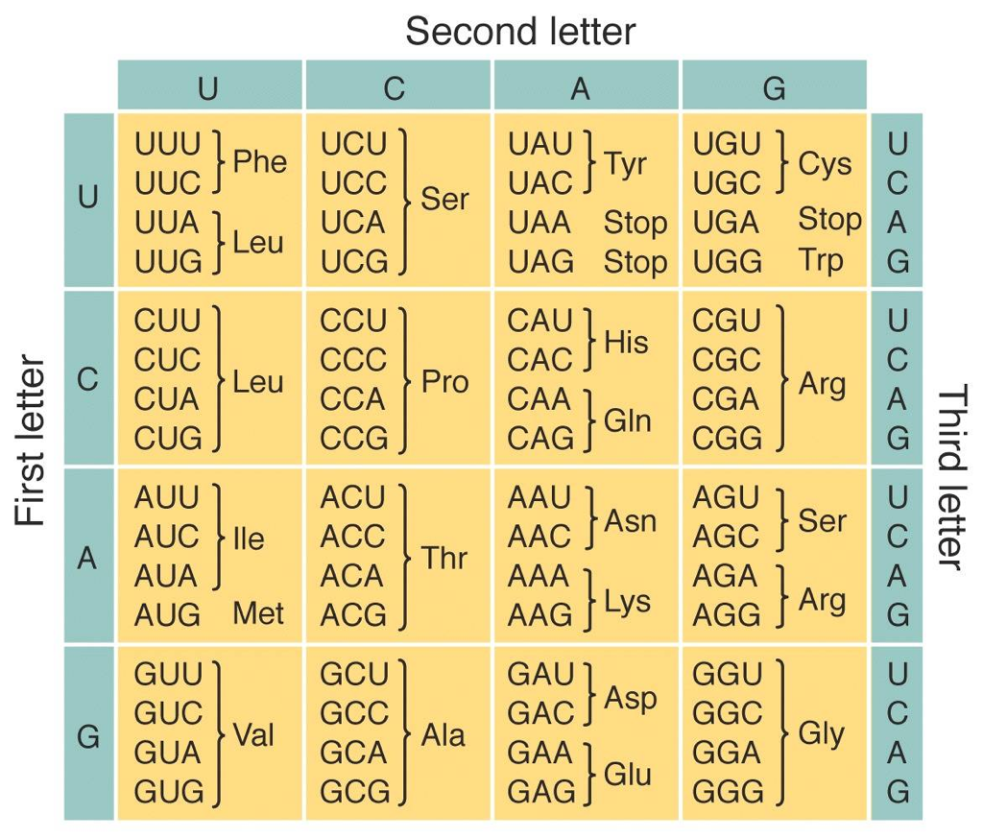
Protein Structure
Primary structure
  The Central Dogma
    DNA → mRNA → Polypeptide
The genetic code is used to match up the DNA/mRNA sequence to the sequence of amino acids in a protein
All living organisms use the same code
Notes:
- Unless specifically indicated, it assumed that the sequence reads left to right from N- to C-terminal

Slide 27
Protein Structure
  The functional diversity of proteins results from the large number of possible proteins that can be built using the 20 different amino acids
  Question: How much mass would it take to construct one molecule each of all of the possible polypeptides containing 100 amino acids residues?
    View the polypeptides as beads on a string, with one of 20 possible types of beads at each position.
o-o-o-o-o-o-o-o-o-o-o-o-o-o-o-o-o-o-o-o-o-o-o-o-o-o-o-o-o-o-o-o-o-o-o-o-o-o-o-o-o-o-o-o-o-o-o-o-o-o
Notes:
Average mass of an amino acid is 110 g/mol
Find average mass of one molecule. (100*110 g/mol)/6.022x10²³ molecules/mol) = 1.83x10⁻²⁰g
Find the number of molecules (20¹⁰⁰=1.27 x 10¹³⁰)
mass = 1.83x10⁻²⁰g* 1.27 x 10¹³⁰ ⁼ 2.31x10¹¹⁰ g

Slide 28
Protein Structure
Number of polypeptides (20¹⁰⁰)
1.26 x 10¹³⁰
Avg. Mass of each polypeptide
1.83 x 10⁻²² g
Total mass needed
2.32 x 10¹⁰⁸ g
Number of Earths
3.9 x 10⁸⁰
Number of Suns
1.2 x 10⁷⁵
Number of Galaxies
9.7 x 10²⁹

Slide 29
Protein Structure
Secondary structure
  The polypeptide backbone can take on regular shapes that allow the backbone amides to hydrogen bond to one another.
  The primary forms of secondary structure include
    α-helix
    β-sheet

Slide 30
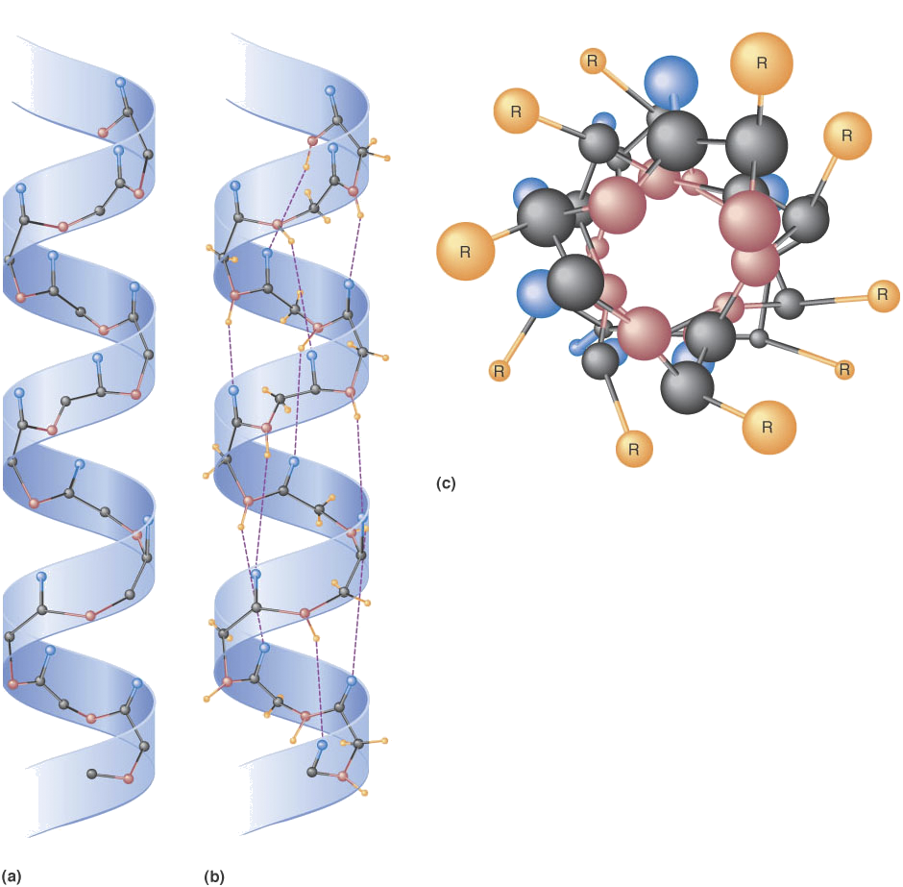
Protein Structure
Secondary structure
α-Helix
Notes:
- On the board: Describe how torsion angles are measured
- This structure allows the peptide amides to hydrogen bond to one another.
- Discuss the stability issue for these hydrogen bonds
- The side chains stick out away from the helix axis, so most can be accommodated

Slide 31
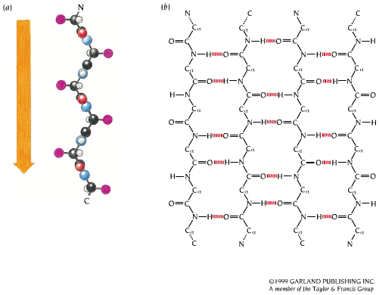
Protein Structure
Secondary Structure
β-Sheet
Notes:
- On the board: Describe how torsion angles are measured
- This structure allows the peptide amides to hydrogen bond to one another.
- Discuss the stability issue for these hydrogen bonds
- The side chains stick out away from the helix axis, so most can be accommodated

Slide 32
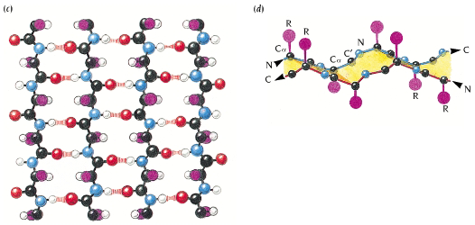
Protein Secondary Structure
Secondary Structure
Antiparallel β-Sheet
Notes:
- On the board: Describe how torsion angles are measured
- This structure allows the peptide amides to hydrogen bond to one another.
- Discuss the stability issue for these hydrogen bonds
- The side chains stick out away from the helix axis, so most can be accommodated

Slide 33
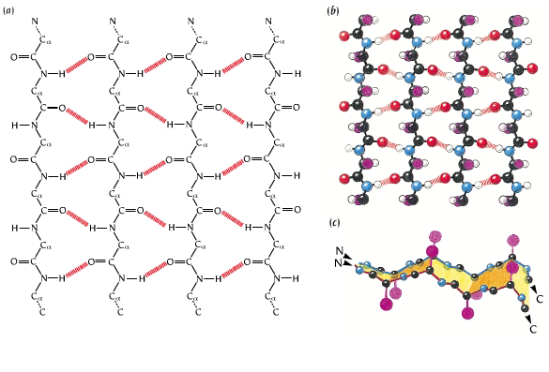
Protein Structure
Secondary Structure
Parallel β-Sheet
Notes:
- On the board: Describe how torsion angles are measured
- This structure allows the peptide amides to hydrogen bond to one another.
- Discuss the stability issue for these hydrogen bonds
- The side chains stick out away from the helix axis, so most can be accommodated
- Show examples from the Garret and Grisham Site for alpha helices and beta sheets

Slide 34
Protein Structure
Tertiary Structure
  The different elements of secondary structure come together to create the overall 3-dimensional structure of the protein
  The structure is stabilized primarily by side chain interactions and is highly influenced by the amino acid sequence (primary structure).
The protein ubiquitin

Slide 35
Protein Structure
Tertiary Structure
  This is usually the native, or biologically active, form of the protein.
  When placed in water, the polypeptide folds to maximize the number of nonpolar (hydrophobic) residues that are buried on the inside away from exposure to water.
The protein
ubiquitin

Slide 36
Protein Structure
Tertiary Structure
Explore the
tertiary structure
and the
secondary structure
of the protein ubiquitin
The protein
ubiquitin

Slide 37
Protein Structure
Tertiary Structure
  The tertiary structure is stabilized by the same non-covalent interactions that we looked at in determining boiling points and solubilites
    Charge/Charge interactions (Salt bridges)
    Ion/Dipole interactions
    Dipole/Dipole interactions
    Hydrogen bonding
    Hydrophobic interactions (nonpolor/water)
  There is one covalent interactions that stabilizes the tertiary structure of some proteins.
    Disufide bond

Slide 38
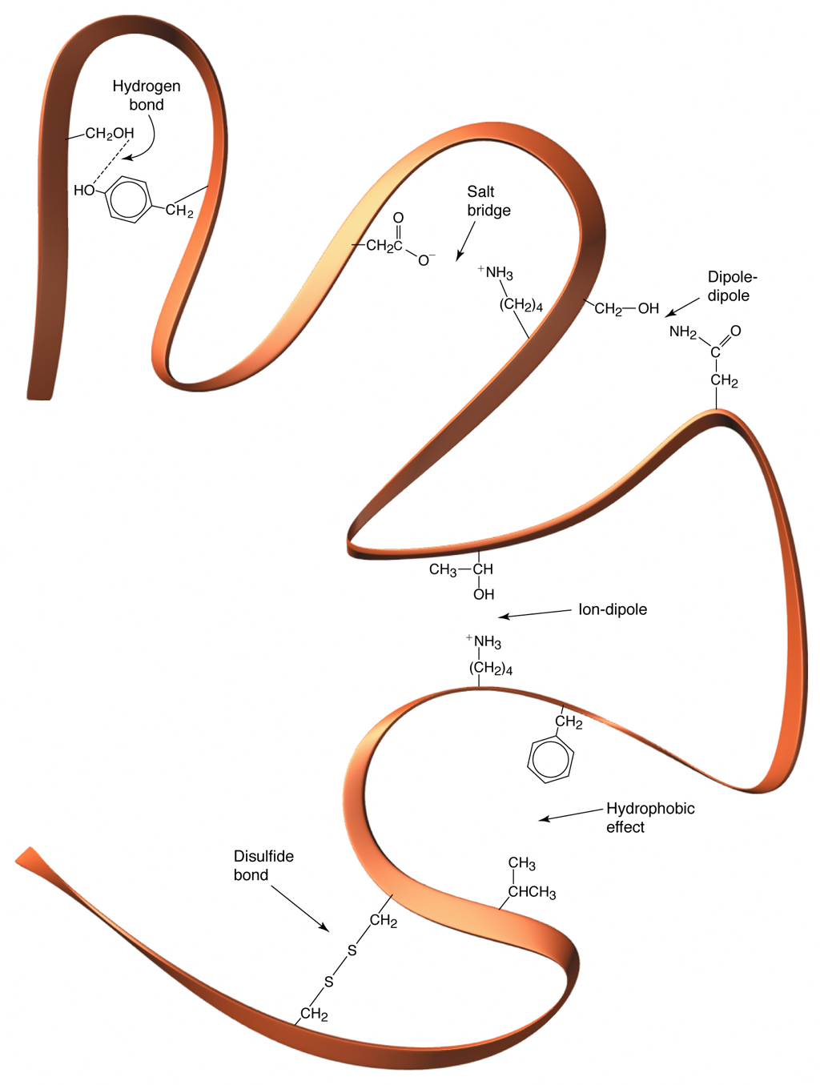
Protein Structure
Tertiary Structure
  The interactions that stabilize the tertiary structure.

Slide 39
Protein Structure
Quaternary Structure
  Some proteins contain multiple polypeptides
    Each peptide is called a subunit
  The polypeptides are held together by the same types of interactions that stabilize the tertiary structure.

Slide 40
Protein Structure: Primary and Secondary Levels

Slide 41
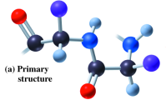
Primary Structure of Proteins
The primary structure of a protein is
The particular sequence of amino acids.
The backbone of a peptide chain or protein.
Ala─Leu─Cys─Met

Slide 42
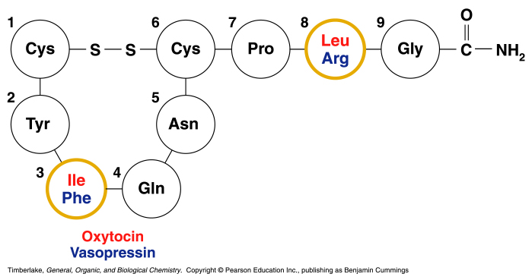
Primary Structures
The nonapeptides oxytocin and vasopressin
Have similar primary structures.
Differ only in the amino acids at positions 3 and 8.

Slide 43
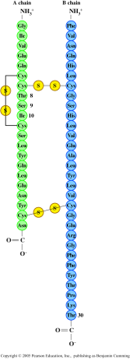
Primary Structure of Insulin
Insulin
Was the first protein to have its primary structure determined.
Has a primary structure of two polypeptide chains linked by disulfide bonds.
Has a chain A with 21 amino acids and a chain B with 30 amino acids.

Slide 44
Secondary Structure – Alpha Helix
The secondary structures of proteins indicate the
three-dimensional spatial arrangements of the
polypeptide chains.
An alpha helix has
A coiled shape held in place by hydrogen bonds between the amide groups and the carbonyl groups of the amino acids along the chain.
Hydrogen bonds between the H of a –N-H group and the O of C=O of the fourth amino acid down the chain.

Slide 45
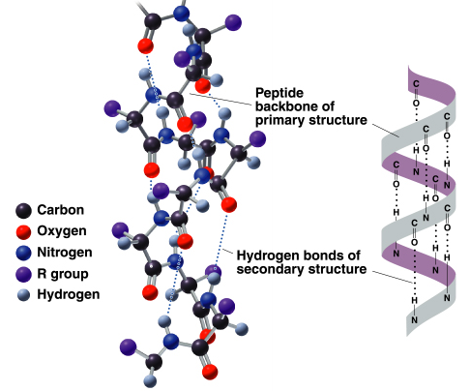
Secondary Structure – Alpha Helix

Slide 46
Secondary Structure – Beta Pleated Sheet
A beta-pleated sheet is a secondary structure that
Consists of polypeptide chains arranged side by side.
Has hydrogen bonds between chains.
Has R groups above and below the sheet.
Is typical of fibrous proteins such as silk.

Slide 47
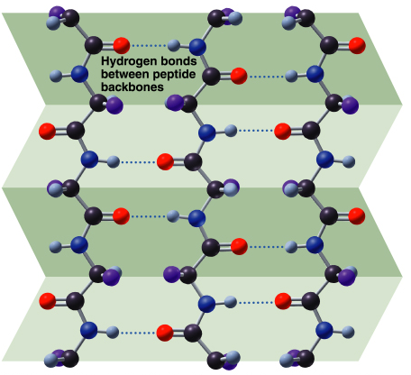
Secondary Structure: β-Pleated Sheet

Slide 48

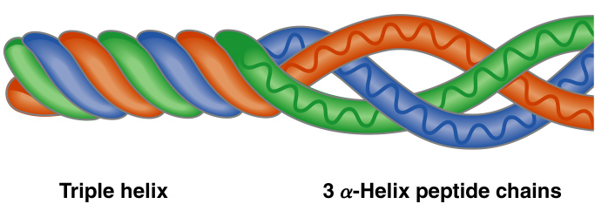
Secondary Structure: Triple Helix
A triple helix
Consists of three alpha helix chains woven together.
Contains large amounts glycine, proline, hydroxy proline, and hydroxylysine that contain –OH groups for hydrogen bonding.
Is found in collagen, connective tissue, skin, tendons, and cartilage.

Slide 49
Protein Structure: Tertiary and Quaternary Levels

Slide 50
Tertiary Structure
The tertiary structure of a protein
Gives a specific three dimensional shape to the polypeptide chain.
Involves interactions and cross links between different parts of the peptide chain.
Is stabilized by
Hydrophobic and hydrophilic interactions. Salt bridges.
Hydrogen bonds.
Disulfide bonds.

Slide 51
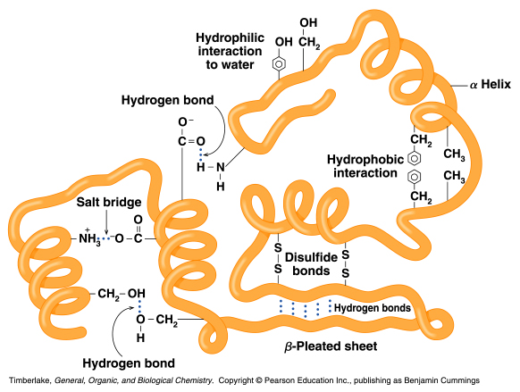
Tertiary Structure
The interactions of the R groups give a protein its specific three-dimensional tertiary structure.

Slide 52
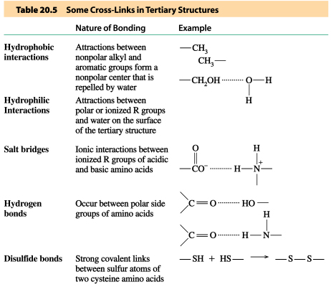
Tertiary Structure
TABLE 19.5

Slide 53
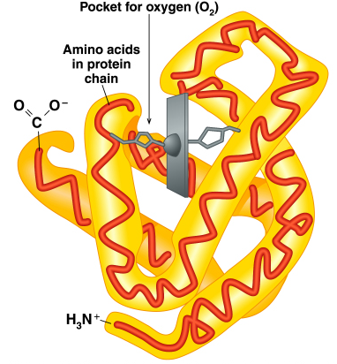
Globular Proteins
Myoglobin
Globular proteins
Have compact, spherical shapes.
Carry out synthesis, transport, and metabolism in the cells.
Such as myoglobin store and transport oxygen in muscle.

Slide 54
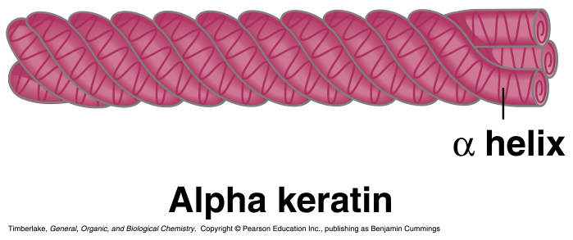
Fibrous Proteins
Fibrous proteins
Consist of long, fiber-like shapes.
Such as alpha keratins make up hair, wool, skin, and nails.
Such as feathers contain beta keratins with large amounts of beta-pleated sheet structures.

Slide 55
THE NUCLEIC ACIDS

Slide 56
Friedrich Miescher in 1869
Isolated what he called nuclein from the nuclei of pus cells
Nuclein was shown to have acidic properties, hence it became called nucleic acid

Slide 57
Two types of nucleic acid are found
Deoxyribonucleic acid (DNA)
Ribonucleic acid (RNA)

Slide 58
The distribution of nucleic acids in the eukaryotic cell
DNA is found in the nucleus
  with small amounts in mitochondria and chloroplasts
RNA is found throughout the cell

Slide 59
NUCLEIC ACID STRUCTURE
Nucleic acids are polynucleotides
Their building blocks are nucleotides

Slide 60
NUCLEOTIDE STRUCTURE
PHOSPATE
SUGAR
Ribose or Deoxyribose
BASE
PURINES | PYRIMIDINES
Adenine (A) Guanine(G) | Cytocine (C) Thymine (T) Uracil (U)
NUCLEOTIDE

Slide 61
Ribose is a pentose
C5
O
C4
C1
C3
C2

Slide 62
Spot the difference
RIBOSE
DEOXYRIBOSE
CH₂OH
CH₂OH
O
OH
O
OH
C
C
C
C
H
H
H
H
H
H
H
H
C
C
C
C
OH
OH
OH
H

Slide 63
THE SUGAR-PHOSPHATE BACKBONE
P
P
The nucleotides are all orientated in the same direction
The phosphate group joins the 3rd Carbon of one sugar to the 5th Carbon of the next in line.
P
P
P
P

Slide 64
ADDING IN THE BASES
P
G
P
C
The bases are attached to the 1st Carbon
Their order is important
It determines the genetic information of the molecule
P
C
P
A
P
T
P
T

Slide 65
DNA IS MADE OF TWO STRANDS OF POLYNUCLEOTIDE
Hydrogen bonds
P
G
C
P
P
C
G
P
P
C
G
P
P
A
T
P
P
T
A
P
P
T
A
P

Slide 66
DNA IS MADE OF TWO STRANDS OF POLYNUCLEOTIDE
The sister strands of the DNA molecule run in opposite directions (antiparallel)
They are joined by the bases
Each base is paired with a specific partner:
A is always paired with T
G is always paired with C
Purine with Pyrimidine
This the sister strands are complementary but not identical
The bases are joined by hydrogen bonds, individually weak but collectively strong

