Slide 1
Dendrimers And Dendritic Polymers
Dr. Shaji Varghese
Assistant Professor
Mar Thoma College
Tiruvalla

Slide 2
Dendritic polymers
Dendritic polymers are highly branched polymer structures, with complex secondary architectures and well-defined spatial location of functional groups.
They can be used in applications such as
Targeted-drug delivary
As macromolecular carriers
For catalysis
As sensors
For light harvesting
For surface engineering
As biomimetic materials

Slide 3
Dendritic polymers
Dendritic material comprise sub-classes such as
Dendrimers
Dendrons
Hyperbranced polymers
Dendrigraft polymers
Dendronized polymers
Dendritic polymers exhibit very different properties compared to their linear analogues.
Vogtle laboratory in 1978 reported the first concept of branching by repetitive growth.
The first dendrimers was synthesized by Tomalia and co-workers at Dow Chemical in the early 1980s in parallel with Newkome’s arborol systems.

Slide 4
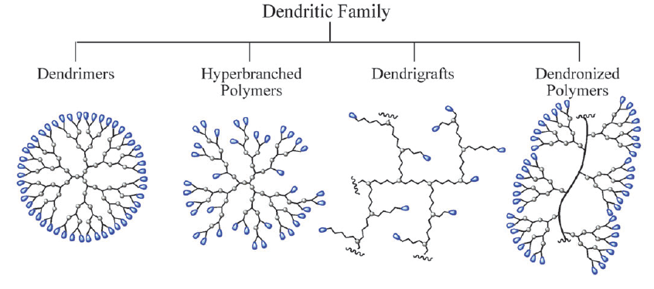
Dendritic Family
Dendrimers, dendrons, hyperbranched polymers, dendrigraft polymers and dendronized polymers.

Slide 5
Dendrimers
When dendritic polymers are perfectly branched they are either dendrons or dendrimers.
The dendrimers comprise a single core that is capped with layers of repeat units which are radially branched. Each layer is called a generation.
Much like proteins and natural products, dendrimers are near monodisperse with predictable molecular weights and nano-scale dimensions.
The unique properties of dendrimers are attributed to their globular structure, resulting from internal structures in which all bonds emerge radially from a central core, and a large number of end-groups are present at its surface.
Due to their globular structures, dendrimers can be seen as nano-particles with the ability of core encapsulation.
In contrast to linear polymers, these macromolecules do not entangle, showing unusual viscosity behaviours, such as low solution viscosity and functional groups can be either protected or exposed

Slide 6
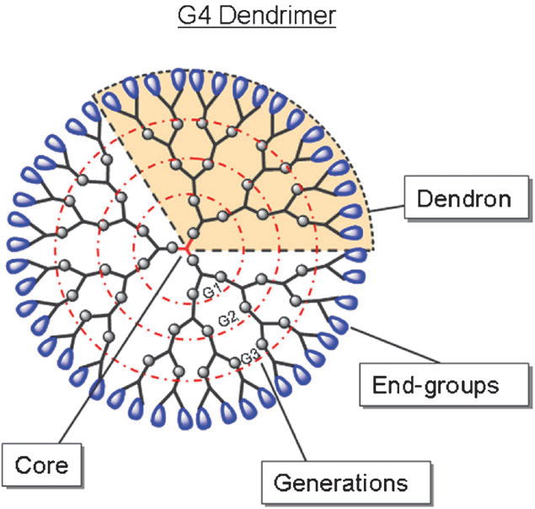

Slide 7
Dendrons
Dendrons which represent a structural component of the parent dendrimer, and are also monodisperse, wedged-shaped sections of a dendrimer.
A dendrimer is made up of a number (≥ 2) of dendrons. Each functional group in a dendritic core gives rise to one dendron.
Furthermore, dendrons of higher generations (≥ G4) can be seen as dendrimers but with an active core moiety that can be further functionalized.
Examples of dendrimers:
Tomalia-type poly(amidoamine) (PAMAM),
Frechet-type poly(benzylether),
Newkome’s arborol dendrimers,
Phosphorus-containing dendrimers
Poly(2,2-bis (hydroxymethyl) propionic acid) (P(bis-MPA) dendrimer).

Slide 8
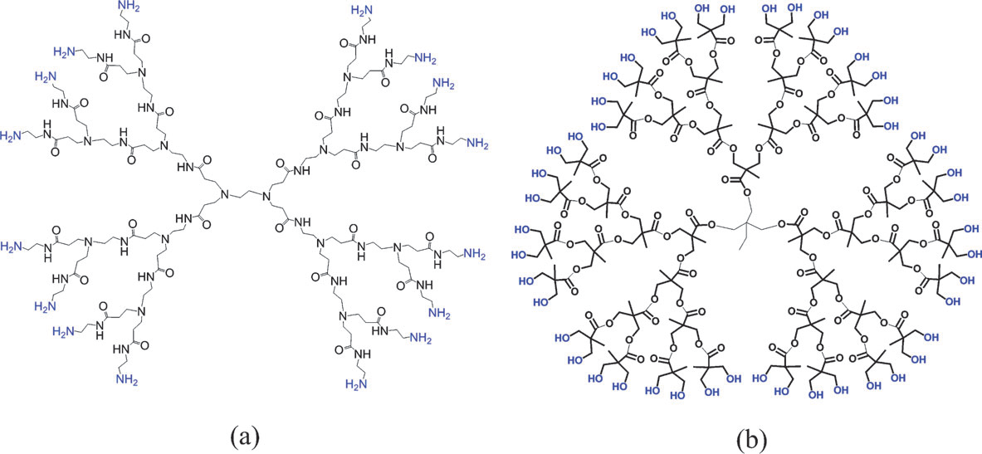
Fig. 3. a G-2 PAMAM dendrimer is shown (a) and a G4 P(bis-MPA) dendrimer (b).

Slide 9
Classification of Dendrimer
PAMAM Dendrimer
PAMAMOS Dendrimer
PPI Dendrimer
Tecto Dendrimer
Multilingual Dendrimer
Chiral Dendrimer
Hybrid Dendrimer Linear Polymer
Amphiphilic Dendrimer
Micellar Dendrimer
Multiple Antigen Peptide Dendrimer
Frechet Type Dendrimer

Slide 10
Methods of synthesis:
Syntheses of dendrimers and dendrons are tedious and require the skills of an organic chemist.
Traditional syntheses involve repetitive stepwise growth and deprotection/activation protocols with careful purification procedures between each generation.
Typically, 4th generation dendrimers require a minimum of 8 reaction steps making them very time consuming and generating significant waste.
Today’s dendrimers are synthesized utilizing either divergent or convergent growth.
Divergent Dendrimer Growth
This name comes from the way in which the dendrimer grows outwards from the core, diverging into space.
Starting from a reactive core, a generation is grown, and then the new periphery of the molecule is activated for reaction with more monomers.
The first synthesized dendrimers were polyamidoamines (PAMAMs).They are also known as starbust dendrimers.
Ammonia is used as the core molecule & In the presence of methanol, it reacts with methylacrylate and then ethylenediamine is added.

Slide 11
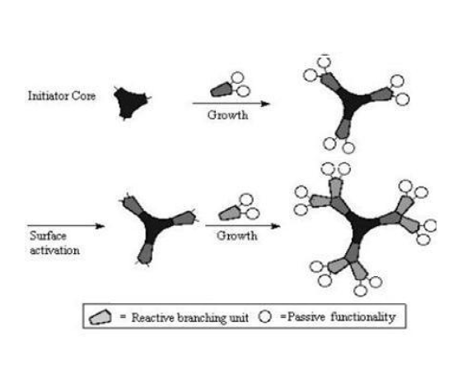
Divergent Dendrimer Growth

Slide 12
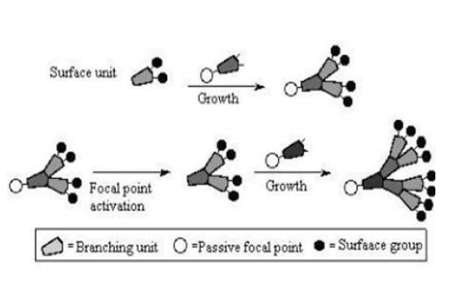
Convergent Dendrimer Growth
Convergent growth begins at what will end up being the surface of the dendrimer, and works inwards by gradually linking surface units together with more.
When the growing wedges are large enough, several are attached to a suitable core to give a complete dendrimer.
The advantages of convergent growth over divergent growth stem that only two simultaneous reactions are required for any generation-adding step

Slide 13
The convergent growth method has several advantages:
1. Relatively easy to purify the desired product and the occurrence of defects in the final structure is minimised.
2. Possible to introduce subtle engineering into the dendritic structure by precise placement of functional groups at the periphery of the macromolecules.
3. Approach does not allow the formation of high generation dendrimer because stearic problems occur in the reactions of the dendrons and the core molecule

Slide 14
APPLICATIONS
A. Pharmaceutical Application:
1. Dendrimers Drug Delivery: Targeted and Controlled Release Drug Delivery
Delivery of Anticancer Drugs by Dendrimers and Dendritic Polymers
Noncovalent Encapsulation of Drugs / Host –Guest Relation
Covalent Dendrimer–Drug Conjugates
2. Dendrimer as Solubility Enhancers
3. Cellular Delivery Using Dendrimer Carriers
4. Dendrimers as Nano-Drugs
5. Dendrimers in Photodynamic Therapy
6. Dendrimers in Gene Transfection
B. Non-Pharmaceutical Application:
1. Diagnostics
2. Dendritic Catalysts / Enzymes
3. Industrial Processes

Slide 15
Hyperbranched polymers
Hyperbranched polymers are highly branched polymer structures, much like the dendrimers, but contain imperfections in the branching points due to their traditional one-pot synthesis.
Hyperbranched polymers contain dendritic sites as well as linear sites with the structure being poorly controlled in comparison to dendrimers.
Their typical polydispersities are about 2 or higher.
Hyperbranched polymers possess many of the properties of dendrimers, have a multitude of end-groups, a globular structure and they show similar viscosity behaviours attributable to significantly reduced entanglements.
Hyperbranched polymers have much higher solubility than their linear analogues due to their many end-groups.
Examples of hyperbranched polymers:
Boltorns (P(bis-MPA) hyperbranched polymer)
Hybranet (poly(ester amide))
poly(phenylenes)

Slide 16
Synthesis
Hyperbranched polymer can be synthesized with most known polymer-forming reactions of AB_{x}-monomers, such as condensation reactions, cationic procedures, ring-opening polymerization and free radical polymerization, in which the A-functionality can only react with the B-functionality and vice versa.
The most common synthetic method involves polycondensation of AB_{x}-monomers in the presence of a catalyst, such as an acid or transesterification reagent.
To achieve a more controlled polycondensation process, another approach involves utilizing a core molecule in the polymerization of AB_{x}-monomers. By adding a functional core, with a By-functionality, the polydispersity of the final polymer is lowered and the molecular weight can better be controlled.

