Slide 1
VICTORIAN ERA
(1837- 1901)
Sheeba K Jacob
Assistant Professor
Department of English
Mar Thoam College, Tiruvalla

Slide 2
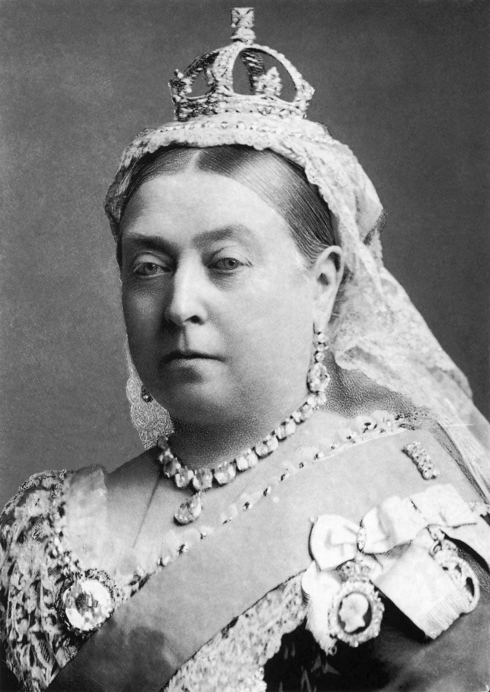
QUEEN VICTORIA.

Slide 3
The Golden Era
Victoria (Alexandrina Victoria; 24 May 1819 – 22 January 1901) was Queen of the United Kingdom of Great Britain and Ireland from 20 June 1837 until her death.
She inherited the throne aged 18 when her uncle, King William IV, died.
Victoria's reign of 63 years and seven months was longer than that of any of her predecessors and is known as the Victorian era.
It was a period of industrial, cultural, political, scientific, and military change within the United Kingdom, and was marked by a great expansion of the British Empire.

Slide 4
Literature of the Victorian (Novel)
While in the preceding Romantic period, poetry had been the dominant genre, it was the novel that was most important in the Victorian period.
Charles Dickens (1812–1870) dominated the first part of Victoria's reign.
William Thackeray's (1811–1863) most famous work Vanity Fair appeared in 1848.
Brontë sisters, Charlotte (1816–55), Emily (1818–48) and Anne (1820–49), also published significant works in the 1840s.
A major later novel was George Eliot's (1819–80) Middlemarch (1872)

Slide 5
The major novelist of the later part of Queen Victoria's reign was Thomas Hardy (1840–1928), whose first novel, Under the Greenwood Tree, appeared in 1872.

Slide 6
POETRY
Elizabeth Barret Browning and Robert Browning conducted their love affair through verse and produced many tender and passionate poems.
Both Matthew Arnold and Gerard Manley Hopkins wrote poems which sit somewhere in between the exultation of nature of the romantic Poetry and the Georgian Poetry of the early 20th century.
Arnold's works anticipate some of the themes of these later poets, while Hopkins drew inspiration from verse forms of Old English poetry such as Beowulf.

Slide 7
The Victorians loved the heroic, chivalrous stories of knights of old and they hoped to regain some of that noble, courtly behaviour and impress it upon the people both at home and in the wider empire.
The Pre-Raphaelite Brotherhood also drew on myth and folklore for their art, with Dante Gabriel Rossetti contemporaneously regarded as the chief poet amongst them, although his sister Christina is now held by scholars to be a stronger poet.

