Slide 1
Classification of Reptilia Dr. Shilly Elizabeth David

Slide 2
Salient Features
Reptiles means Creeping
Study of reptiles →Herpetology
• Cold- blooded(poikilothermic)
• Exoskeleton of epidermal scales, scutes or bony plates
• Skin dry, horny & non glandular (without skin glands)
• Heart with 2 auricle and incompletely divide ventricle except crocodiles whose have 4 chambers
• R.B.C. oval and nucleated, Cloaca present
• Uricotelic excretion
Notes:
Cold-blooded creatures take on the temperature of their surroundings. They are hot when their environment is hot and cold when their environment is cold.

Slide 3
Salient Features
• Metanephric kidney
• Cranial nerves 12 pairs (except snakes which have 10 pairs)
• Sexual dimorphism present
• Fertilization internal
• Eggs are cleidoic (large yolky eggs with calcareous shell)
• No larval stage
• Amniotes (all 4extra-embryonic membranes present)
Notes:
Kidney- pronephros , mesonephros, metanephros

Slide 4
Classification
Class
Reptilia
Subclass
Anapsida
Subclass
Parapsida
Subclass
Diapsida
Subclass
Synapsida
Order
Chelonia
(Chelone)
Order
Ichthyosauria
(Ichthyosaurus)
Order
Therapsida
(Cynognathus)
Order
Rhynchocephalia
(Sphenodon)
Order
Squamata
(Chamaelon, Draco)
Order
Crocodilia
(Crocodile)

Slide 5
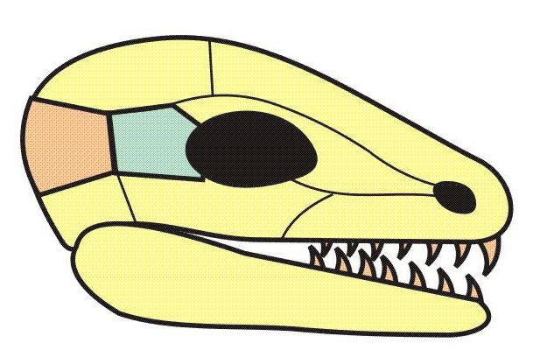
Skull Structure
The number and arrangement of holes (temporal fenestrae) behind the eye socket in the skull
With respect to these fenestrae, the most important bones are the POST-ORBITAL and SQUAMOSAL bones.
PO = post orbital bone
SQ = squamosal bone
SQ
PO

Slide 6
Anapsids
The anapsid condition is characterized by the absence of temporal fenestrae.
It is the most primitive skull type among the amniotes.
SQ
PO

Slide 7
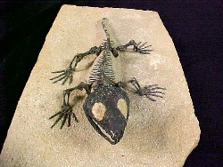
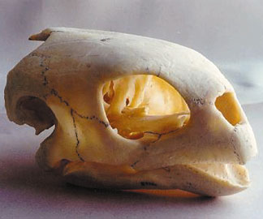
Anapsids
The anapsid group includes the earliest “stem” reptiles (captorhinomorphs) and perhaps the turtles and tortoises (although this is debated).
captorhinomorph
turtle

Slide 8
Synapsids
The synapsid condition is characterized by a single opening below the junction of the post orbital and squamosal bones.
SQ
PO

Slide 9
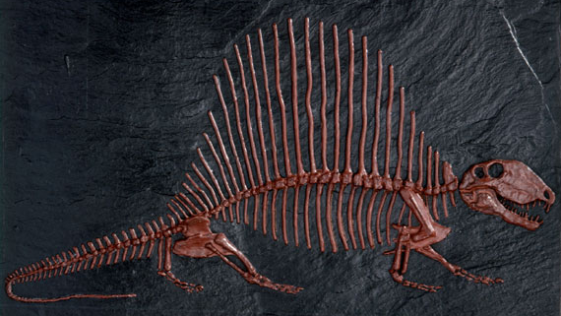
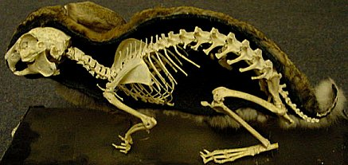
Synapsids
The synapsid group includes:
Pelycosaurs
(sail-backed reptiles)
Mammal-like reptiles
(therapsids)
True mammals

Slide 10
Diapsids
The diapsid condition is characterized by two openings – one above and one below the junction of the post orbital and squamosal bones.
SQ
PO

Slide 11
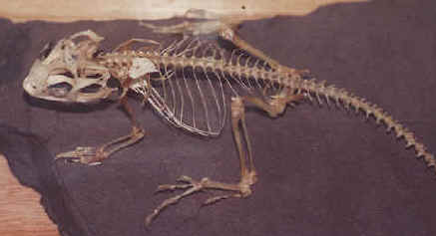
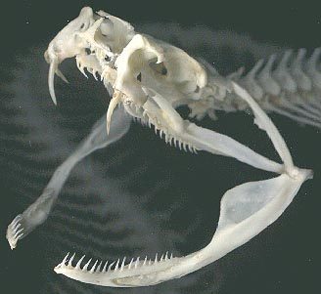
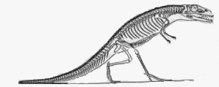
Diapsids
The diapsid group is represented by all of the archosaurs (“ruling reptiles”).
The diapsid group includes:
Snakes and lizards
Thecodonts (ancestral group of higher diapsids)

Slide 12
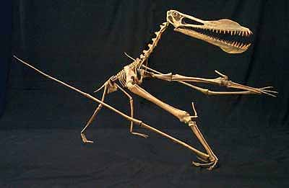
Diapsids
Crocodilians (e.g. crocodiles and alligators)
Pterosaurs (flying reptiles)

Slide 13
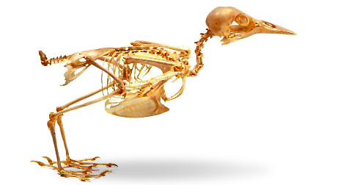
Diapsids
Dinosaurs
Birds

Slide 14
Euryapsids
The euryapsid condition is characterized by a single opening above the junction of the post orbital and squamosal bones.
SQ
PO

Slide 15
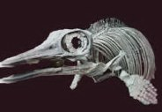
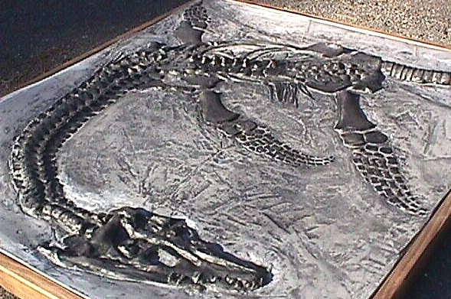
Euryapsids
The euryapsid group is represented by extinct “marine reptiles”
Ichthyosaurs
Plesiosaurs

Slide 16
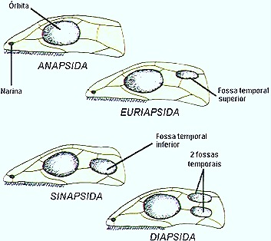
To Summarize:
Anapsids:
(no temporal fenestrae)
Turtles/tortoises
Captorhinomorphs
Synapsids:
(one temporal fenestra
low in skull)
Pelycosaurs
Mammal-like reptiles
Mammals
Diapsids:
(two temporal fenestrae)
Lizards and snakes
Crocodilians
Pterosaurs
Dinosaurs,
Birds
Euryapsids:
(one temporal fenestra
high in skull)
Icthyosaurs
Plesiosaurs

Slide 18
Amphicoelous vertebrae are found in fishes apoda and some urodela. These have concavities on anterior as well as posterior side of the centrum.
Procoelous vertebrae are concave on the anterior side and convex on the posterior side of the centrum.
Ex. Anura and reptiles.
Opisthocoelous vertebrae possess concavity on the posterior side while convexity on the anterior side, as found in salamanders, parrots and ungulates.
Heterocoelous : Vertebral centra in which the anterior end is convex in vertical section, concave in horizontal section, while the posterior end has these outlines reversed.
Acoelous : Acoelous vertebrae are flattened on both ends. Mammals are acoelous.
Notes:
Amphiplatyan vertebrae are flat on both sides as in mammals.
Heterocoelous vertebrae are characteristic of birds neck. The centrum is saddle-shaped to provide high flexibility to the neck movement.
Biconvex vertebra is the 9th vertebra of frog, whose centrum has convexity on both anterior as well as posterior side.
Platycoelous vertebrae are flat on the anterior side and concave on the posterior side and are found in some mammals.
Coeloplatyan vertebrae are also found in some mammals. They are concave on the anterior side and flat on the posterior side.

Slide 19
Subclass I Anapsida
Oldest known reptiles; turtles and extinct Permian (around 270 million years ago) forms
Completely ossified skeleton and body usually covered with scales or horny plates; once the dominant land animals
Primitive reptile having no opening in the temporal region of the skull; all extinct except turtles
Sternum absent
Jaws lack teeth and covered by horny sheath
Limbs are paddle like or normal
Eggs laid on land, parental care by females
Notes:
The sternum, or breastbone , is a flat bone at the front center of the chest

Slide 20
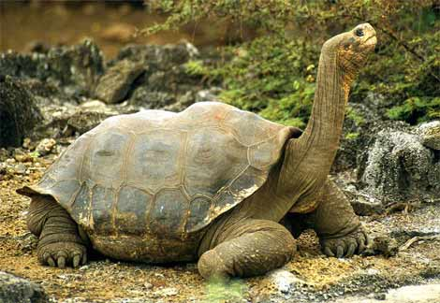
Chelone
Chelonia mydas → Green turtles because of the color of the flesh
Largest turtles ranging from 71 to 153 cms ; Weight - 205 kg
Limbs - paddle-like for swimming
Head small compared to their body size
Males larger than females and the tail is longer, extending well beyond the shell
Eggs laid in pits
Carapace olive to brown/ black, depending on the geographic location of the species. Green turtles cannot pull their heads inside of their shells.
Two sub-species - Chelonia mydas mydas & Chelonia mydas agassizii.
Notes:
Reproduction
Males and females mature between 10 and 24 years. The breeding season depends on the latitude. Internal fertilization takes place when the male and female copulate. This is the only time there is vocalization. Like many species, there is male competition. One male may try to bite another male who is copulating with a female. Mating occurs underwater or on the surface about one kilometer from the shore. Sometimes the female will retain enough sperm to nest several times that year. Nesting occurs every three to six years. When the female is ready to lay her eggs, she leaves the water, crawls onto the sand and starts digging for hour and hours until her flippers will not allow her to dig deeper. She then lays 100 to 200 eggs. This group of eggs is called a clutch. She covers them with sand to protect them from the sun, heat, and predators. Pacific green turtles lay fewer eggs than Atlantic green turtles. The gestation period is 40 to 72 days, depending on the location. http://animaldiversity.org/accounts/Chelonia_mydas/

Slide 21
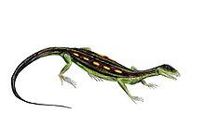
Subclass II Parapsida
This group includes extinct forms.
Includes Ichthyosaurs, Araeoscelis of Mesozoic era
Reptiles with one temporal fossa, placed high up on the skull- Supratemporal fossa, seen below postorbital & supra temporal bone & above parietal
Araeoscelis
Notes:
Mesosoic
A geological era lasting from 248 to 65 million year ago, comprising the Triassic* , Jurassic* and Cretaceous* periods.
Araeoscelis , small terrestrial reptile, was around 60 centimetres (2.0 ft) long, and superficially resembled a modern lizard.
Cretaceous
A period of geological time from 140 to 70 million years ago during which chalk was being laid down. The last period of the Mesozoic* era.

Slide 22
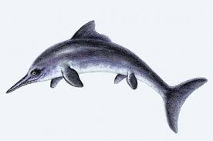
Subclass II Parapsida
Ichthyosaur means 'fish-lizard’, extinct about 90 million years ago
Body – spindle shaped, head produced into a long snout
Sharp teeths on upper and lower jaws
Limbs modified into paddles & exhibited hyperdactyly and hyperphalangy
Dorsal & caudal fins present
Notes:
hyperphalangy (addition of joints to toes) and hyperdactyly (addition of extra digits)
Araeoscelis , small terrestrial reptile, was around 60 centimetres (2.0 ft) long, and superficially resembled a modern lizard.
Cretaceous
A period of geological time from 140 to 70 million years ago during which chalk was being laid down. The last period of the Mesozoic* era.

Slide 23
Subclass III Diapsida
Consists of supratemporal and infratemporal fossae & separated by postorbital & squamosal bones
Infratemporal fossa bounded below by quadratojugal & jugal bones
3 orders
Squamata
Rhynchocephalia
Crocodilia
Notes:
hyperphalangy (addition of joints to toes) and hyperdactyly (addition of extra digits)
Araeoscelis , small terrestrial reptile, was around 60 centimetres (2.0 ft) long, and superficially resembled a modern lizard.
Cretaceous
A period of geological time from 140 to 70 million years ago during which chalk was being laid down. The last period of the Mesozoic* era.

Slide 24
Subclass III Diapsida
Order I : Rhynchocephalia
Body small, elongated & lizard like
Diapsid skull, quadrate fixed
Skin covered with scales & mid dorsal spines
Limbs pentadactyl, clawed & burrowing
A parietal foramen with vestigial pineal eyes present
Represented by only one genus→ Sphenodon (Tuatara)
Notes:
hyperphalangy (addition of joints to toes) and hyperdactyly (addition of extra digits)
Araeoscelis , small terrestrial reptile, was around 60 centimetres (2.0 ft) long, and superficially resembled a modern lizard.
Cretaceous
A period of geological time from 140 to 70 million years ago during which chalk was being laid down. The last period of the Mesozoic* era.

Slide 25
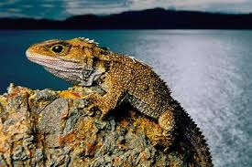
Subclass III Diapsida
Sphenodon
Rare group of reptiles that inhabit the rocky islands off the coast of New Zealand
They are cold-blooded and live in cool habitats
They grow slowly and have a long lifespan. Reproduce until 60 years old
Posses two rows of teeth in their upper jaw and one row of teeth in their lower jaw
Diapsid skull with two temporal openings, Amphicoelous vertebrae
Prominent parietal eye on top of head
First tuatara appeared during the Mesozoic Era,
about 220 million years ago & has not undergone
much evolutionary changes → Living fossil
Notes:
hyperphalangy (addition of joints to toes) and hyperdactyly (addition of extra digits)
Araeoscelis , small terrestrial reptile, was around 60 centimetres (2.0 ft) long, and superficially resembled a modern lizard.
Cretaceous
A period of geological time from 140 to 70 million years ago during which chalk was being laid down. The last period of the Mesozoic* era.

Slide 26
Subclass III Diapsida
Order II : Squamata
Diapsid skull, quadrate movable
Skin → horny epidermal scales, shields, spines
Elongated & cylindrical body, long tail
Limbs present/ absent
Vertebrae → procoelous, Ribs → single headed
Cloacal opening is a transverse slit
Male → Double copulatory organ
Represented by Lizards & Snakes
Notes:
Squamates (Squamata) are the most diverse of all the reptile groups, with approximately 7400 living species. Squamates include lizards, snakes, and worm-lizards.
Two characteristics that unite the squamates. The first is that they shed their skin periodically. Some squamates, such as snakes, shed their skin in one piece. Other squamates, such as many lizards, shed their skin in patches. In contrast, non-squamate reptiles regenerate their scales by other means—for example crocodiles shed a single scale at a time while turtles do not shed the scales that cover their carapace and instead add new layers from beneath.
The second characteristic shared by squamates is their uniquely jointed skulls and jaws, which are both strong and flexible. The extraordinary jaw mobility of squamates enables them to open their mouths very wide and in doing so, consume large prey. Additionally, the strength of their skull and jaws provides squamates with a powerful bite grip.

Slide 27
Subclass III Diapsida
Lacertilia – Lizards → There are more than 4,500 species of lizards alive today, making them the most diverse group of all squamates.
Members of this group include chameleons, geckos, night lizards, blind lizards, skinks
Ophidia- Snakes → There are about 2,900 species of snakes alive today. Members of this group include pythons, vipers, blind snakes, mole vipers and sunbeam snakes.
Snakes have no limbs but their legless nature doesn't stop them from being among the world's most formidable reptilian predators.
Notes:
Two characteristics that unite the squamates. The first is that they shed their skin periodically. Some squamates, such as snakes, shed their skin in one piece. Other squamates, such as many lizards, shed their skin in patches. In contrast, non-squamate reptiles regenerate their scales by other means—for example crocodiles shed a single scale at a time while turtles do not shed the scales that cover their carapace and instead add new layers from beneath.
The second characteristic shared by squamates is their uniquely jointed skulls and jaws, which are both strong and flexible. The extraordinary jaw mobility of squamates enables them to open their mouths very wide and in doing so, consume large prey. Additionally, the strength of their skull and jaws provides squamates with a powerful bite grip.

Slide 28
Thank You

