Slide 1
LICHEN FLORA OF LOW LAND AREA OF PATHANAMTHITTA DISTRICT
Prof. Sonia Anna Zachariah
Assistant Professor
Department of Chemistry
Mar Thoma College, Tiruvalla

Slide 2
Research problem
Air quality determines the growth of lichens and lichens in turn serve as good indicators of pollution
The area with the cleanest air is supposed to be rich in lichen diversity

Slide 3
LICHEN FLORA OF LOW LAND AREA OF PATHANAMTHITTA DISTRICT

Slide 4
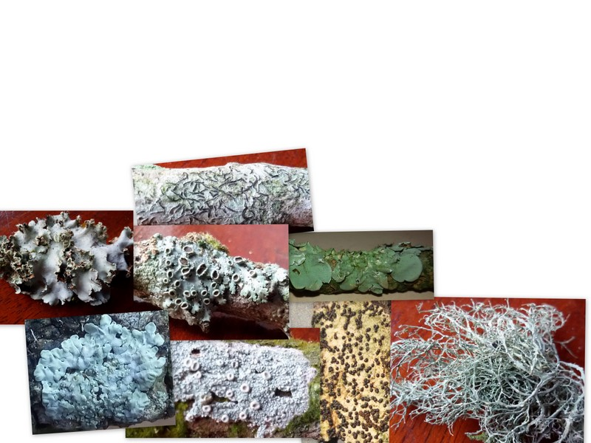
LICHENS : THE SUCCESSFUL SYMBIONTS WITH PHYCOBIONT AND MYCOBIONT PARTNERS
DIFFERENT GROWTH FORMS
Crustose
Foliose
Fruticose

Slide 5
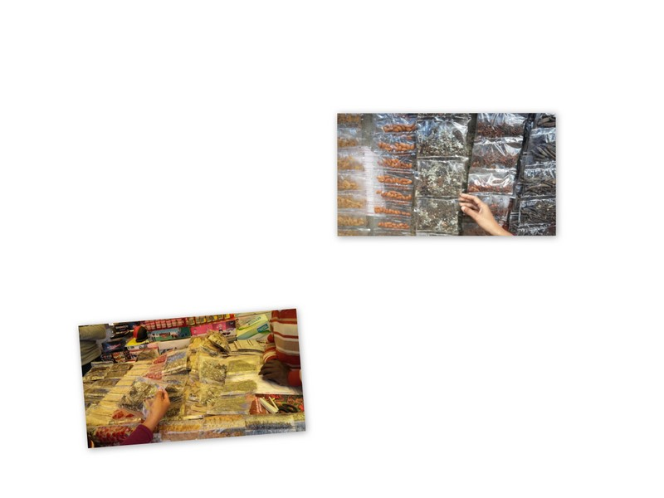
SIGNIFICANCE
Pioneer Colonizers
Pollution Indicators
Food and Fodder
Source of Medicines
Industry

Slide 6
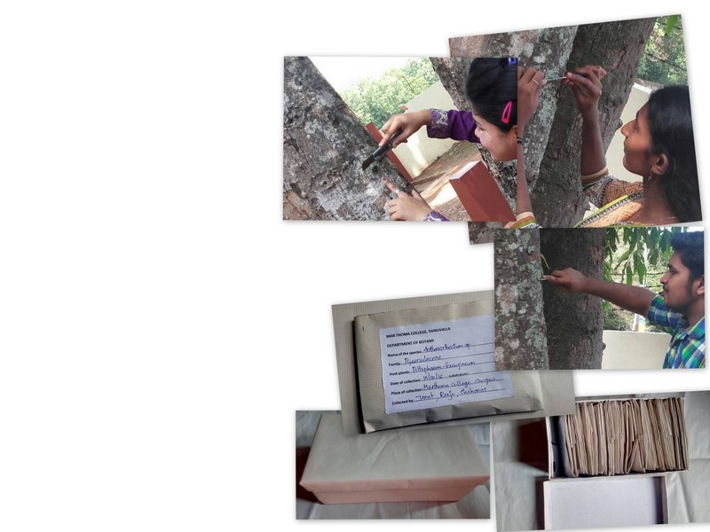
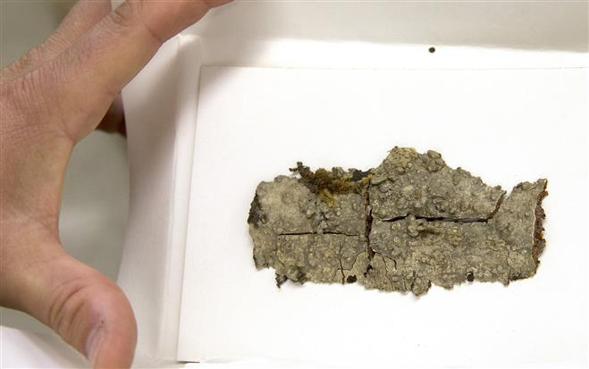
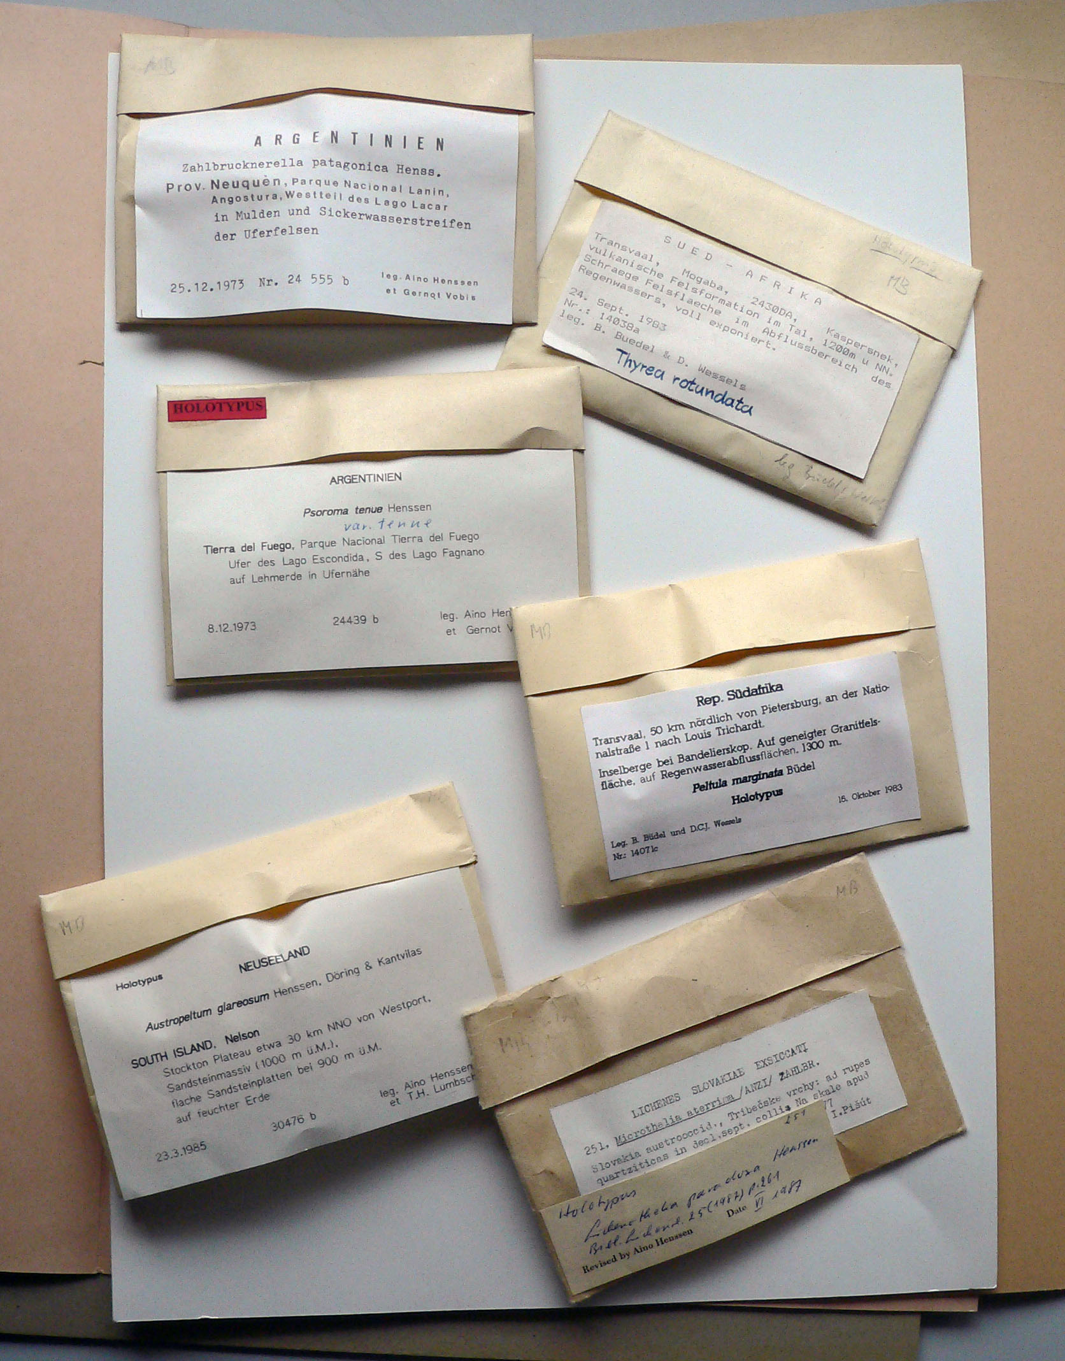
METHODOLOGY FOLLOWED
COLLECTION
RECORDING FIELD NOTES
EXAMINING THE COLLECTED SPECIMENS
PRESERVATION AND PRESSING
HERBARIUM PREPARATION
IDENTIFICATION

Slide 7
Result analysis
Diverse genera of Crustose and
Foliose lichens were found
CRUSTOSE | Anisomeridium
 | Anthracothecium
 | Bacidia
 | Chrysothrix
 | Clathroporina
 | Cryptothecia
 | Dirinaria
 | Graphis
 | Ocellularia
 | Porina
 | Strigula
Fruticose forms were absent
FOLIOSE | Leptogium
 | Parmotrema
 | Phyllopsora
 | Pyxine

Slide 8
Lichen genera on various hosts
16 different species of the Genus Pyxine | Cocos nucifera
 | Areca catechu
 | Artocarpus heterophyllus
 | Cocos nucifera
 | Ficus religiosa
 | Mangifera indica
 | Polyalthia longifolia
 | Swietenia mahagoni
 | Aerca catechu
 | Areca catechu
 | Artocarpus heterophyllus
 | Cocos nucifera
 | Eugenia jambos
 | Mangifera indica
 | Polyalthia longifolia
 | Swietenia mahagoni
 | Areca catechu
 | Rock

Slide 9
4 Different species of Anthracothecium | Croton sp.
 | Phyllanthus embilica
 | Swietenia mahagoni
 | Tamarindus indica
9 Different species of Graphis | Areca catechu
 | Artocarpus heterophyllus
 | Azadiracta indica
 | Cocos nucifera
 | Garcinia gummi gutta
 | Mangifera indica
 | Plumeria rubra
5 Different species Bacidia | Artocarpus heterophyllus
 | Cocos nucifera
 | Garcinia gummi gutta
 | Swietenia mahagoni
4 Different species of Parmotrema | Areca catechu
 | Polyalthia longifolia
 | Strychnos nux- vomica
 | Swietenia mahagoni

Slide 10
Trees with diverse lichen species
Cocos nucifera | 3 Bacidia sp.
 | Chrysothrix chlorina
 | Graphis sp.
 | Leptogium austro americanum
 | Pyxine asiatica
 | Pyxine cocoes
 | 3 Pyxine sp.
Swietenia mahagony | Anisomeridium sp.
 | Bacidia psorina
 | Bacidia sp.
 | Graphis angustata
 | Graphis scripta
 | Graphis sp.
 | Parmotrema cristiferum
 | Pyxine cocoes
 | 2 Pyxine sp.

Slide 11
Areca catechu | 2 Graphis sp.
 | Parmotrema sp.
 | Pyxine cocoes
 | Pyxine consocians
 | Pyxine sp.
 | Pyxine subcinerea
Mangifera indica | Graphis scripta
 | Pyxine cocoes
 | 3 Pyxine sp.
Artocarpus heterophyllus | Bacidia sp.
 | Dirinaria sp.
 | Graphis sp.
 | Ocellularia sp.
 | Pyxine cocoes
 | Pyxine sp.
 | Strigula sp.
Polyalthia longifolia | Ocellularia sp.
 | Parmotrema dilatatum
 | Pyxine cocoes
 | Pyxine sp.
 | Graphis sp.

Slide 12
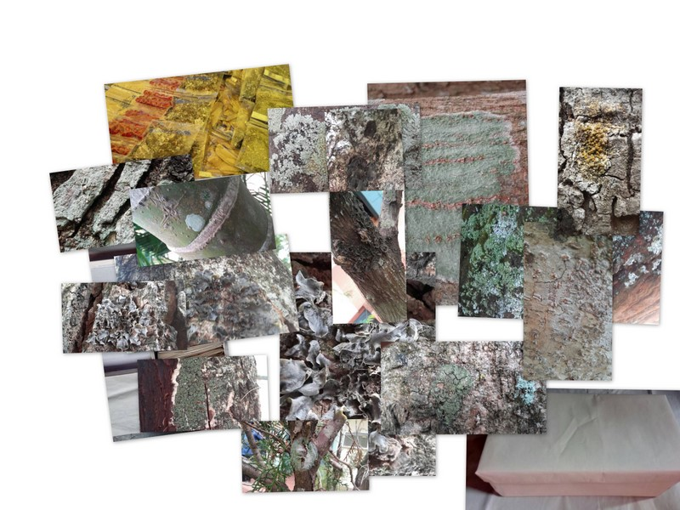
Thank you

