Slide 1
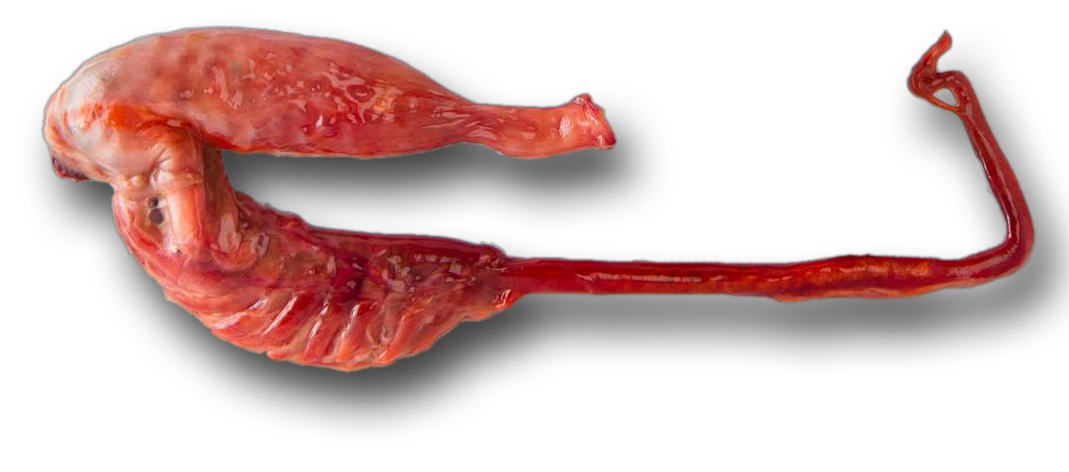
Alimentary canal and feeding adaptations in fishes
Dr.Sunitha A.Philip

Slide 2
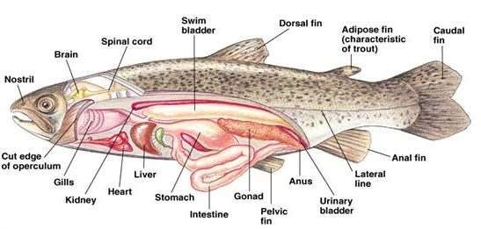
Introduction
Digestive system includes alimentary canal and associated glands.Alimentary canal or gut shows four distinct regions.
MOUTH
Ingressive zone
Progressive zone
Degressive zone
Egressive zone
OESOPHAGUS
STOMACH
INTESTINE
RECTUM

Slide 3
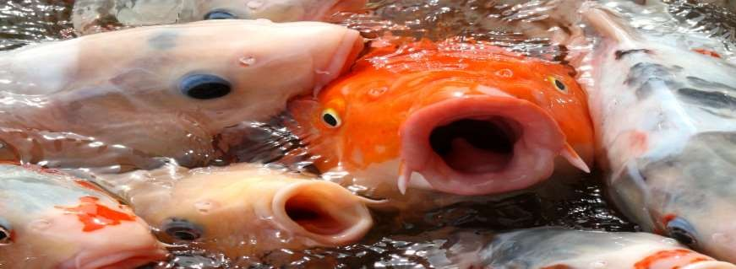
Mouth
Mouth is the anterior opening of alimentary canal .
Most fish mouth fall into three general types: 1 . Superior mouth type
Terminal mouth type
Inferior or sub terminal mouth type

Slide 4
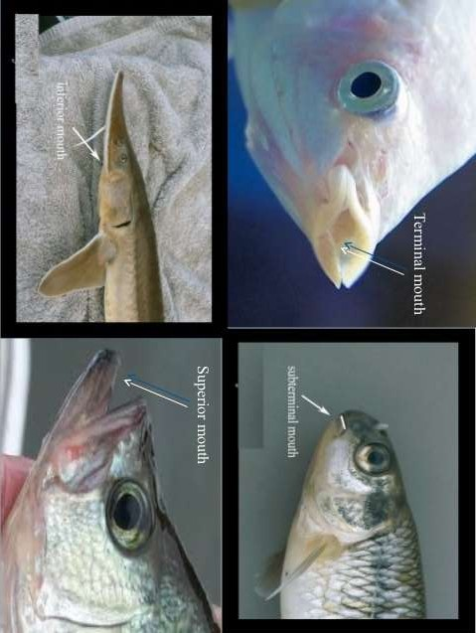

Slide 5
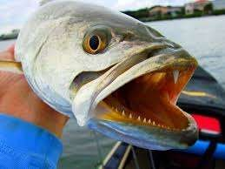
Teeth
Teeth are generally hollow cones of dentine containing the pulp cavities.
Absence of teeth in case of cyprinoids ,which have got pharyngeal teeth instead of normal teeth which are adapted for crushing & grinding
the prey .
Pharyngeal teeth are located below & above pharyngeal arches.

Slide 6
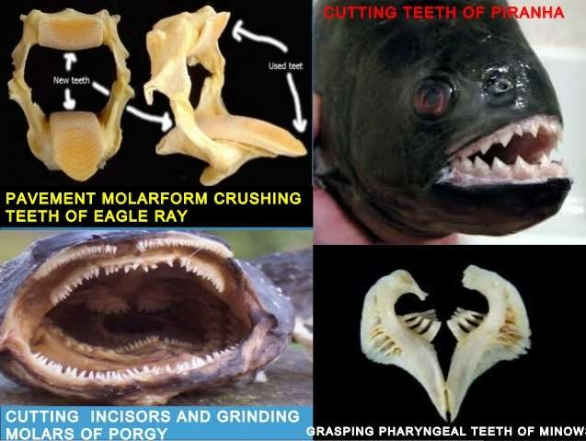
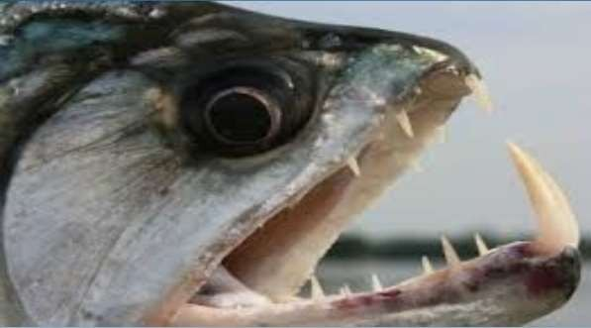
Teeth adapted for crushing hard shell of mollusks & crustaceans

Slide 7
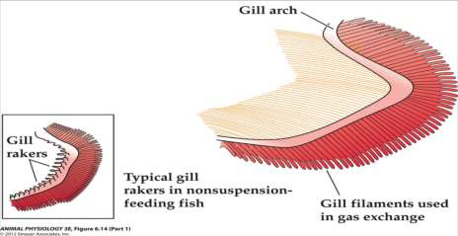
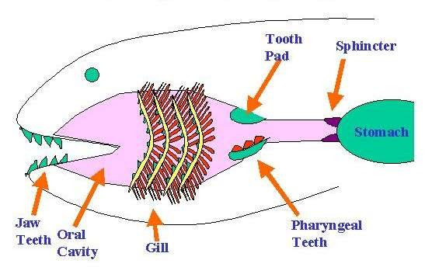
BUCCAL CAVITY, PHARYNX & GILL RACKERS
The buccal cavity and pharynx are not clearly marked off from each other.
A number of perforations of gill slits are located on each side of the pharyngeal wall.
Primary function of the gill rakers is to protect gill filaments from injury and to assist the fishes in the process of ingestion .

Slide 8
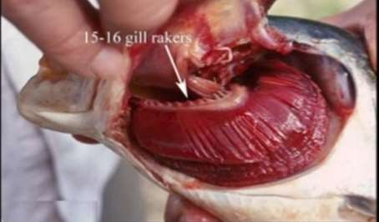
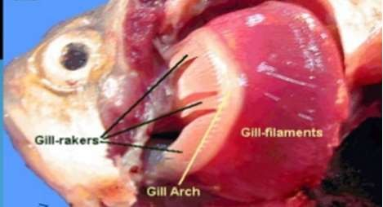
OMNIVOROUS
In the omnivorous fishes like Puntius sarana,gill rakers are short and stumpy.
HERBIVOROUS:
In Labeo rohita,Cirrhina
marigala,gill rakers form a broad sieve like structure across the gill slits for filtering the water in order to retain the food in the bucco- pharynx

Slide 9
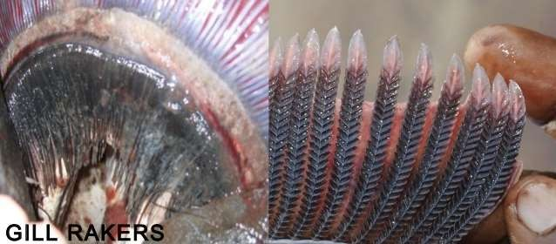
Carnivorous Fishes : Gill rakers are normally long, hard and teeth like forming rasping organs as in Wallago attu, Mystus seenghala, Channa striatus.

Slide 10
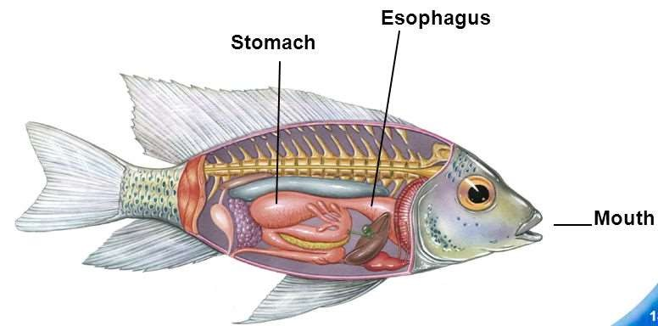
Oesophagus
The pharynx opens behind into the oesophagus which have large number of mucus secreting cells which are scattered in the mucosa.
Taste buds are also present e.g. Labeo rohita,c.carpio,catla catla
Short & narrow tube in case of herbivorous and omnivorous fishes
e.g. Labeo rohita,Puntius sarana, Cyprinus carpio etc
Large & distensible tube in case of carnivores and predatory fishes
(e.g. Wallago attu, H. fossilis etc

Slide 11
Stomach
Stomach acquire different shapes according to the availability of space in the body cavities of different fishes.
ANTERIOR – CARDIAC STOMACH
STOMACH
POSTERIOR – PYLORIC STOMACH
All the fishes do not possess a true stomach as it is almost absent in various herbivorous fishes like Labeo rohita,Catla catla etc.
In such fishes, the anterior part of the intestine is swollen to
form a sac like structure called intestinal bulb.
A true stomach is present in the carnivorous and predatory fishes
e.g. Channa striatus, Mystus seenghala etc .

Slide 12
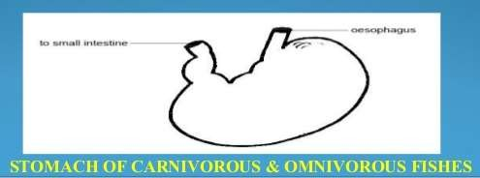
_{Carnivorous fishes:}• Stomach is generally sac-like
and thick walled in Carnivorous and predatory fishes.
Omnivorous fishes:
Stomach of omnivorous fishes is also sac like .e.g. Puntius sophore,Cyprinus carpio etc.
In some fishes like Hilsa hilsa,Gudusia chapra, stomach is reduced in size but is greatly thickened to become gizzard like for trituration of food

Slide 13
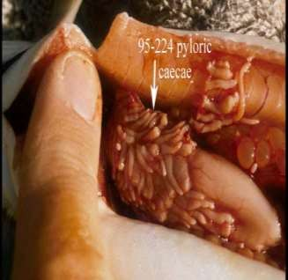
Pyloric caeca
Anterior part of the intestine give rise to a number of finger-like outgrowths called pyloric or intestinal caeca.
Pyloric caeca serve as accessory food reservoirs .
Histologically, intestinal caeca resembles the intestine and probably serve to enhance the absorptive area.

Slide 14
Intestine
The part of alimentary canal that follows the stomach is called intestine and is divided into two parts:
Anterior part : small intestine
Posterior part : large intestine
The small intestine just behind the stomach receives ducts from the liver and pancreas is called as duodenum while rest part is called ileum .
There is no clear cut demarcation between the small intestine and large intestine .
The length of the intestine depends upon the feeding habit of the fish.

Slide 15
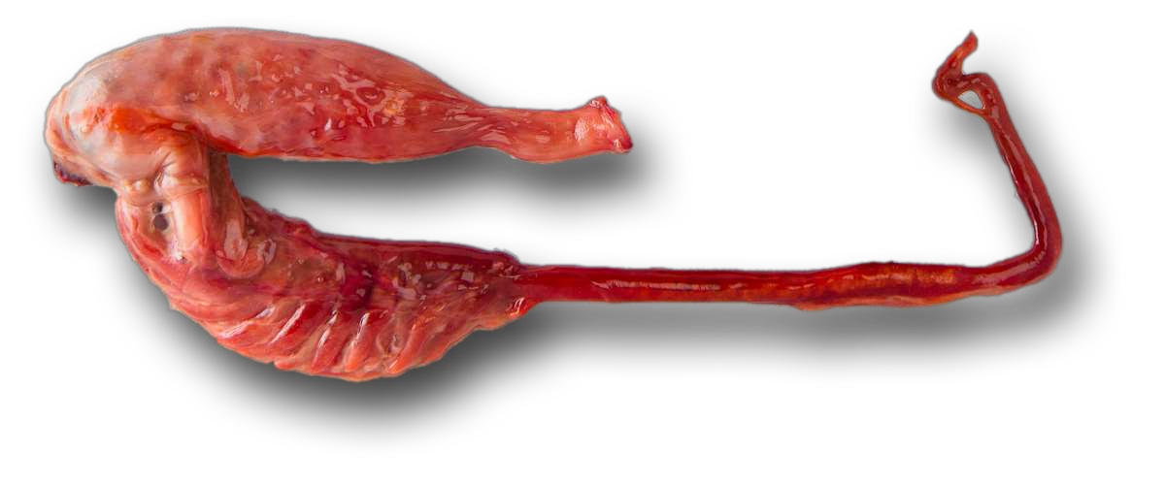
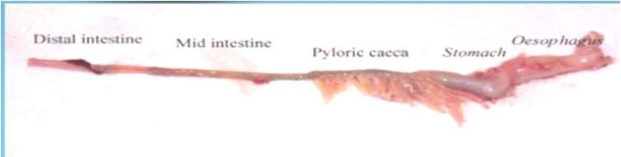
Carnivorous fishes : It is shortened in carnivores such as in Wallogo attu, Mystus seenghala because flesh can be digested more readily than the plant based food stuff.

Slide 16
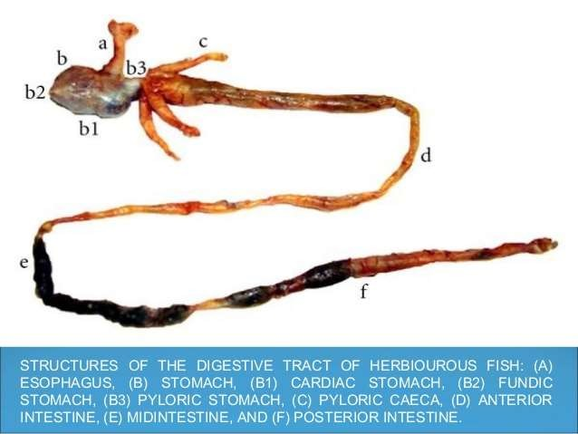
Herbivorous fishes:
Intestine is often elongated and arranged in many folds in case of herbivorous fishes.
Longer intestines are of great advantage to herbivorous fishes
as they retain food for long period of time to ensure digestion.

Slide 17
Omnivorous fishes:
Intermediate length is found in case of omnivorous fishes e.g. Puntius sophore etc.
The intestinal bulb of Rohu is about 25cm,the small intestine about 8m and the large intestine about a meter in length.

Slide 18
Rectum
It is not usually distinguishable externally but an ileo- recta valve is present in few species of fish to demarcate it from the intestine e.g. Tetradon
Histologically ,the mucosal folds of the rectum differ from the intestine in being shorter and broader, possess a large number of mucus secreting cells produce copious mucus to lubricate waste food and aid in easy defecation

Slide 19
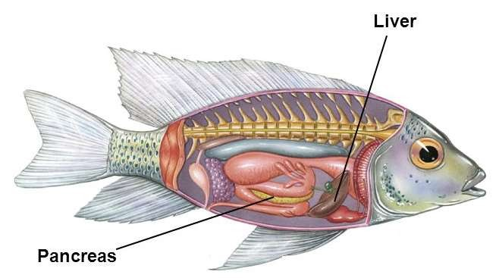
Digestive glands
Two main digestive glands :
1 . Pancreas: pancreas is a diffuse gland, but is well developed
around the blood vessels between the lobes of the liver.
Pancreas has two digestive functions:
Source of exocrine secretion into the intestine.
Endocrine secretion of the hormones insulin and glucagon .
2.Liver:
Liver is a bilobed gland usually yellowish brown in color.
The liver in fish produces bile which is stored in the gall bladder.
Key storage of food energy in the form of glycogen.

Slide 20
Digestive enzymes
Pepsin
Trypsin
Chymotrypsin
Elastase
Carboxypeptidase
Aminopeptidases
Pancreatic alpha amylase
Colipase
Pancreatic lipase
Cholestryl ester hydrolyase
Ribonucleases
Deoxyribonucleases

Slide 21
Feeding adaptaions in fishes
Various structures have been modified according to the nature of the food and feeding habits of the fish.
Position and shape of the mouth.
Dentition.
Lips may become cornified as in case of Labeo ,granular or papillated.
Taste buds and mucus secreting cells .
Structure of pharynx and gill rakers have also undergo modifications according to the feeding habit of the fish.
Relative length of the gut (RLG).

Slide 22
The structure of the alimentary canal varies in different species of fishes,and is generally adapted in relation to the food and feeding habit.
The variations are seen in the position of the mouth,architecture of the buccopharynx
,relative length of the gut,presence or absence of the stomach and pyloric caecae.

Slide 23


http://www.google.in
www.yourarticlelibrary.com
www.earthlife.net/fish/digestion.html/
Textbook of fish physiology by HOAR
Textbook of fish biology and fisheries by S.S.KHANA,H.R.SINGH

Slide 24



