Slide 1
Bryophyta-Thallus Structure Susan Kuriakose Assistant Professor Department of Botany Mar Thoma College,Tiruvalla

Slide 2
Hepaticopsida-General characters
Plant body thalloid or foliose
Aseptate rhizoids-simple or tuberculate,ventral scales present
Chloroplast without pyrenoids
Simple or compound oil bodies
Sex organs develop from superficial cells on the dorsal side of the thallus
Sporophyte simple or differentiated in to foot ,seta and capsule
Sporogenous cells from endothecium
Columella absent,elaters may be present
Sporophyte completely dependent upon gametophyte

Slide 3
Marchantiales-
Targionia
Division:Bryophyta
Class:Hepaticopsida
Order:Marchantiales
Family:Targioniaceae
Genus:Targionia
Species:hypophylla

Slide 4
Structural organisation
Gametophyte
Sporophyte
Simple strap shaped thallus
Sparingly dichotomously branched
Two rows of ventral scales on either side of the midrib-scales simple or appendaged
Rhizoids are simple and tuberculate.
The mid dorsal groove (Riccia),polygonal area and gemmae cups(Marchantia) are absent.
Photosynthetic/assimilatory region-Single row of airchambers with branched or unbranched filaments.
Storage zone-similar to Riccia
Foot,sets,capsule
Capsule has a lid or operculum at the apex.
Some elaters get fixed at the apex.they are short,stumpy with annular or spiral thickening.
Free elaters are larger with 2 or 3 spiral thickening.
After the removal of lid capsule dehisces in to 4-8 irregular valves.
Capsule wall is one cell thick with annular or semiannular thickening

Slide 5
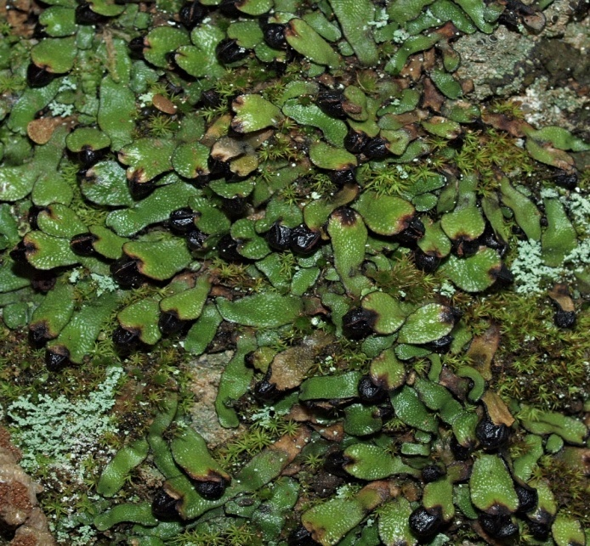
Reproduction
Sexual rpdn
Veg. rpdn
Numerous ventral adventitious shoots are produced from ventral surface of midrib. These on detachment help in veg rpdn
Monoecious(homothallic)
Antheridia-on the dorsal surface of the adventitious shoots forming spherical cushion like areas- sessile male receptacle.
Archegonia-initially produced at the apex from growing point subsequently shifted downwards. In a mature thallus
arch. are found enclosed within a boat shaped 2-lobed involucre at the ventral surface near the apex.(diagno. feature)

Slide 6
Cyathodium
Systematic position
Thin, once or twice dichotomously branched without midrib,densely overlapping and yellowish green

Slide 7
Lunularia
External features
Internal characters
Thallus,dichotomous&terestrial,found in large patches and overlapping.dorsal pores are simple and raised and bounded by3 rings of 6-8 cells each.scales found in one row on each side of somewhat distinct midrib,they are thin &delicate and attached by a semi-lunar base and appendaged.
Assimilatory region-air chambers in one layer short branched assimilatory filaments.
Storage region-thin walled parenchymatous.

Slide 8
Reproduction
Sexual rpdn
Veg.rpdn
Male receptacle-sessile, disc-shaped &terminal,surrounded with elevated borders of thallus.
Female receptacle-stalked,delicate&&partially transparent with scattered hairs or naked.trminal on short branches becomes apparently lateral and surrounded by scales in several rows at the base.mature receptacle composed of 4-cruciate,horizontal,tubular involucres,each containing a single sporogonium,perianth absent.capsule with a long pedicel remains exerted from the bilabiate opening of the involucre.
Gemmae cups on dorsal surface. Gemmae are multicellular,stalked,biconvex with thin margins and 2 lateral notches with overlaping margins.

Slide 9
Sexual rpdn
Capsule wall-unistratose &without annular bands.capsule dehisces nearly to the base by narrow valves.
Elaters are long, slender, bispiral& thread like
Spores are rounded, tetrahedral, smooth& yellowish brown

Slide 10
Dumortiera
Internal characters
External characters
Thalluslarge,prostrate,overlapping and terrestrial,growing near streams.repeatedly branched branching may be due to apical innovations.notched apex undulate margins and prominent midrib.Scales are reduced and attached to the thallus in a single row one on each side of the midrib.
Lacks air chambers and uppermost cells contain chloroplast

Slide 11
Sexual rpdn
Monoecious or dioecious, Male receptacle-disc shaped,depressed in the center,subsessile with bristles on the margins.
Female receptacle-stalk is long and 2 furrowed with its top covered with chaffy scales.Disc shaped ,umbonate,convex with a few bristle like hairs and with 6-10 short lobes.A sacctate involucre is found horizontally on the underside and distinct when sporogonium is young and appear sessile.Perianth absent
Capsule wall-unistratose with annular bands
Elaters appear fixed arising from bottom
Capsule dehisces by splitting into 4-8 valves
Elaters are long ,sometimes branched and have 2-4 spiral thickenings.
Spores are tetrahedral and dark brown

Slide 12
Reboulia
External characters
Internal characters
Thallus dichotomous, lobes are oblong or obovate with emarginate or bilobed apex. Thalli green and purple margins.Ventral surface and ventral scales are purple.Scales are arranged in two rows one in each side of the midrib.They are obliquely lunate with 2 linear appendages.midrib is thickand gradually passing into lamina ending in to one cell thick margin.
Air chambers arranged in several rows as in Plagiochasma.
Pores are elevated with 3-5 (rarely 8)concentric rings of 6-8 cells each.

Slide 13
Sexual rpdn
Monoecious or dioecious
Female receptacle-borne terminally. Stalk remains surrounded at the base and the apex by narrow scales with a single rhizoidal furrow. Receptacles are conical or hemispherical divided to the middle into 4-9 obtuse lobes.Airchambers with compound pores,Involucres arise on the underside of the lobes from margins. These are bivalved .Each involucres encloses a single sporogonium.Perianth not found
Male receptacle- sessile,oval to semicircular cushion-like and surrounded by small scales. Found at the apex of lobe.

Slide 14
Sporogonium
Large foot,short stalk,sub-globose capsule, capsule wall unistratose.Capsule dehisces at the apex.Elaters have 2-3 spiral thickening and are coiled,long and rarely branched.Spores are brown, spherical, reticulate-lamellate with broad wing.

Slide 16
Porella(Madotheca)
Division:Bryophyta
Class:Hepaticopsida
Order:Jungarmaniales
Family:Porellaceae
Genus:Porella
Species:platyphylla
Distribution :Mostly in tropics,Porella platyphylla is cosmopolitan.
External characters:greenish,leafy and fairly large upto15cm long,dorsiventral,branched central axis, branching is monopodial ,both central axis and branches bear leaf-like expansions(dorsal and ventral leaves in 3 rows),incubous arrangement of leaves-anterior edge of each leaf covers the posterior edge of the leaf in front,dorsal leaf is bilobed-upper or dorsal lobe is large and oval in outline(antical lobe),ventral smaller lobe is called postical lobe or lobule,ventral leaves which is decurrent at the base are called amphigastria,leaves lack nerves and even midrib.P.navicularis have ectophytic association with Nostoc.Rhizoids are thin walled and arises from the lower surface near the base of the ventral leaves.

Slide 17
Internal Structure of the stem and leaf
Young stem consists of green parenchyma cells,even epidermal layer is not well defined,in the older portion there is differentiation,consists of an outer cortical and an inner medullary region
Leaf-thin plate of uniform cells ,one cell layer in thickness,cells contain abundant chloroplast, no midrib.

Slide 18
Reproduction
Vegetative reproduction: Through fragmentation and regeneration
Sexual reproduction--- Porella is dioecious, Male gametophytes are comparatively smaller than the female gameto­phyte. Antheridia are borne on specialised lateral antheridial branches which project out at right angles to the main axis. The dorsal leaves, called bracts, are smaller than those on the main branch and are closely imbricated. The ventral leaves (amphigastria) of the antheridial branch are known as bracteoles. A single antheridium is borne in the axil of each leaf. The mature antheridium is differentiated into a globose body and a long stalk

Slide 19
Archegonia are produced at the apex of archegonial branch on the female plant. The archegonial branch is much smaller than the vegetative branch, bearing a number of large perichaetial leaves (bracts). The lower bracts form involucre, while the two upper bracts coalesce to form a perianth. Ten to fifteen archegonia develop within the perianth. The archegonia develop in acropetal succession. A mature archegonium differentiates into a neck and a venter. The neck is long, comprises of five vertical rows of neck cells enclosing 6-8 neck canal cells. The venter is 2-layered, consists of a small ventral canal cell and a large egg. A rosette of 4 cover cells is present at the top of the archegonial neck. The process of fertilisation is found to be similar with that of other bryophytes.

Slide 20
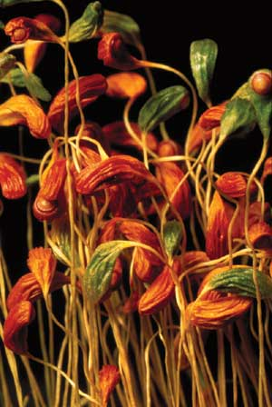
Thank You

