Slide 1
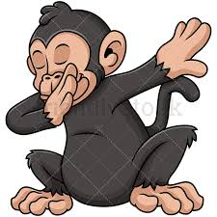
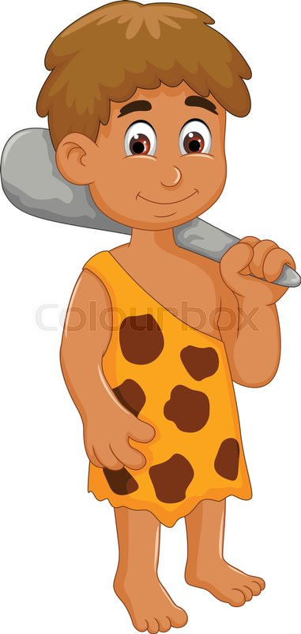
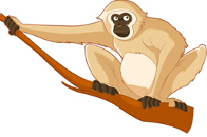
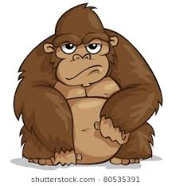
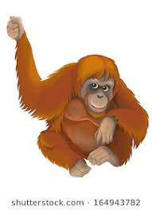
By Dr. Susan Thomas
PRIMATE EVOLUTION

Slide 2
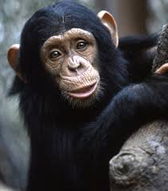
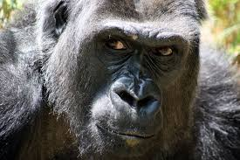
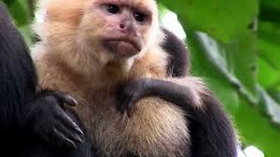
GENERAL CHARACTERISTICS
Hands and feet
Fingers and toes
Shoulder and hip
Presence of clavicle
Improved vision
Arms that can rotate around shoulder joints
Well developed cerebrum
Erect bodies

Slide 3
Primates have a number of adaptations that indicate that they have an arboreal ancestors, those characters are
Ability to move the four limbs in various directions
Grasping power of hands and feet
Slip resistant cutaneous ridges
Retention of clavicle
Flexibility of spine

Slide 4
Primates almost contain 230 species and they are divided into sub orders.
Prosimians retain earlier mammalian characters
Prosimians include tarsiers, galago and lemurs
Anthropoids include monkey, apes and humans
Anthropoids have larger nails and their brain is large relative to prosimians
PROSIMIANS
ANTHROPOIDS
PRIMATES

Slide 5
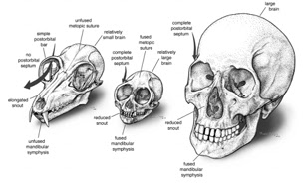
Anthropoids have more common primate characters which include
Shortened face
Forward directed eyes
Large complex brain
Notes:
Left one indicates skull of lemur which is a prominans and two right ones are those of squirrel and human

Slide 6
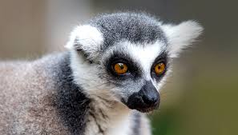
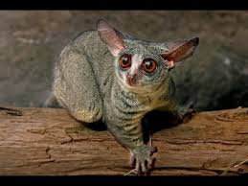
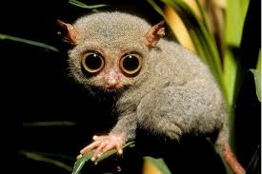
PROSIMIANS
LEMURS
GALAGO
TARSIERS

Slide 7
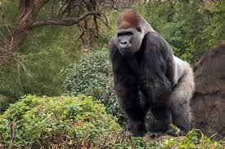
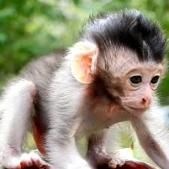
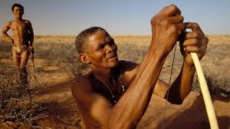
ANTHROPOIDS
MONKEYS
APES
HUMANS

Slide 8
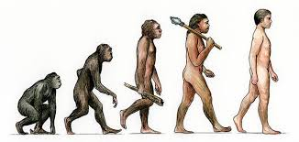
Stages in primate evolution

Slide 9
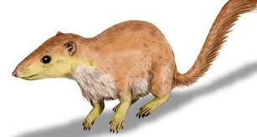
PROTO PRIMATES
First primate like mammals are referred to as proto primates.
They were roughly similar to that of tree shrews and squirrels.
Existing fossil evidence is fragmentary.
Considered as mysterious creatures until fossil evidences were discovered.
PROTO PRIMATES

Slide 10
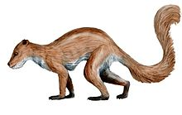
PLESIADAPIS
Oldest known primate like mammal with a relatively robust fossil is Plesiadapis.
They were found in North America and Europe in Cenozoic era
Got extinct by the end of Eocene.
These have characters like teeth and skeleton in common with true primates.
PLESIADAPIS

Slide 11
The first true primates were found in North America, Europe, Asia, Africa in Eocene Epoch.
Resembles to present day lemurs.
Evolutionary changes continued- brain and eyes.
End of Eocene epoch many of prosimians were extinct due to cooler temperature and competition from first monkeys

Slide 12
Evidences shows that Anthropoid monkeys have evolved from prosimians.
35 mya – old world monkeys.
30 mya – new world monkeys.
Old world monkeys – catarrhines
New world monkeys- platyrrhines.

Slide 13
At the time new world monkeys arose, the continents S America and Africa had drifted apart.
Monkeys in old world reached new world by drifting on log rafts or mangrove floating islands.
Due to reproductive isolation- they underwent separate adaptive radiation over millions of years.
New world monkeys are arboreal while old world monkeys are ground dwelling species.

Slide 15
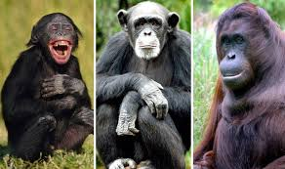
Apes evolved from catarrhines in Africa.
Apes are divided into two groups
LESSER APES
GREAT APES

Slide 16
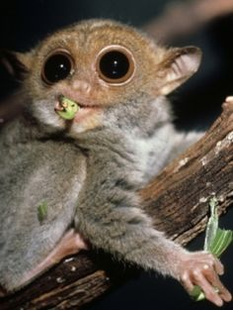
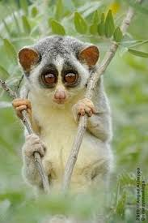
PROSIMIANS

Slide 17
ORDER PRIMATES
SUB ORDER PROSIMII
FAMILY
LEMURIDAE
FAMILY
TARSIDAE
FAMILY LORISIDAE

Slide 18
LEMURS
Appear exclusively in Madagascar.
Protected areas - population parallel to role of forest monkeys on main land.
Primitive than monkeys.
Have longer snout, moist philtrum between nose and lip

Slide 19
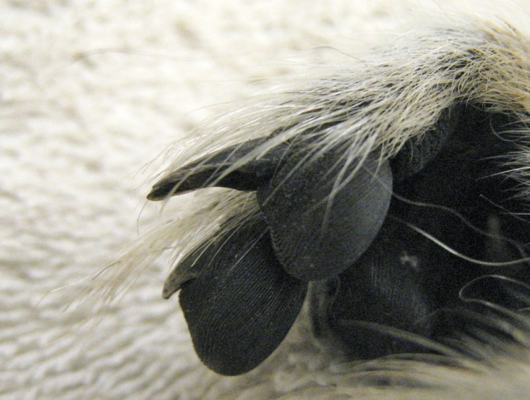
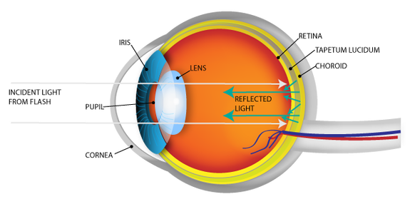
They have special toilet claw, thick fur, sensitive facial hair and dental comb.
Presence of tapetum lucidum
Remain nocturnal
TOILET CLAW
TAPETUM LUCIDUM

Slide 20
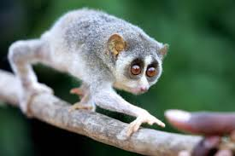
LORISES
Found in forests of Africa and South East Asia.
Adaptation includes larger fore brain, snout shorter than lemurs, large eyes that face forwards.
Retinal tapetum, dental combs, toilet claw and moist philtrum

Slide 21
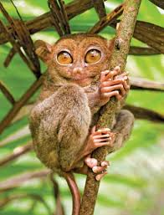
TARSIERS
Nocturnal south east Asian primates.
Stand between prosimians and anthropoids
Presence of two toilet claws on each foot.
Enormous eyes relative to head size.

Slide 22
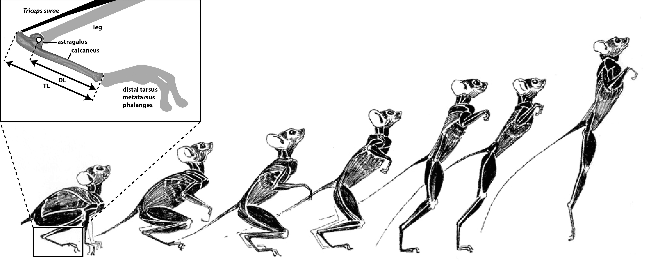
Lack renal tapetum that is a characteristic feature of lemurs and lorises.
Replacement of moist philtrum by dry furry space between nose and lip.
Bony orbit around eyes.
Fusion of tibia and fibula in the lower leg- adaptation to make a single leap

Slide 23
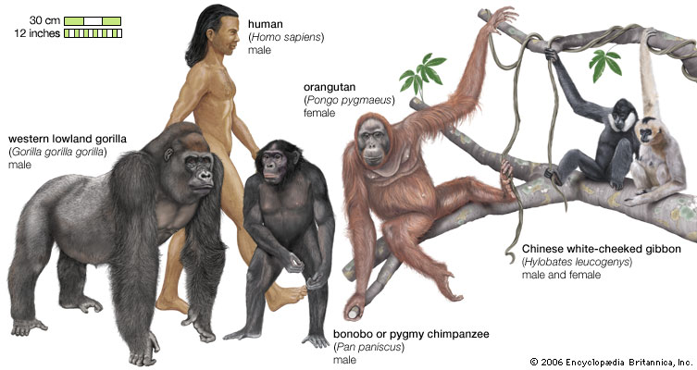
ANTHROPOIDEA

Slide 24
ANTHROPOIDS
PLATYRRHINES
CATARRHINES
CEBOIDS
CERCOPITHECOIDS
HOMINOIDS

Slide 25
PLATYRRHINES
Include new world moneys.
Found in central and south America, all of which are arboreal.
Broad nose, widely spaced nostrils facing laterally, three premolars on each side of jaw – characteristics
Cebidae – nails instead of claws also presence of prehensile tail

Slide 26
CATARRHINES
Include two super families – Cercopithecoidea( old world monkeys)
And Hominioidea ( apes and humans)
Narrowly spaced nostrils.
Dental formula 2123
Larger than new world monkeys
Lack prehensile tail.
Terrestrial and arboreal forms

Slide 27
HOMINOIDS
They are a group of primates with almost 22 species.
Include chimpanzees, gorilla, orangutans, gibbon and humans beings.
Apes and humans – brachiating locomotion.
Arboreal have to hold on to overhead tree branches – posture erect than monkeys
Arms and shoulder were more flexible, wrist and elbow are more limber also spine is shorter and stiffer

Slide 28
Hominoids differ from monkeys in following ways
Broader and larger pelvis – support vertical weight
Visceral attachments and arrangements – vertical support for stomach, intestine and liver.
Loss of tail
Five cusped lower molars
Broad but shallow thorax – change to more vertical posture.
Scapulae placed dorsally – to extend arm laterally.

Slide 29
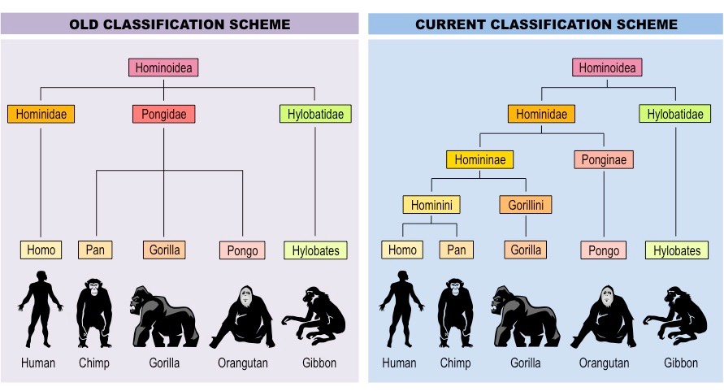

Slide 30
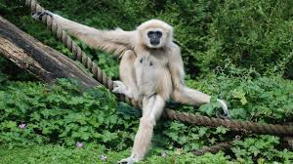
GIBBON
Most primitive existing hominoids
Exclusively arboreal and confined to South East Asia.
Share characteristics with old world monkeys.
Relatively small size and ischial callosities
Superb acrobatic brachiators

Slide 31
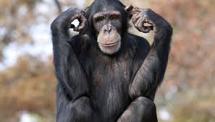
CHIMPANZEES
They are found equatorial Africa where they live in groups of 40 to 50 socially organised in a dominance hierarchy.
Feeding – arboreal, less specialised for arboreal pursuits than Asiatic apes.
Spend most of their time on grounds.
Travel terrestrially by ‘ KNUCKLE- WALKING’ using friction pad on middle of phalanges of non thumb digits as forelimb support

Slide 32
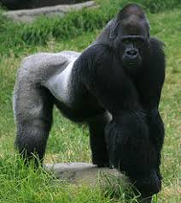
GORILLA
Largest apes.
Inhabit equatorial Africa in 2 main distributions.
Low land gorillas west of Congo basin.
Mountain gorillas eastward.
DNA is very similar to that of humans.
They live in groups called troops.

Slide 33
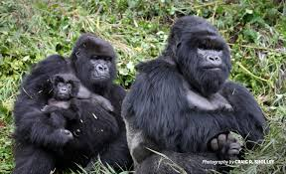
Made up of one adult male or silverback with multiple adult and offspring.
The gorilla is robust and powerful, with an extremely thick, strong chest and a protruding abdomen.
Both skin and hair are black.
The face has large nostrils, small ears, and prominent brow ridges.
Adults have long, muscular arms that are 15–20 percent longer than the stocky legs.

Slide 34
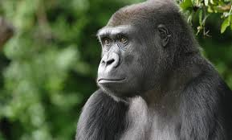
Males are about twice as heavy as females
May attain a height of about 1.7 metres (5.5 feet)
Weight (in the wild) of 135–220 kg (300–485 pounds).

Slide 35
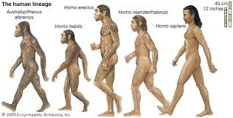
HUMANS
Have wide range of adaptations
Hindlimbs are longer relative to forelimbs.
Bipedal terrestrial locomotion
Large brain.
Small face.
Shorter canines
Less body hair.

Slide 36
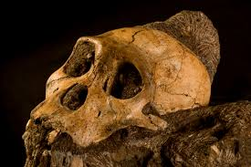
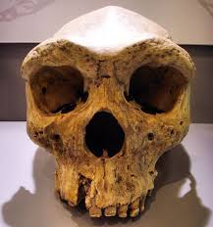
HOMINID FOSSILS

Slide 37
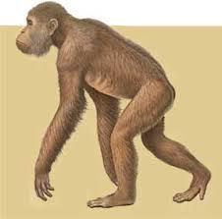
IImportant Ancestral Forms Of Homo sapiens are:
DRYOPITHECUS
It lived 20 million yrs ago in Miocene epoch.
Common ancestor of humans and apes.
Fossils found from an island in Africa’s Lake Victoria at 1930.
Flattened face ,Shortened jaw and enlarged Incissors.
Arms and legs of same length.
Semi – erect posture on the ground.
More bipedal than other apes.

Slide 38
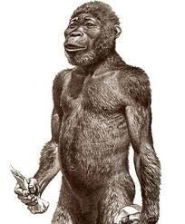
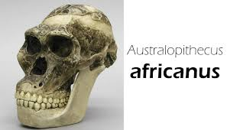
AUSTRALOPITHECUS(Man –Ape of Africa)
Australopithecus africanus belongs to pleistocene era( 1.2 - 3 mya).
Founded in Africa and weighed 40 – 60 pounds.
Bipedal form of primates with erect posture.
Had teeth similar to humans but jaws and teeth are larger than modern man.
It had an ape – brain (capacity 450 – 700cc).
They were true hunter scavengers.
Later Australopithecus robustus discovered, weighed 150-200 pounds, walked erect.
Lucy – lived 3.2 mya, walk upright like a human, because of particular shape of her hip and knees.

Slide 39
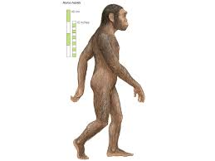
Homo habilis
Bipedal
Had a larger brain
They used tools.
They are intellectual and have linguistic powers.
This process of being a human in biological and social sense is called hominisation.
Homo habilis represents a significant step towards human evolution.

Slide 40
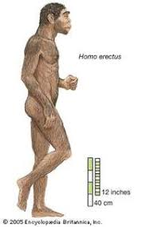
HOMO ERECTUS
Remains are found in Africa, South East Asia and China.
It lived from over 2 million yrs ago up to about 300,000 yrs ago.
It contains Java man and Peking man.
They had a receding forehead, heavy jaws and prominent bony brows.
It was more than 5 feet tall, weighed 70 kg, and had a human like skeleton.
Cranial capacity was 970 cc.
They lived in caves , made fire and brought it indoors to cook food or split stones.

Slide 41
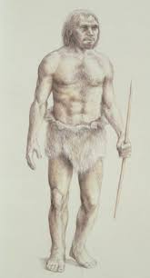
Homo neanderthalensis(Neanderthal man)
Discovered in Neander valley Germany in 1856.
Existed 150,000 yrs ago in Europe, Asia, and North Africa.
Short with heavy jaws , receding chin, with erect posture and hands used like man.
Brain was big as modern man with cranial capacity 1450 cc.
Became extinct 25,000 yrs ago.
They lived in caves , made simple tools, dug pits to trap large animals.
They also buried the dead.

Slide 42
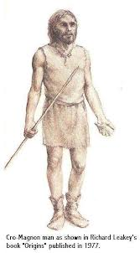
The Cro - Magnons
Discovered in France in 1868.
As they are like modern man they were considered as a sub species of Homo sapiens.
They were about 150 cm tall, with a rounded forehead, distinct chin, narrow nose and broad face.
They walked erect and cranial capacity was about 1650 cc.
They became the farmers and mental workers of Egypt, philosophers of greece etc:
They buried their dead according to their customs.
They became extinct 20,000 yrs ago .

Slide 43
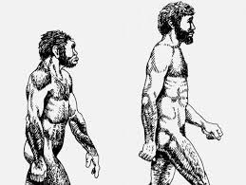
HOMO SAPIENS
They first appeared in less than 1,00,000 yrs ago.
During its evolution, our ancestors changed from ape to apelike to human-like to human.
They changed from 4 legged to 2 legged posture, became erect and bipedal.
Feet lost their hand like features and became suited for upright walking and running.
The hands became free to manipulate and thumb become opposable with precision and power grip.
Brains grew larger and a more creative intelligence developed.

