Slide 1
The religious poetry of T.S. Eliot : A preamble
Teena T Elizabeth
Assistant Professor
Department of English
Mar Thoma College, Tiruvalla

Slide 2
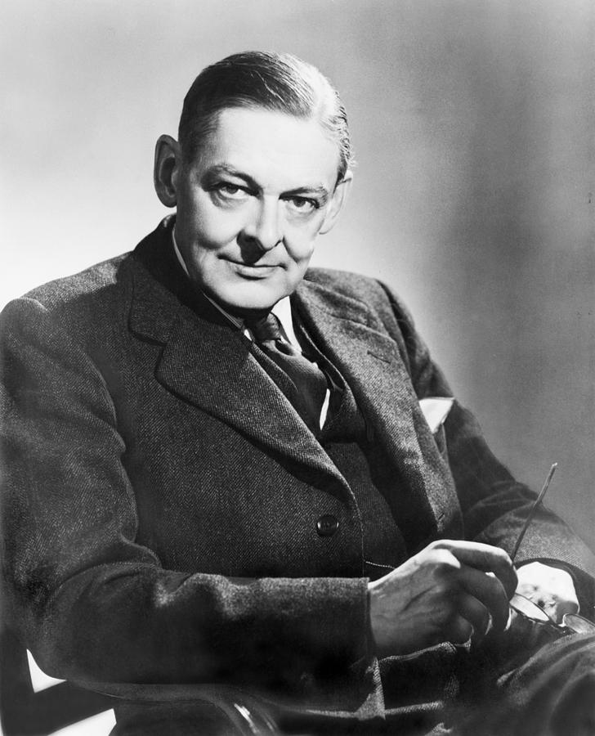

Slide 3
Thomas Stearns Eliot
American-English poet, playwright, literary critic, and editor, a leader of the modernist movement in poetry
One of the most distinguished literary figures of the 20th century
Eliot exercised a strong influence on Anglo-American culture from the 1920s until late in the century.

Slide 4
His experiments in diction, style, and versification revitalized English poetry
He shattered old orthodoxies and erected new ones through his critical essays
In 1948 he was awarded both the Order of Merit and the Nobel Prize for Literature.

Slide 5
Major Influences:
The most conspicuous influences on his works are: the family, Donne and the Metaphysicals and the Jacobeans, the French Symbolists, Dante, Irving Babbitt, Santayana, Josiah Royce, F. H. Bradley, Bergson, German phenomenologists, Ezra Pound, T. E. Hulme, Wyndham Lewis, Middleton Murry, Rémy de Gourmont, The Criterion circles, primitive ritual and Christianity, and the
Indian Scriptures

Slide 6
Out of all these influences we can pin down three significant influences:
Indian thought
The philosophy of F. H. Bradley
Christianity
Though it is possible to ascertain numerous influences on Eliot and his writings Indian, Bradleyean, and Christian thought predominate

Slide 7
Eliot’s poems can be seen as belonging to two phases:
Before conversion
After conversion

Slide 8
Before conversion poems dealt with themes that include:
Failure of communication
Estrangement between man and woman
Individual’s isolation
Till The Waste Land, Eliot’s poetry is richly furnished with images of the sordid, the disgusting and the depressing and with personalities of similar quality

Slide 9
The Waste Land and The Hollow Men are titles indicating the grounds of alienation
The Waste Land is a grand consummation of the themes, techniques and styles that Eliot had been developing in his earlier stage.
The Hollow Men is at once an epilogue to the earlier stage and a prologue to the new stage in his career
This is the way the world ends
Not with a bang but a whimper.
The Hollow Men provides a link between the despair of The Waste Land and the new-found faith expressed in The Ash Wednesday

Slide 10
The distinctive features of Eliot’s earlier poetry :
Derived impetus from French symbolists and English imagists and combined images in a non-discursive, non-logical , often purely intuitive order
Developed a new stock of images from contemporary life
Metrical influence of the later Elizabethans enabled him to stretch, contract and distort blank verse to give it the vitality and flexibility of living speech.

Slide 11
The new stage is marked by Eliot’s entry into the Church of England
The difference in position is produced by a development rather than a break from the earlier stage
The title Ash Wednesday itself indicates the position of the poet in the new phase of his career that emerged after the publication of The Hollow Men
His outlook starts to mature as he finds a way of living in the world through his developing Christian faith

Slide 12
The predicament of the modern man in ascending spirituality and search for reality is found in
Eliot’s
Ash Wednesday (1930),
A Song for Simeon (1928),
Animula (1929),
Mariana (1930) and
Choruses from the Rock (1934)
Man’s struggle to retain their spiritual identity in an age increasingly devoted to the secular remedies can be identified as the major concern of these poems grouped together as Ariel poems.

Slide 13
After this , Eliot returned to the poetry of religious meditation
In the Four Quartets , the religious poetry achieves a contemplative depth
A quartet is a piece written for four stringed instruments, divided into five sections called movements.
The movements are linked by a recurring theme or themes
All the four quartets share common structural features and are concerned with related themes

Slide 14
The common theme is religious
The poet names the poems after four places which were important to him in his own personal history:
Burnt Norton –a large country house in Gloucestershire, where Eliot stayed during the summer of 1934
East Coker- a small village in Somerset, the ancestral village of the poet
Dry Salvages –a small group of rocks off the north coast of cape Ann, where Eliot’s forbears had originally settled
Little Gidding –a small country church in Huntingdonshire where Eliot appears to have made a pilgrimage to

Slide 15
Throughout the four poems we find allusions to contemporary events
A considerable number of words, images, phrases and ideas recur through the whole sequence of the poems
The Four Quartets have proved themselves as a valuable record of modern religious experience
It is a poet’s attempt to enlighten and justify his whole spiritual climate
The Quartets are difficult poems owing to the concentration with which Eliot’s belief is expressed, developed and insisted upon

Slide 16
Each of the four poems is coloured by a particular element :
In Burnt Norton- Air
In East Coker - Earth
In The Dry Salvages- Water
In Little Gidding- Fire
We encounter philosophical meditations on varied topics as we go through the four poems.
Burnt Norton is the poet’s reaction to an experience of spiritual illumination that was occasioned by a visit to the garden of the house. The experience stood out from the dull sequence of ordinary life. The poem consists of various reflections on the meaning of such experiences.

Slide 17
East Coker contains a number of themes interwoven into a meditation on the passage of time. The poet’s personal reflections on his own arrival at middle age, and his family’s history are central. The poem is deeply personal with a self-exposure. The religious significances are more explicit. The focus is on a famous passage on the nature of language and poetry. Out of darkness, Eliot offers a solution: "I said to my soul, be still, and wait without hope."

Slide 18
The Dry Salvages provides a symbolic significance of the sea-scape contrasted with the river scene. The river and sea images convey aspects of human existence in time. We also have a harsh and painful portrayal of the human condition and a thoroughly unequivocal expression of dependence upon the divine grace. It strives to contain opposites: "The past and future / Are conquered, and reconciled."

Slide 19
In Little Gidding, the themes that were dealt with in the earlier poems are gathered and woven together but with a new confidence and spiritual exaltation to an assertion of the possibility of the total transfiguration and supernaturalizing of life. This is the brilliantly musical of all the four poems. The beginning of the Quartets ("Houses / Are removed, destroyed") had become a violent everyday experience. the Quartets end with an affirmation of Julian of Norwich: "All shall be well and / All manner of thing shall be well."

Slide 20
Four Quartets is thus a record of his spiritual journey and the underlying argument is spiritual progress
The divine-human encounter in the poem is at the level of mediation

Slide 21
THANK YOU

