Slide 1
Topic : Stone Age- Evolution
Prepared by:
K M Vishnu Namboodiri
Assistant Professor and Head
Department of History
Mar Thoma College

Slide 3
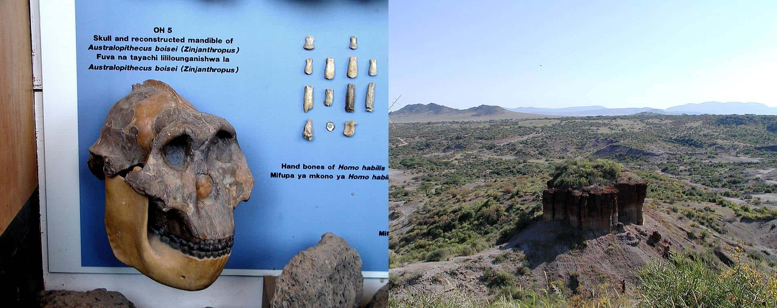
Lower Paleolithic Age
Lower Paleolithic Age/ Early Stone Age lasted b/w 2.7 mya to 2 lakh years ago and is marked with the beginning of stone tool making.
Regular tool making commenced with the emergence of Homo Habilis.
Evidence of the beginning of stone tool manufacturing is found at Olduvai
Olduvai, Tanzania.

Slide 4
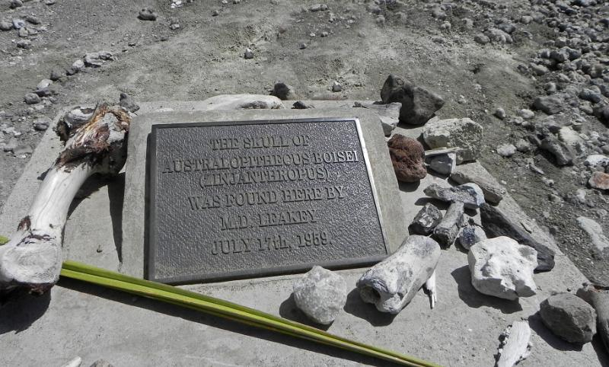
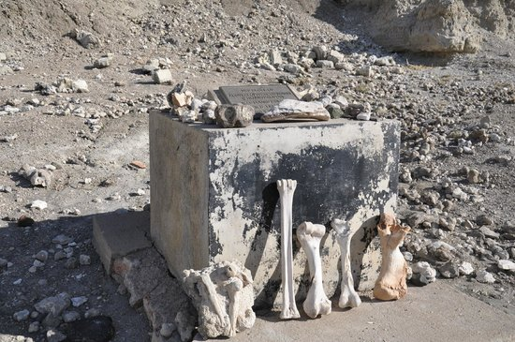
The oldest stone tool culture is named ‘Oldowan’ and was discovered by Louis and Mary Leakey
Oldowan is the oldest known paleolithic culture.
Oldowan tools mark the beginning of the Paleolithic age.

Slide 5
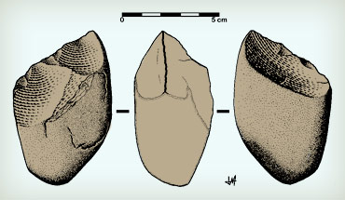
Tools made by Homo Habilis
The earliest tools made by Homo Habilis were extremely crude, small and rudimentary.
The tools consisted of pebble cores with rough flakes struck from them, providing ‘choppers’.
The Sharp edge of the choppers was ideal for butchering, cutting and scraping meat from bones

Slide 6
FACTORS THAT CONTRIBUTED TOWARDS TOOL MAKING
Specialised hand
Bipedalism
Large brain- Australopithecus was not able to make tools due to small cc.
Hand eye cordination
Conceptualisation and knowledge

Slide 7
Paleolithic age is the earliest phase of human prehistory
Gathering, Scavenging and Hunting
Tools meant to assist humans in processing plant and animal foods
Oldowan tools were mainly used for cutting plant foods, breaking nuts, digging roots, scraping wood, extracting bone marrow and obtaining honey

Slide 8
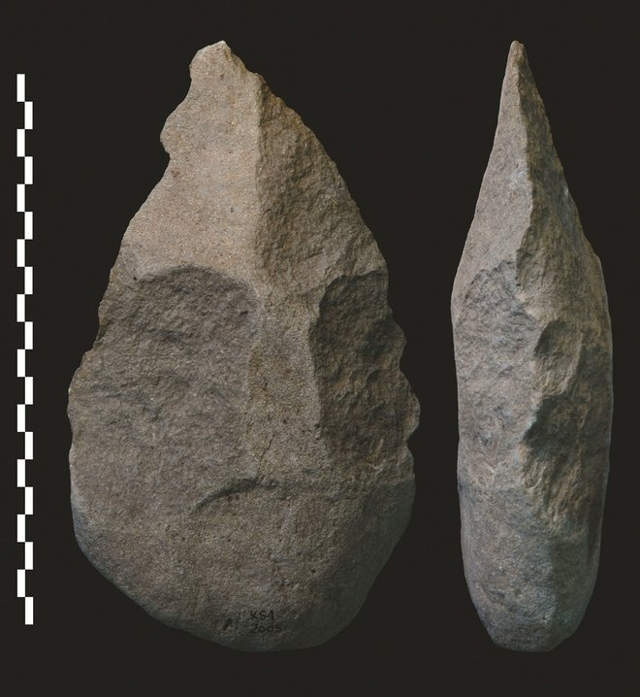
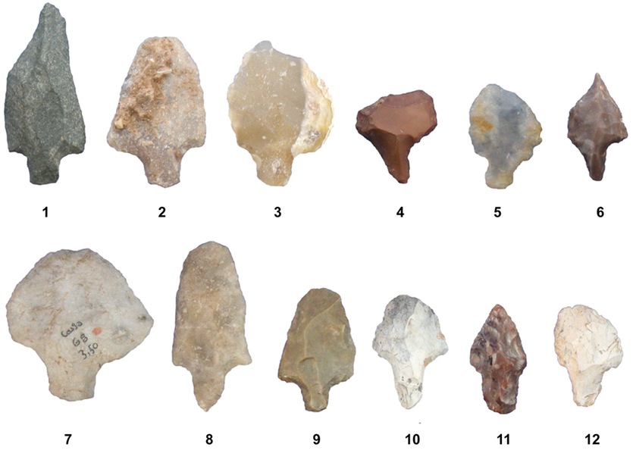
CHANGES BROUGHT ABOUT BY HOMO ERECTUS
With the evolution of Homo Erectus hunting became well established
Hunting and foraging
More efficient tools
Standardized tools (repeatable pattern)
Attempt to impose predetermined design into tools
Most prominent tool used by them was the tear drop shaped Hand Axe
Pointed at one end and broad at the other
Core tool
Core tool v/s flake tool

Slide 9
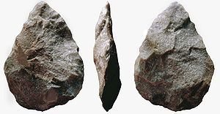
Acheulian Hand Axe Culture
The culture that evolved with Homo Erectus
Named after a site in northern France
Developed around 1.4 mya
Acheulian tools are found in East, South and West Africa, Spain, France and parts of Europe, West Asia, South Asia and India
Hand axe was majorly used for processing meat- skinning and chopping (large animals). Use of Traps in Hunting.
Flake tools were also used for cutting and slicing
Hand axe would have been used as a discus (throwing)
Uniformity in the production of hand axe in all the regions inhabited by Homo Erectus.
Complexity
of tools can only be achieved with improved communication

Slide 10
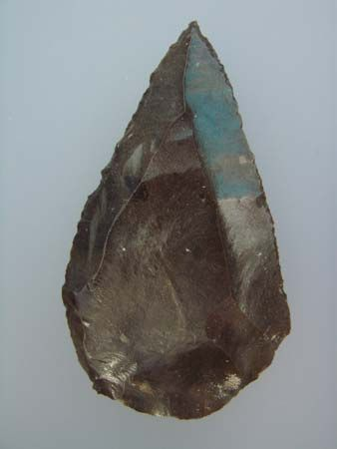
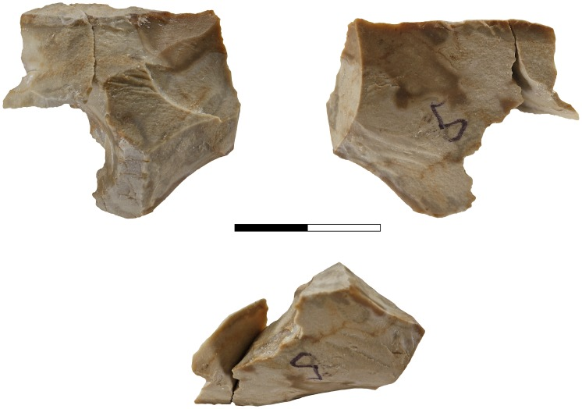
CLACTONIAN AND LEVALLOSIAN CULTURES
In some parts of England and northern Europe core tools which were different from Acheulian hand axe were manufactured
Clactonian- North Europe; Turtle Shaped
Levallosian- England; Round

Slide 11
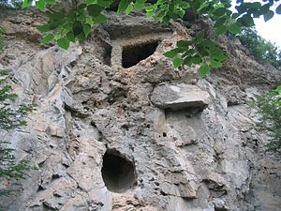
Homo Erectus began to use fire about 7,00,000 years ago
Cooking
Removing poisonous substances from plants
Scaring animals
Providing warmth
Zhoukoudien (5 lakh mya) caves in Northern China has provided definite evidence of the early use of fire
Hoxne in England and Torralba in Spain provides similar evidence of use of Fire.

Slide 12
the practice of intentional burial may have begun much earlier during the late Lower Paleolithic

Slide 13
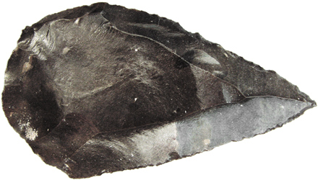
Middle Paleolithic Age
3 lakh years ago to 30,000 years ago
Middle Paleolithic is marked by Mousterian Culture (France). It was the work of the Neanderthals
Middle Paleolithic cultures may have possessed a developing religious ideology which included belief in concepts such as an afterlife
Also the earliest undisputed evidence of artistic expression during the Paleolithic period comes from Middle Paleolithic

Slide 14
Activities such as catching large fish and hunting large game animals with specialized tools connote increased group-wide cooperation and more elaborate social organization
humans also first began to take part in long distance trade between groups for rare commodities
Evidence from archaeology and comparative ethnography indicates that Middle Paleolithic people lived in small, egalitarian band societies
Typically, it has been assumed that women gathered plants and firewood and men hunted and scavenged dead animals through the Paleolithic

Slide 15
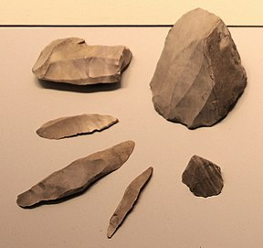
Around 200,000 BP Middle Paleolithic Stone tool manufacturing spawned a tool-making technique known as the prepared-core technique, that was more elaborate than previous Acheulean techniques
Nonetheless Neandertal usage of projectile weapons in hunting occurred very rarely (or perhaps never) and the Neandertals hunted large game animals mostly by ambushing them and attacking them with mêlée weapons such as thrusting spears rather than attacking them from a distance with projectile weapons

Slide 16
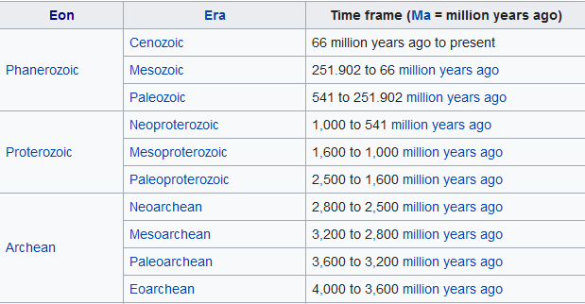
EPOCH
Geological time is divided in to sub divisions known as Eons.
Eons are sub divided in to Eras.

Slide 17
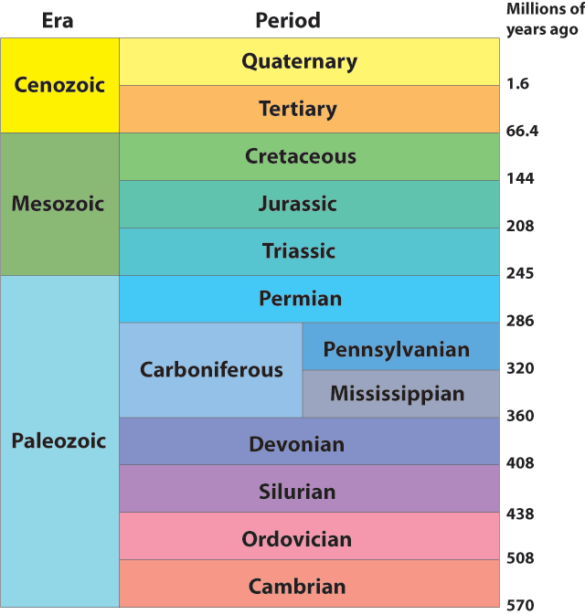
Eras are divided in to periods
Periods in to Epochs
Epochs into ages

Slide 18
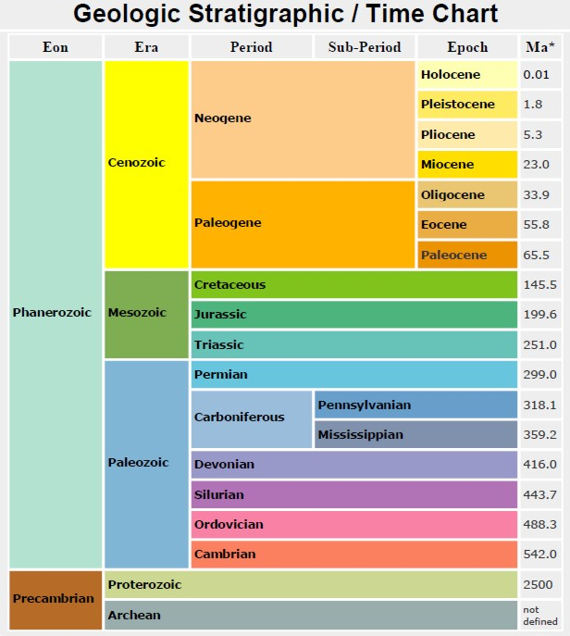
Formation of present day land mass 65mya

Slide 19
Most of the Paleolithic Age coincided with the Pleistocene Epoch
Cenozoic Era is divided into two periods Tertiary and Quaternary
Tertiary period is divided into 5 epochs
Paleocene (65 mya to 56.5 mya)
Eocene (56.5 mya to 35.4 may)
Oligocene (35.4 mya to 23.3 mya)
Miocene (23.3 mya to 5.2 mya)
Pliocene (5.2 mya to 1.64 mya)
Evolution of Primates – 70 mya

Slide 20
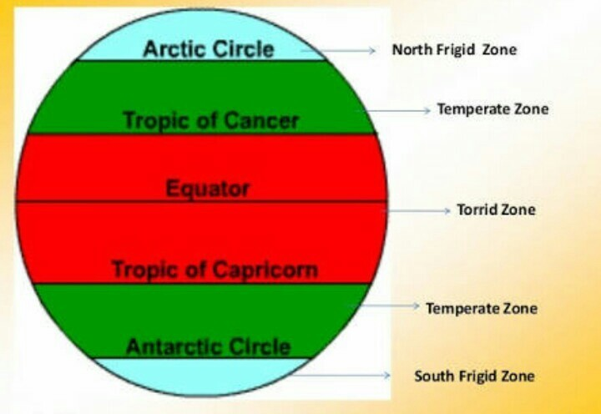
Major advanced tool making began in the Quaternary period.
Quaternary period is subdivided into two epochs –Pleistocene (1.64 mya to 12,000 years ago) and Holocene (12,000 years ago to present)
During Pleistocene there was a significant lowering of temperature. This resulted in ICE AGES.
A large portion of Northern Hemisphere was covered with ice for a long time.
Regions with temperate climate were covered with Ice and glaciers

Slide 21
Beginning with 2.36 mya each glaciation took place at an interval of 1,00,000 years.
In between these glaciations there were warmer intervals known as Interglacials.
The last ice age also known as Würm glaciation began 1,18,000 years ago.
The ice age was preceded by an interglacial between 1,28,000 to 1,18,000 yrs ago.
It was during this period that homo sapiens came into existence
The last ice age began to end 12,000 years ago which marked the beginning of Holocene epoch.

Slide 22
The Mousterian Culture was an attempt to adapt to the warmer climate which preceded the last ice age.
The period also saw the beginning of cultural adaptation.
Neanderthals lived in an environment where large animals was available in plenty.
They hunted bison, horse, reindeer and red deer
The streams and rivers were also exploited
Many of the tools were specialised tools.
Mousterian cultures developed independently in West Asia and Africa also.
The tools of the lower and middle paleolithic cultures are not very much fundamentally different.

Slide 23
Techniques that evolved were further refined by about 35,000 years ago which marked the beginning of Upper Paleolithic and the appearance of Homo Sapiens Sapiens.
Large number of Upper Paleolithic sites are seen in France and Spain.
Aurignacian, Solutrean and Magdalenian cultures belong to upper paleolithic.

Slide 24
Aurignacian culture, toolmaking industry and artistic tradition of Upper Paleolithic Europe that followed the Mousterian industry and was succeeded by the Solutrean
The Aurignacian culture was marked by a great diversification and specialization of tools, including the invention of the burin, or engraving tool, that made much of the art possible.
The art of the Aurignacian culture represents the first complete tradition in the history of art, moving from awkward attempts to a well-developed, mature style.
The earliest examples of the small, portable art objects produced during this period are from western Europe and consist of pebbles with very simple engravings of animal forms. Later, animal figures were carved in pieces of bone.

Slide 25
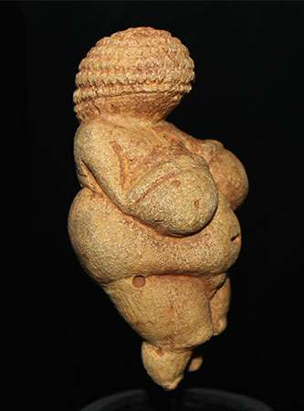
A tradition of true sculpture in the round grew up in eastern Europe, with vividly realistic, though simple, clay figurines of animals and highly stylized statuettes of pregnant women, the so-called Venus figures, presumably fertility figures

Slide 26
The Solutrean industry is a relatively advanced flint tool-making style of the Upper Palaeolithic, from around 22,000 to 17,000 years ago. Solutrean sites have been found in modern-day France, Spain and Portugal.

Slide 27
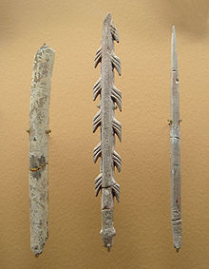
The Magdalenian cultures are later cultures of the Upper Paleolithic in western Europe, dating from around 17,000 to 12,000 years ago. It is named after La Madeleine, a rock shelter. Painting of hunting scenes in DARK CAVES.
By the end of the Magdalenian, the lithic technology shows a pronounced trend toward increased microlithisation

Slide 28
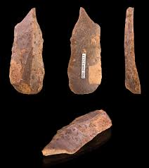
Upper Paleolithic tools were increasingly specialised.
Refinement in tools used for making tools.
Example: Burin, a chisel for making other tools
Aurignacians made small blades with parallel edges.
Solutreans made tools with sharp leaf point
Magdalenians made excellent harpoons
Upper Paleolithic saw the use of materials other than stone such as wood, bone, ivory, deer hones as weapons
Composite tools- Arrows with poison. Crude clothing.

Slide 29
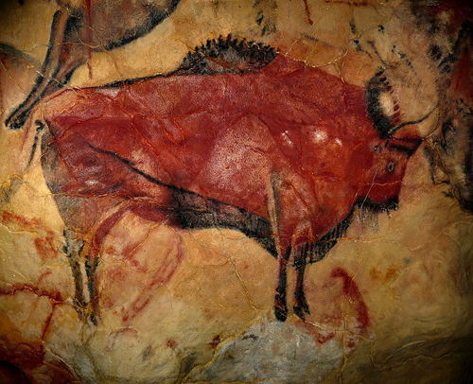
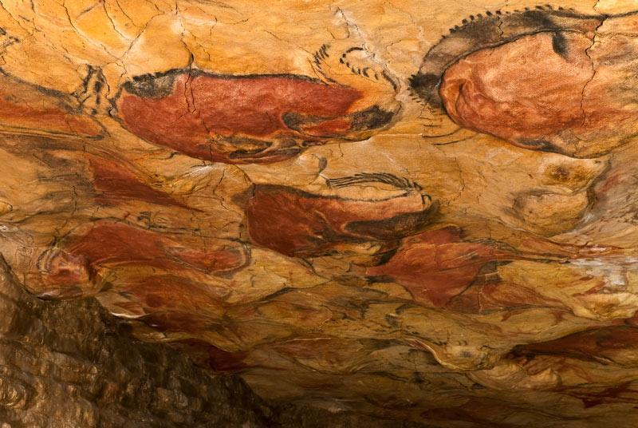
Upper paleolithic provides the earliest evidence of art
Upper Paleolithic art began in Eastern Europe and South West Asia.
Altamira Cave roof paintings (Northern Spain)

Slide 30
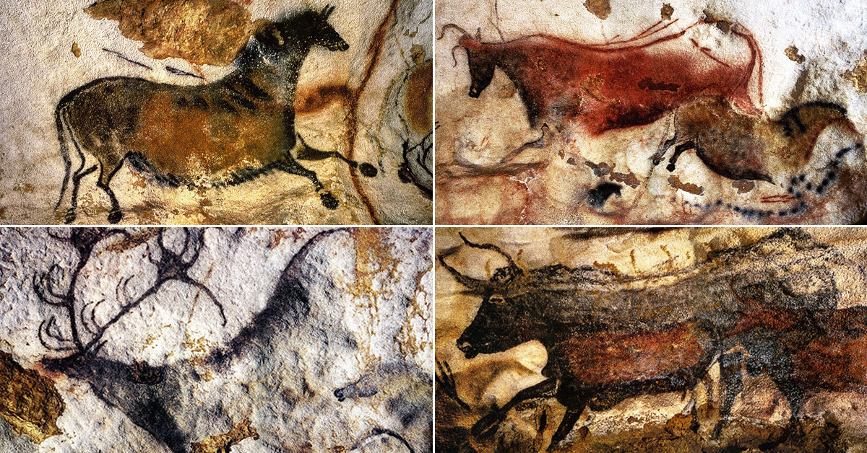
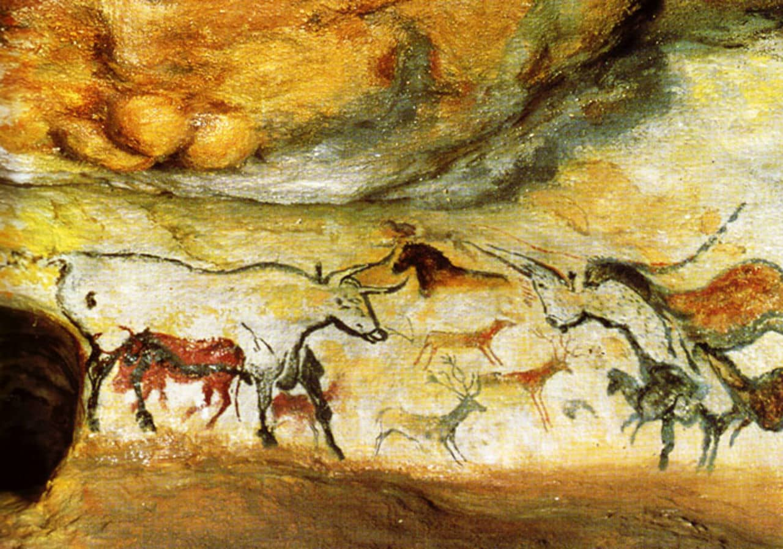
Lascauz Cave painting, France.

Slide 31
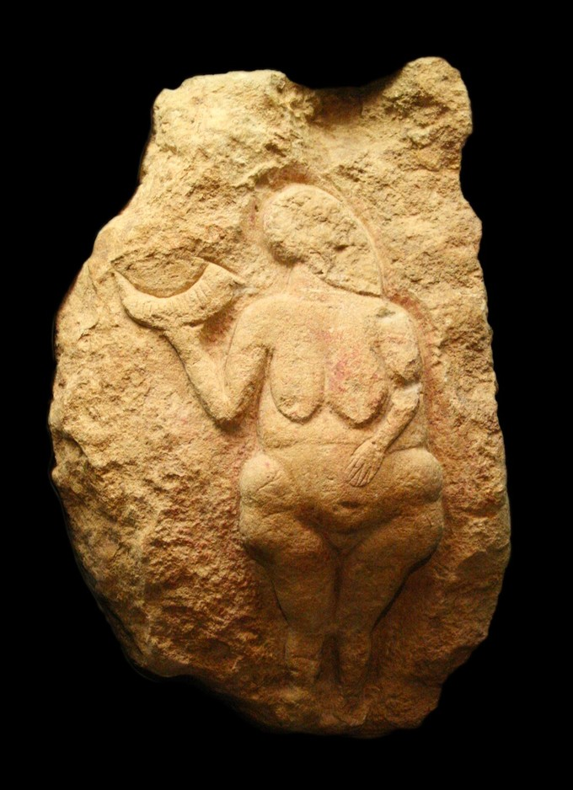
They also made handles, statues and clay figures
They depict animals or geometric shapes
Number of clay figurines portray human female body

Slide 32
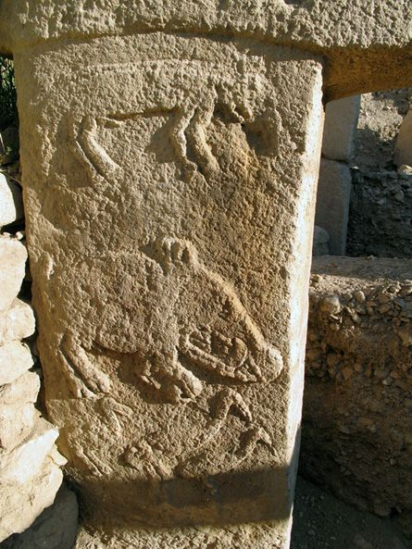
The Solutreans were experts in carving figures on walls of caves. This technique is called Bas-relief

Slide 33
Purpose of Upper Paleolithic painting
Art for art sake
Planning
Magic/ religion. For control over animals.
Linking of natural forces with animals. Gain control over nature.

