Slide 1
FUNCTIONS OF MANAGEMENT
Prof. Aby Thomas
HOD
Dept of Economics
MarThoma College, Tiruvalla

Slide 2
What we have studied so far……
Planning
Organising
Staffing
Functions of Management

Slide 3
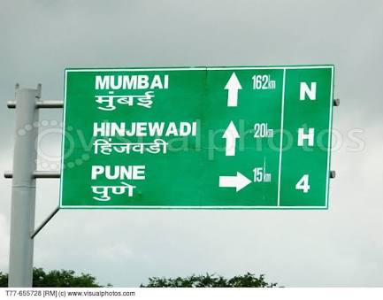
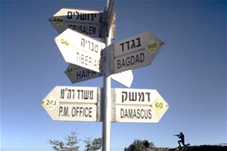
Don’t you noticed these boards????
What's the relevance of these boards….
Yes, these boards gives directions to our travel…isn’t it????

Slide 4
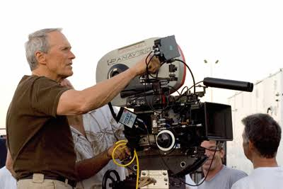
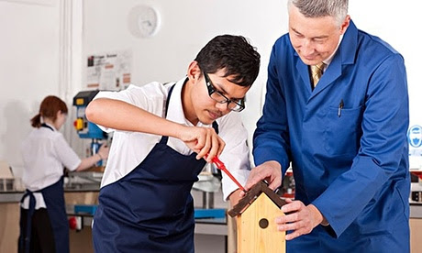
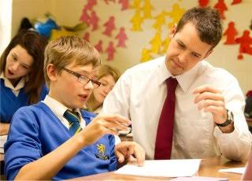
Examples of Directing in our daily life
Teacher directing the students
Film director directs the movies
Restaurant manager directing employees.

Slide 5
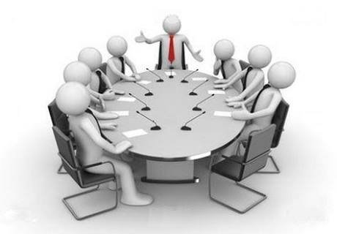
Directing in management

Slide 6
Simple sentence….
Directing means giving instructions and guiding people in doing work.

Slide 7
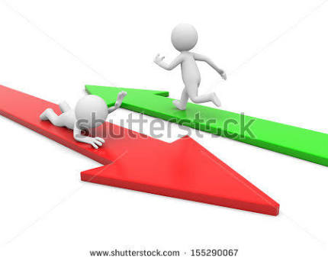
Directing
Directing is a managerial function of Instructing, Guiding, Counselling, Motivating and Leading people in organisation to achieve its objectives.

Slide 8
Definition
According to koontz and O’ Donnell,
“Direction is a complex function that includes all those activities which are designed to encourage subordinates to work effectively and efficiently in both short and long run”

Slide 9
Characteristics of Directing
Directing initiates actions – Management in Action
Directing is pervasive
Continuous process
Flows from Top to Bottom
Performance Oriented
Human Element

Slide 10
Importance of Directing
Initiates Action
Creates team works
Helps in motivation
Facilitates changes
Harmony and cooperation in organisation
Notes:
Mutual understanding and team work

Slide 11
Elements of Directing
S
L
M
C
S – Supervision
M – Motivation
L – Leadership
C – Communication

Slide 12
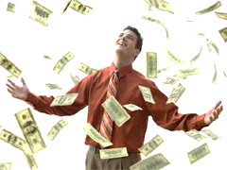
Motivation

Slide 13
Motivation
MOTIVATION
Motive
(Expression of needs & Wants)
Motives are expressions of a person’s needs and wants.

Slide 14
Motivation - meaning
Motivation is the process of stimulating people to action to accomplish desired goals and actions.

Slide 15
Characteristics of Motivation
Motivation is an internal feeling.
Motivation produce goal oriented behaviour.
Motivation can be either + or –
Motivation is a complex process
Motivation is a continuous process.

Slide 16
Motivation Process
Unsatisfied Needs
Tension
Drives
Search Behaviour
Satisfied Need
Reduction of tension

Slide 17
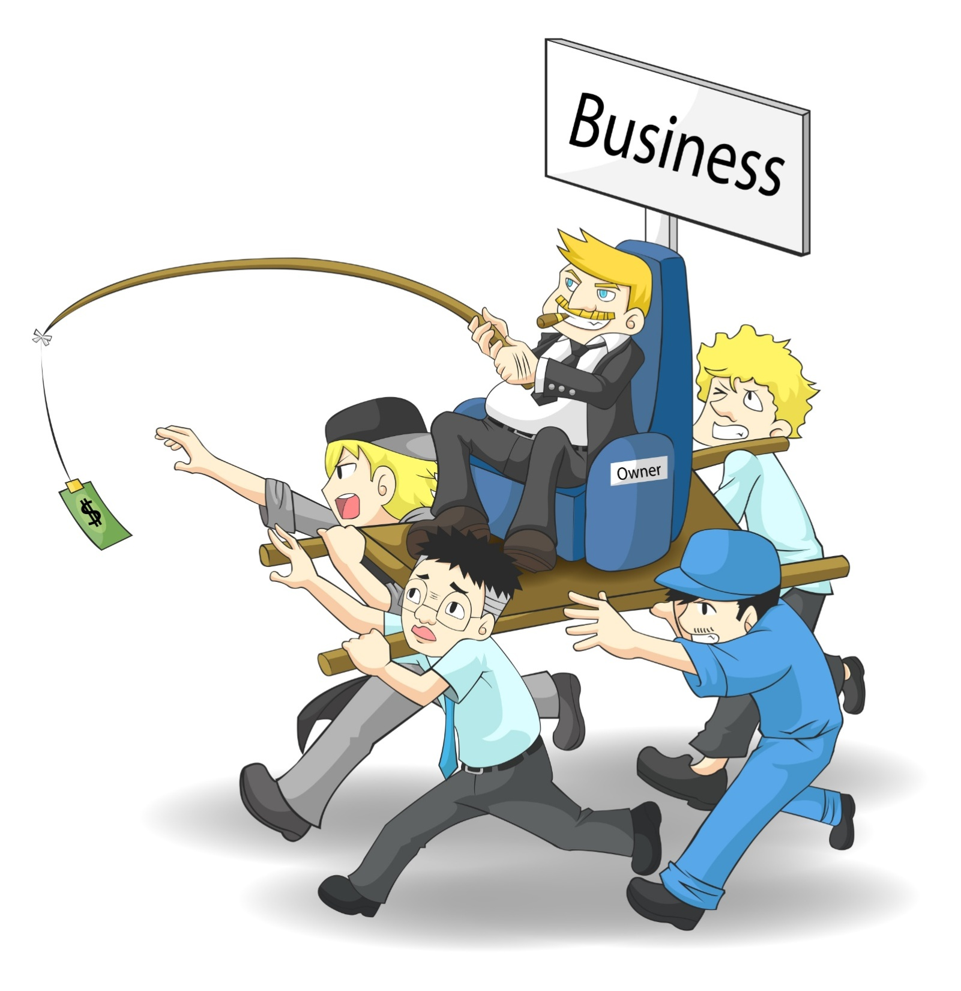
Benefits of motivation
Motivation improves work performance
Creates positive attitude
Reduces employee turnover
Reduces employees absenteeism
Reduces resistance
Supportive work environment
Notes:
Absenteeism - The fact of being away from work

Slide 18
Maslow’s Need hierarchy Theory of Motivation

Slide 19
Self Actualisation Needs
To become what one is capable of becoming
Esteem Needs
Self respect , recognition of good work
Social Needs
Affection,sense of belongingness,acceptance and friendship
Safety and security needs
Job security , stability of income
Basic Psychological needs
Food, shelter , clothing
Notes:
1- basic salary 2- pension plans 3- relationship with colleagues 4- promotion 5-challenging goals

Slide 20
Assumptions
Behaviour
Hierarchical order
Satisfied Order
Lower Need

Slide 21
Incentives All measures which are used to motivate people to improve performance.
Financial
Non-Financial
Financial Incentives :
Incentives or rewards which can be measured in terms of money.
Non Financial Incentives :
Incentives which are not measurable in terms of money.
Psychological and emotional satisfaction

Slide 22
Financial Incentives
Pay And Allowance : Salary + other allowances
Productivity linked incentives : Amount of incentives connected with productivity
Bonus : Reward offered on a one time basis for high performance or festivals.
Profit Sharing : Share of profit is offered to employees
Co-partnership : Usual wages + share in profit +share in the management of a company
Retirement Benefits : Benefits after retirement.
Perquisites : Benefits in kind. Or compensation in addition to normal wages or salaries

Slide 23
Non Financial Incentives
Status :
Status refers to the ranking of positions in the organisation.
Organisational Climate:
Characteristics which describe an organisation and distinguish one organisation from the other.
Employee recognition Programmes:
Recognition means acknowledging with a show of recognition.
Employee Participation:
Involving employees in decision making in any issues related to the company
Employee Empowerment:
Empowerment means giving more autonomy and power to subordinates

Slide 24
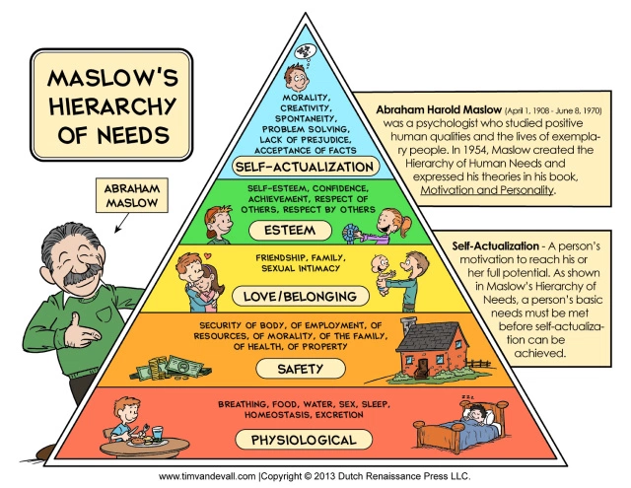
Advantages of Maslow’s Theory
Motivating employees
Interpersonal variations in human behaviour
Constantly changing force
Understanding different needs rather than food
Simple to understand
Notes:
1.Needs-difference in needs- satisfaction
2.desired behaviour can be made by understanding and satisfying the need
3.Needs never end

Slide 25
Criticisms of Maslow’s Theory
Hierarchy of needs is not always present
Behaviour of man is not a result of desires and needs only
Not universal
He is not motivated by a one need.
Satisfaction of one need may not arise another high need always
Notes:
Expectations,percerption,experience

Slide 26
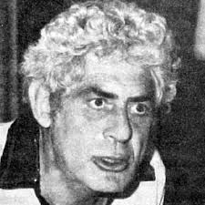
Herzberg’s Two Factor Theory
Federick Herzberg
Concentrated more on self-esteem and self actualisation needs
Two factor or Dual Factor Theory
Interviewed 200 engineers and accountants in 11 industries in Pittsburgh
He asked two questions
When did you feel good for the job?
When did you feel exceptionally bad about your job?
Factors responsible for job satisfaction are different from factors led to dissatisfaction

Slide 27
Two sets of factors which determine human behaviour at work .
Satisfaction is affected by Motivational Factors and Dissatisfaction is affected by Hygiene factors

Slide 28
Hygiene factors
Presence of this factors did not significantly motivate them.
But the absence of this factors cause serious dissatisfaction.
Also called as maintenance factors or dissatisfiers or extrinsic factors
maintenance factors – helps in maintaining the existence level of performance of job
Dissatisfiers - the absence of this factors cause serious dissatisfaction.
extrinsic factors – they are related to job environment and not to job content
KICK IN THE ABDOMEN FACTORS(KITA)

Slide 29
Motivators
Related to job directly
Presence creates highly motivating
Absence does create dissatisfaction
Satisfiers : real cause of job satisfaction
Intrinsic factors : related to job itself

Slide 30
Conclusion
Todays motivators are tomorrows hygiene factors.
Because todays motivating factors stop influencing the behaviour of person when they get them.
One hygiene may be the motivator of another.
Hygiene factors must be present to prevent employees dissatisfaction and motivation factors to increase level of satisfaction.
Notes:
Promotion is a motivating factor. After getting them it may be hygiene.bcoz when they get, its presence did not motivate workers

Slide 31
Process of Motivation
First Stage
Second Stage

Slide 32
First Stage
Managers must ensure that there are hygiene factors.
Then only workers would not be dissatisfied.
A further increase in these factors will not motivate the workers to improve the performance.
Managers provide motivators
Provide high level of satisfaction
Second Stage

Slide 33
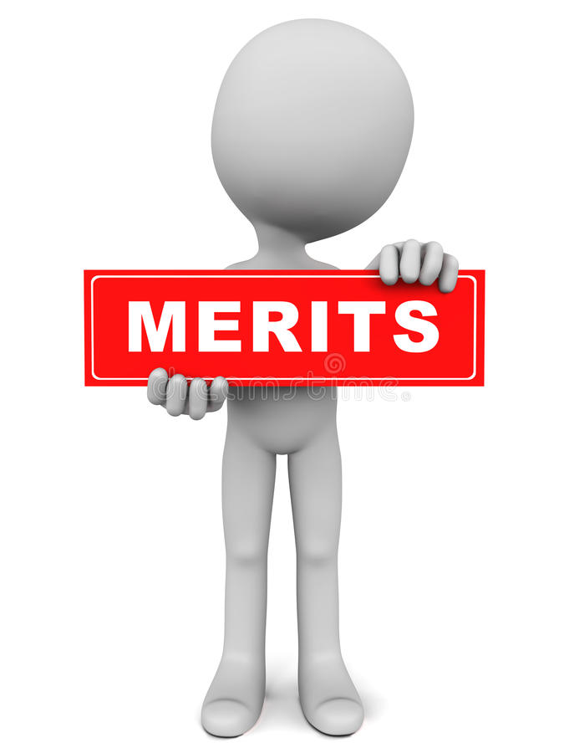
Merits
Eye opener to managers
Basic understanding of human behaviour
Simple
Specific actions for managers to improve motivation
Notes:
One cannot achieve higher performance by simply improving wages and working condition

Slide 34
Criticisms
Small sample
No universal application
Two factors are not distinct.
Mainly applicable to people working at high managerial levels.
People are heterogeneous in needs and expectations.
Too much attention on satisfaction rather than on performance level.
Notes:
Both factors contribute to satisfaction and dissatisfaction

Slide 35
Comparison of Herzberg and Maslow Theory

Slide 36
Similarities
Both theories emphasise on different needs of individuals
Oversimplify motivation process
Individual differences
compatible

Slide 37
Differences
Basis | H | M
Based | Two factor | Hierarchy of needs
Formulated | In terms of rewards | Human needs
Hierarchy | No | yes
Studies | Observation | Empirical
Low level needs | Hygiene factors | Motivational factors
Identified | Factors that help in job satisfaction | Needs of person that motivate his behaviour
Applicability | Limited | Universal

Slide 38
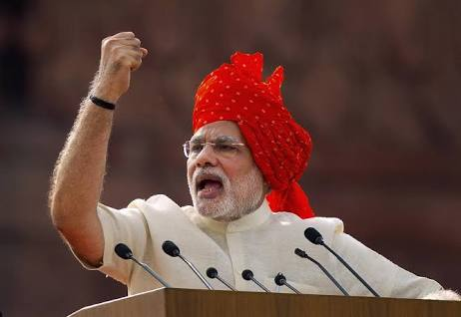
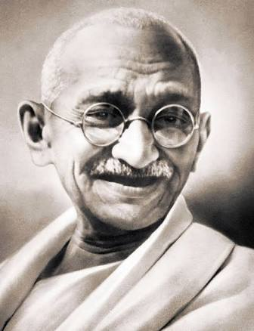
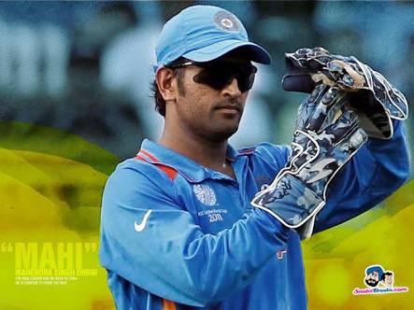
Leadership

Slide 39
Leadership
“People cannot be manged,inventories can be manged,people must be led” Ross Periot
Leden - to travel or show the way.
According to Peter F Drucker
Leadership is the lifting of people vision to a higher sight, the raising of performance to higher standard, the building of their personality beyond its normal limitations.

Slide 40
Leadership in management
Leadership is defined as process of influencing the behaviour of employees at work towards the accomplishment of organisational objectives.
Leader
Individual having the attributes of leadership is termed as Leader.

Slide 41
Features of Leadership
Interaction
Common Goals
Influence
Co-operation
Process of influencing
Process of interaction
Accomplishment of individual as well as group interest.
Process of obtaining co-operation

Slide 42
Qualities of a good leader
Intelligence & Scholarship
Ability to inspire and guide followers
Communication Skill
Self Confidence & Sense of responsibility
Listening Skill
Empathy
The ability to look at things from others point of view.

Slide 43
Leadership Styles or Leader’s behaviour
Autocratic
Democratic
Laisses Faire
Paternalistic

Slide 44
Autocratic Leadership

Slide 45
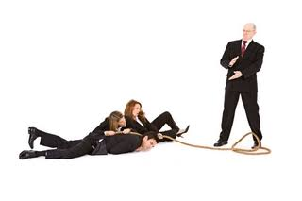
Autocratic or Authoritative Leadership
Autocratic leader is one who makes all policies and takes all decisions without consulting the subordinates.

Slide 46
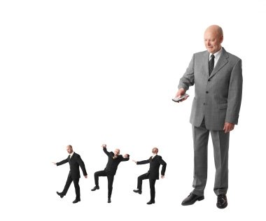
Features
Centralised decision
Orders
Discipline = rewards and punishments
One way communication
Supervises and control behaviour of followers very closely.
Dictatorship style or authoritative style

Slide 47
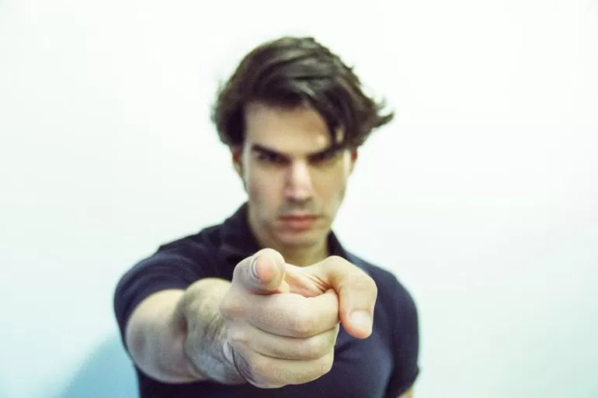
Types
Strict autocrat : - Motivation style
Benevolent autocrat : + Motivation style
Manipulative autocrat : one who makes the subordinate feel that they are participating in decision making

Slide 48
Advantages
Quick decision
Strict discipline
Increases efficiency
Strong motivation and reward to mangers.

Slide 49
Disadvantages
Low motivation among subordinates
No scope for development of subordinates
Misunderstanding due to one way communication
Frustration and conflict
No say in decision making

Slide 50
Suitability
Subordinates are incompetent and inexperienced
Leaders prefers centralised decision making
Leader may have more knowledge
Fear and punishment are used as disciplinary technique.
Uniformity and consistency required.

Slide 51
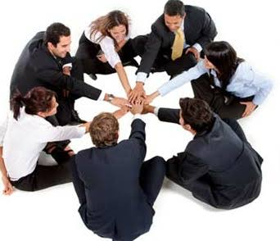
Democratic Leadership
Democratic or consultative leader is one who takes decisions in consultation and ensure the participation of subordinates

Slide 52
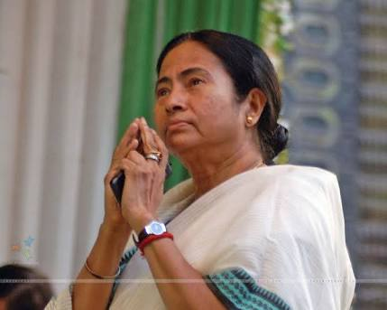
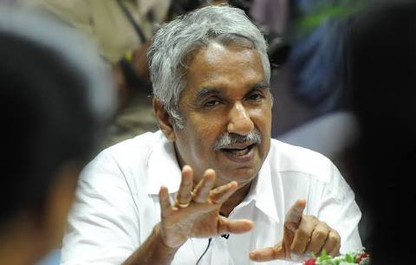
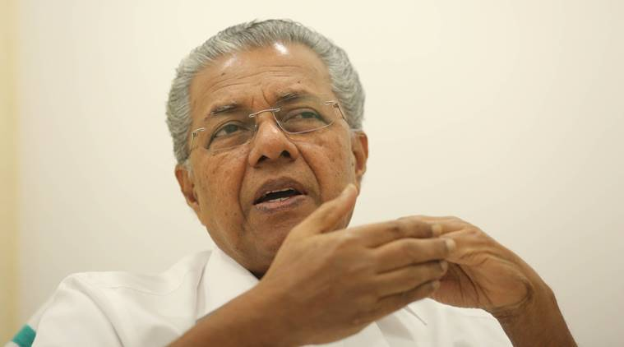

Slide 53
Features
Leader decentralises the power
Delegates authority
Subordinates participates in decision making
Consultation and participation
Participative or Consultative leadership
Freedom to group members
Two way communication
Cooperation and protection of group interests

Slide 54
Advantages
Motivates employees
Encourages cooperative spirit
Increases efficiency of employees
Two way communication
Enhances productivity
Provides opportunity for employees to express their ideas

Slide 55
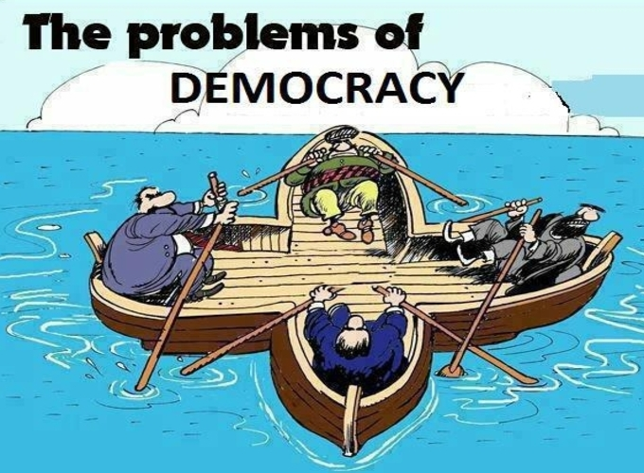
Disadvantages
Slow decision making
Difficult to maintain discipline
Suitable only when employees are more matured
Time consuming
It may not yield expected results when subordinates do not interact with the leader.

Slide 56
Suitability
Subordinates are competent
Leader prefers participative decision making
Rewards and involvements are used as motivation techniques
Leader wishes to develop analytical and self control abilities in his subordinates

Slide 57
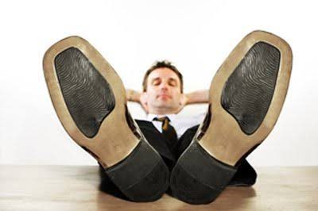
Laissez Faire
Laissez Faire means “No interference in the affairs of others”
Laisses faire leadership involves giving complete freedom to subordinates for making decision and implementing those decisions

Slide 58
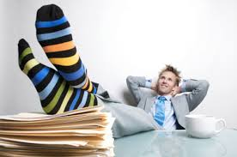
Features
Manager gives complete freedom to subordinates
Leader allows subordinates to set goals, to take decision, implement decisions
He does not uses power.
Passive
Role of leader to give advice when it is sought
Leader do not exercise any control over his subordinates
Subordinates performs everything

Slide 59
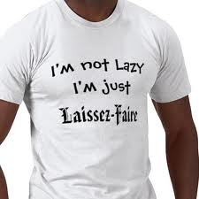
Advantages
Improves motivation of subordinates
Develop managerial skills
Free flow of communication
Highly flexible

Slide 60
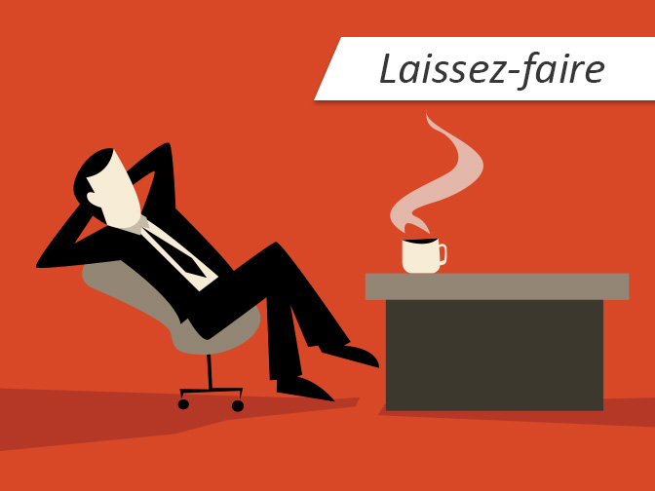
Disadvantages
Confusion and chaos
Control is likely to lost
Ignores managers contribution
Move in different directions

Slide 61
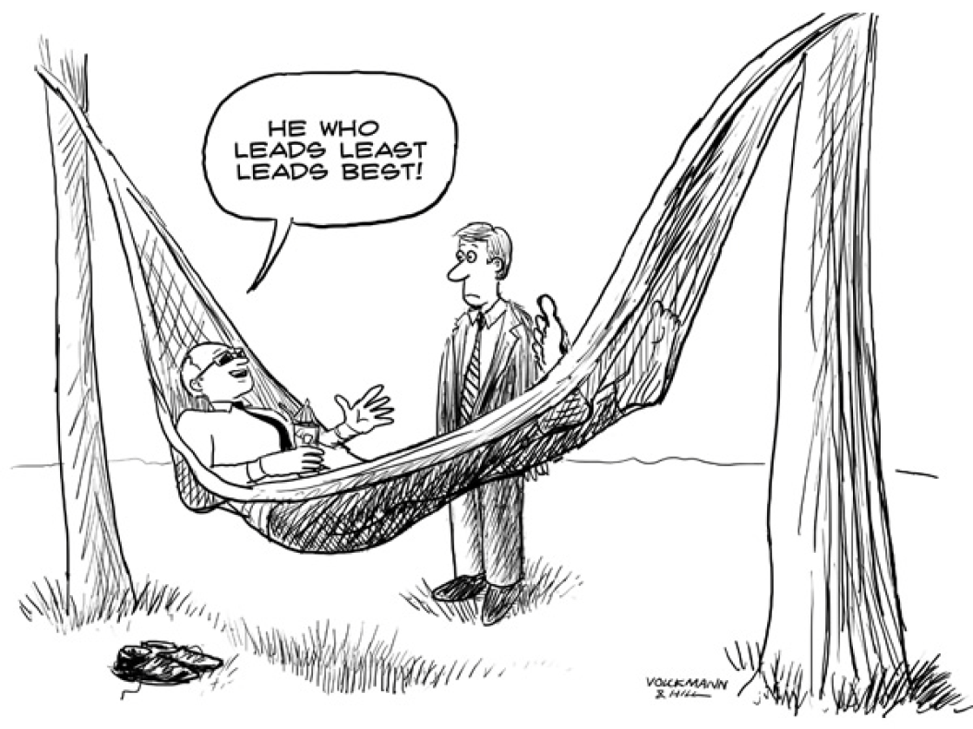
Suitability
Subordinates are competent
Leader prefers full delegation
When org. goals have been communicated well to the group members
When group have understood the organisational goals to be achieved

Slide 62
Paternalistic Leadership

Slide 63
Features
Leader serves as the head of organisation
Treats his followers like his family members.
Paternal or fatherly role
Provides good working condition,benefits,and services
Japan,Chinese,turkey.

Slide 64
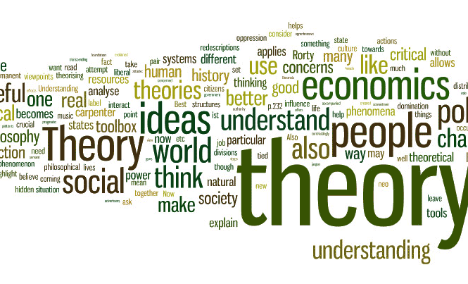
Theories of Leadership
TT
Trait Theory
BT
Behavioural Theory
ST
Situational Theory

Slide 65
Trait Theory
Trait theory of leadership is one of the first academic theories of leadership
Attempts to answer why some people are good leaders and others are not.
The trait theory of leadership is an early assumption that leaders are born
Those that possess the correct qualities and traits are better suited to leadership.
This theory often identifies behavioural characteristics that are common in leaders.

Slide 66
Qualities
Physical and nervous energy
Direction
Enthusiasm
Friendliness
Integrity
Technical mastery
Decisiveness
Intelligence
Teaching skill
Faith
Notes:
having or showing intense and eager enjoyment, interest, or approval.

Slide 67
Innate
Acquirable

Slide 68
Innate Qualities
Qualities possessed by various individuals since their birth.
Natural or God gifting qualities
Cannot acquired by individuals
Physical Features
Intelligence
Notes:
Height weight physique health appearance
Mental ability

Slide 69
Acquirable Qualities
Qualities which can be acquired and increased through various process.
A child learns many of the behavioural pattern through socialisation.
Behavioural patterns are developed among the child as various traits over the period.
These traits can be increased through training programme.
Notes:
a distinguishing quality or characteristic, typically one belonging to a person

Slide 70
Emotional stability | Free from bias, consistent in action, self confident
Human relationship | How to behave and how to react
Empathy
Objectivity | assess anything based on relevant facts and information
Motivating skills
Technical skills | Ability to plan, organise,delegate,analyse,seek advise, make decision
Communication skills
Social skills | Ability to work with people by understanding their strength and weakness

Slide 71
Situational Theory
No single leadership style is the best for all times and all situations
Leader effectiveness is the result of the situation in which leader operates
Situational variables should be analysed before an optimum style is selected
Leadership process is a function of
Leader
Followers
Situation

Slide 72
Managerial Grid by Blake and Mouton
Models of situational leadership theory
Robert blake and Jane mouton
Two basic dimensions of Production
Concern for Production
Concern for people
9 by 9 Grid or Matrix
Based on 81 combinations identified 05 leadership styles

Slide 73
9
Notes:
1-1 leader is lazy- no interest in staff or work
1-9 leader developing satisfying relationship with staff.cocern,love affection and friendship- employee oriented…expects higher performance. No result
9-1 authority obedience style. Minimum attention paid to human beings. People are treated like machines
5-5 middle road management – live and let live..sat both org and human needs
9-9 democratic imp perf,turnover,high emp sat

Slide 74
Likert’s Four Level Model
Rensis Likert of University of Michigan (USA)
Study on leadership styles and patterns
Four models of Management.
Systems of management.

Slide 75
Exploitative Autocratic :
Highly autocratic
Managers set the goals
Benevolent Autocratic
Consultative :
Mangers set goals after consultation
Managers srt major decisions and routine decisions by subordinates
Subordinates are free to to discuss work related problems with management.
Democratic :
Subordinates take active participation in goal setting and decision making
Subordinates are motivated to take greater responsibility.

