Slide 1
DEPARTMENTOF MALAYALAM MAR THOMA COLLEGE TIRUVALLA
DRISHYAKALA SAHITHYAM
BA/B.SC (MODEL-1)
COMMON COURSE MALAYALAM
SEMESTER - 3
PRESENTED BY
DR. SHINY THOMAS

Slide 2
KATHAKALI
Kathakali is a major form of classical Indian dance
The traditional themes of the Kathakali are folk mythologies, religious legends and spritual ideas from the Hindu epics and the Puranas

Slide 3
Attakatha
Attakatha is a literary genre in Malayalam language
Nalacharitham Attakatha is one of the most famous work in this genre & written by Unnayi Warrier
The play consists of four parts – called First , second, Third and Fourth day –each part being long enough to be performed over a full night

Slide 4
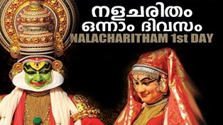
Based on the Mahabharatha , it tells the story of King Nalan and his consort Damayanthi.

Slide 5
Thank You

